Slide 1
SEND at Holly Park
25.02.26

Slide 2

SEND at Holly Park
Adapting the curriculum to meet children’s needs.
What happens if your child is not making progress or you have concerns.
SEND Support plans
Education, Health and Care Plans.
The Treehouse.

Slide 3

Ordinarily Available.
Ordinarily Available Provision (OAP) refers to the support and resources that mainstream schools and other educational settings are expected to provide for all children, including those with special educational needs and disabilities (SEND) using their own internal funding and resources.
The aim is to ensure consistency, promote inclusive practice, and meet diverse needs through quality first teaching and adaptations

Slide 4


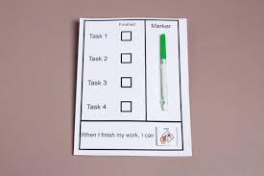
Different classroom adaptations
Ear defenders
Writing slopes
Pencil grips
Wobble cushions
Fidget toys
Sensory toys
Task checklists
Different size/colour fonts
Now and next board/visual timetables
Position of children in the class.

Slide 5
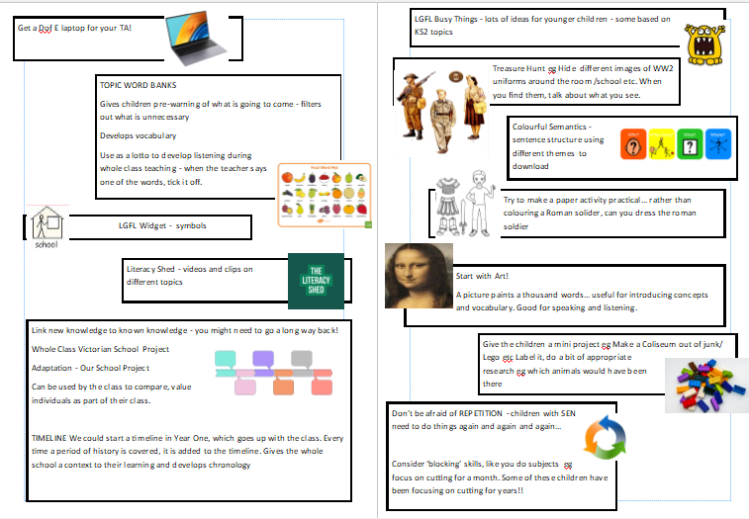
Layer 2 - planning and delivery adapted.
Lessons are planned and delivered in an adapted way so that the lesson has meaning and is accessible to children with SEND.

Slide 6
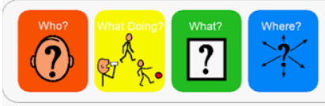

Adaptations
Zones of regulations
Colourful semantics
Restorative approach
Use of word banks
Group interventions - reading, writing, maths
Time with learning mentor

Slide 7

What happens if my child is not making progress.
If your child isn’t making the expected progress then teachers/parents come and speak to me and discuss concerns and next steps.
This involves -
Referral to outside agencies e.g. speech and language, paediatricians, inclusion advisory team.
Come in and observe the child, meet with the family and teacher and provide different strategies to support the teacher and child.

Slide 8
What happens if my child is not making progress
Tailored interventions - 121 activities, small group work.
Progress is tracked for these provisions for the child and more regular updates for the parents.
At this stage your child will be added to the SEND profile so we can track their progress and all staff are aware of their needs. This is the first stage of the Assess, plan, do, review plan.

Slide 9
Diagnosis
At this stage we sometimes make referrals to paediatricians or CAMHS and parents are seeking a diagnosis for the child.
The support your child is given is not based on their diagnosis but is based on the child’s needs.
With or without a diagnosis we will support your child’s needs.
Can sometimes help access different support from outside of school.
Some parents feel it can help give a better understanding of their child for the future and that their child may understand themselves better as they get older.

Slide 10
SEND support plans
If after the additional support that has been put in place the child is not making progress then we will set them a SEND support plan.
This is a document that holds three targets that are thought of between parents/teachers/TAs/SENDCO.
We include the provision that is needed to help meet these targets. At this stage your child will be receiving some tailored support to help them meet these targets and may be receiving additional support from the SEND TAs and learning mentor where needed.

Slide 11
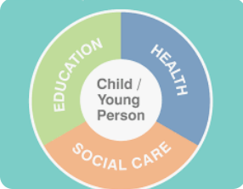
Education, Health and Care plan
For children with complex needs and their needs cannot be met by what is ordinarily available.
They are not making progress with all the additional support that has been put in place.

Slide 12
What is an Education, Health and Care Plan
An Education, Health, and Care Plan (EHCP) is a legally binding document in England for children and young people aged 0 to 25 who have complex needs. It details their educational, health, and social care requirements and outlines the support they need to achieve their personal goals. An EHCP is issued after a formal needs assessment, identifies needs and strengths, and specifies outcomes and the support required to meet them.

Slide 13
To apply for an EHCP
School have to prove they are providing above what is ordinarily available.
Show evidence of at least 3 Assess, plan, do, review cycles.
Have sought advice from different professionals and tried to input their strategies and advice and still no progress has been made.
This process can take up to a year to collect all the evidence.

Slide 14
Application process
School makes the application, providing all the additional relevant information.
From the day the Borough receives it they have 20 weeks for the process to be complete - if it is successful.
First stage - the application goes to a panel where they decide if the child has SEND and if they need support above what is ordinarily available.
If this successful then it is “agree to be assess” and assessments from different professionals will take place.
Then it goes back to a panel and they decide whether to issue the EHCP.

Slide 15
EHCP
If your child receives an EHCP they will be given a level of funding that provides the school with additional funding to support your child.
This can be used in different ways -
TA support for parts of the day when needed to run interventions
Additional resources to support your child
In the past EHCPs came with hours of TA support, this is not the case anymore, they come with the amount of funding.

Slide 16
TAs working 121 with children.
At Holly Park we do not have 121 TAs working with children.
This is seen as good practice after a lot of research was done by MITA in 2017/2018 around deployment of TAs.
In our classrooms we have SEND TAs who support our children with SEND. They run the interventions, support them with their work in class, help with emotional regulation.
For our children this encourages inclusion, communication skills, group work and independence. It also means they get more teacher time.

Slide 17

The Treehouse
For some children, even with an EHCP their needs cannot be met in the mainstream classroom and they struggle to access the learning.
For these children we have set up “The Treehouse”.
This is a smaller classroom setting where the learning is tailored to the child’s needs and skills for learning are taught explicitly.
There is a morning session which focuses on maths and English and an afternoon which focuses on speech, language and communication skills.

Slide 18
Every child is different and every child has their own needs.
At Holly Park we treat every child as an individual and we try to meet their needs in the best way for them.
The process for each child may vary slightly to what I have said due to a child’s needs.
We discuss with parents at every stage of the process.

Slide 19

Any questions.

