Slide 1
Year 6
National Tests
2025
12th – 15th May

Slide 2
What Are The tests For?
They show a snapshot of where children are – an indicator
They show progress from the end of KS1
They test all work covered in whole of KS2 not just Y6
Information is passed on to secondary schools - used a basis for GCSE predictions.

Slide 3
What Will Be Assessed And How?
Tests English – Reading & SPAG
Maths
No tests BUT Teacher Assessment
Science
Writing

Slide 4
Maths
3 PAPERS
Arithmetic
Reasoning
NO CALCULATORS

Slide 5
3 Papers
Paper 1 – Arithmetic
  40 marks
  36 questions
  30 minutes
Paper 2 and Paper 3 – Reasoning
  35 marks (each)
  20 questions (each)
  40 minutes (each)
  Total 110 marks in 110 minutes

Slide 6
Difficulty and Coverage
THE PAPERS COVER ASPECTS OF THE CURRICULUM FROM YEAR 3 TO YEAR 6
THE TESTS ARE VERY CHALLENGING
THE THREE TESTS AVERAGE OUT AT ONE MARK-A-MINUTE

Slide 7
Difficulty and Coverage
The three tests cover objectives from Y3 – Y6 of the curriculum
Each test contains elements of all four year groups but not necessarily in order

Slide 8
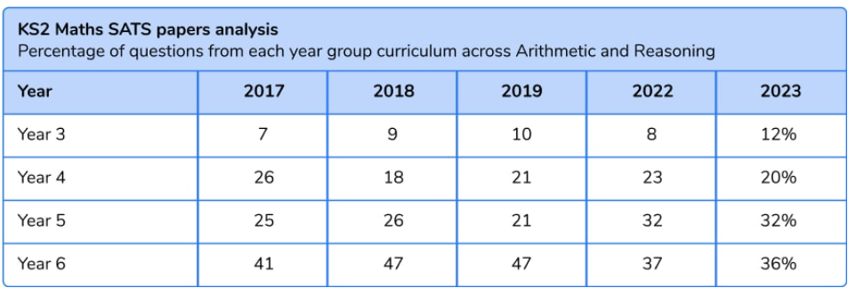
The Percentage of Questions From Each Year Group

Slide 9
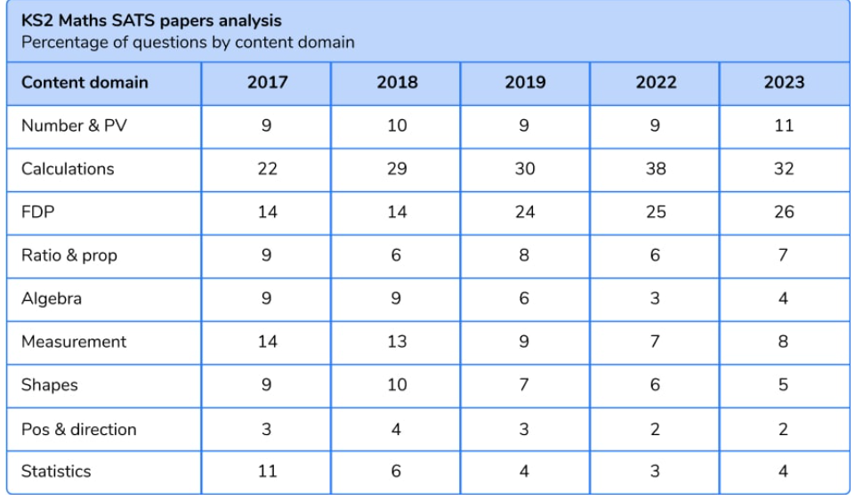
The Percentage of Questions by Topic Area

Slide 10
The Papers
PAPER 1 – ARITHMETIC
PAPER 2 – REASONING
PAPER 3 – REASONING
All papers require a good understanding of number and calculation

Slide 11
Paper 1 – Arithmetic
Focus is on calculating with four operations
Every question has space for working out and an answer box
However, not every question needs written working
More than one mark-a-minute

Slide 12
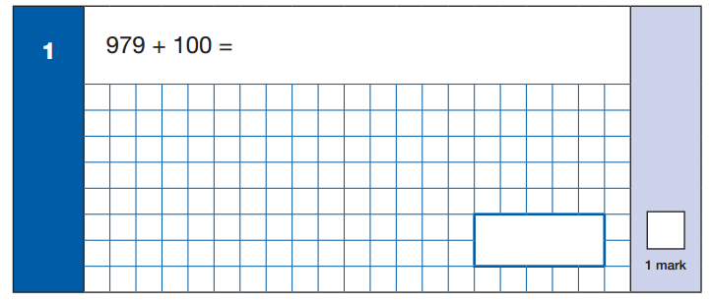
Paper 1 – Arithmetic
Relatively simple question to start with. This is a good demonstration of the type of question that you wouldn’t necessarily need to do written working for.

Slide 13
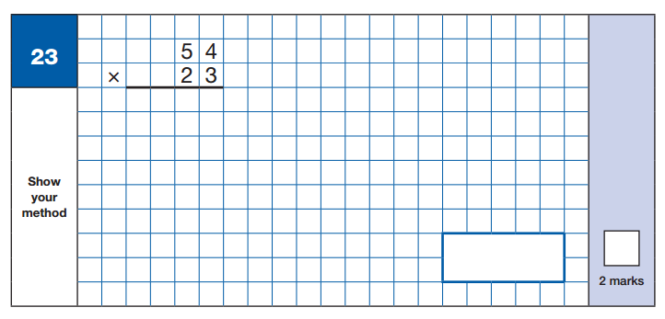
Paper 1 – Arithmetic
All of the two-mark questions are either long multiplication or division.

Slide 14
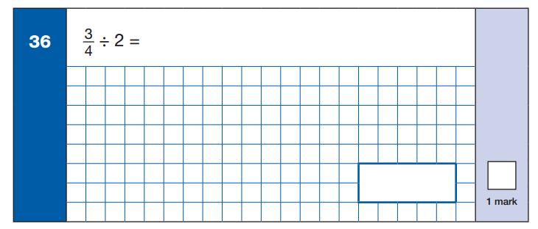
Paper 1 – Arithmetic

Slide 15
Papers 2 and 3 – Reasoning
Focus is on problem-solving, but good understanding of calculating is needed
Multi-stage problems
Some equipment may be used (ruler, protractor and mirror – tracing paper is no longer permitted)
Children must read questions carefully, decide which operation(s) is/are applicable and then carry out their working carefully
Some questions require a written answer to explain if a given person’s thinking is correct and why/why not
There is no difference, that I can see, between the two papers

Slide 16
Paper 2 & 3
Papers 2 and 3 require the ability to read a question carefully and apply logic and reasoning to solve problems

Slide 17
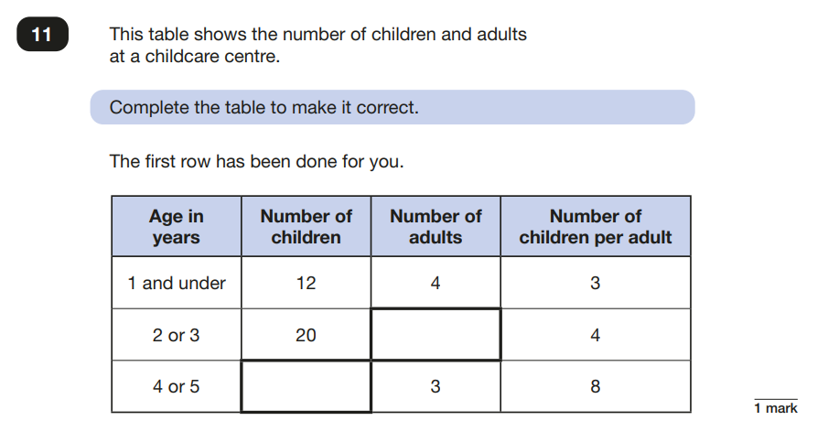
Papers 2 and 3 – Reasoning

Slide 18
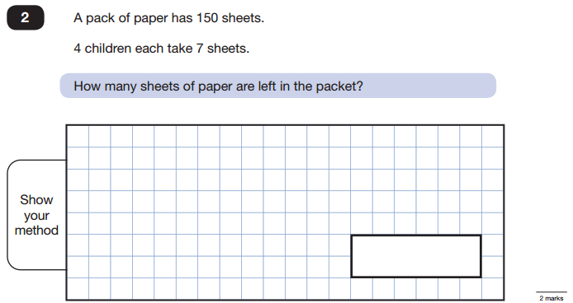
Papers 2 and 3 – Reasoning
Classic two-step problems like this are not new, but again test the ability to read carefully and solve a problem.

Slide 19
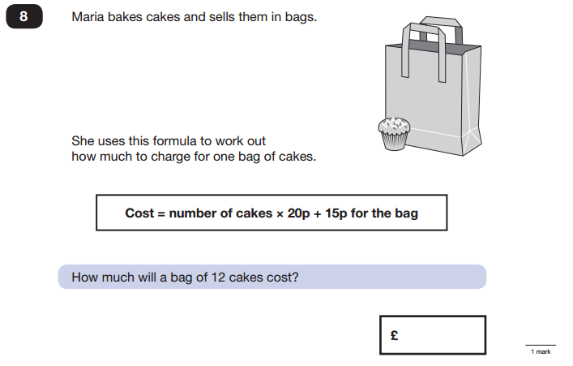
Papers 2 and 3 – Reasoning
This question has two parts (this is part one), and each part requires you to read, understand and manipulate the formula.

Slide 20
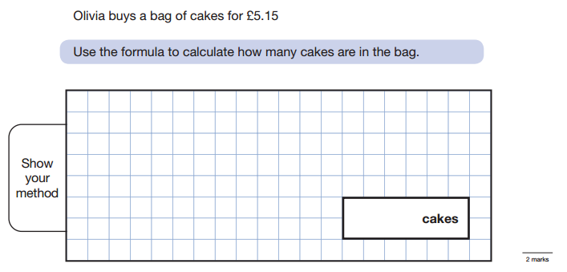
Papers 2 and 3 – Reasoning
This is part two of the question.

Slide 21
Reading
Contains 3 texts of increasing demand (USUALLY!).
Varying text types
e.g: extract from a story, non-fiction account, poem.
Texts are not linked by theme.
1 hour (including reading time)
50 marks available.

Slide 22

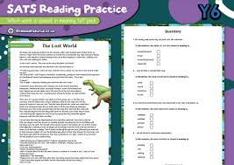
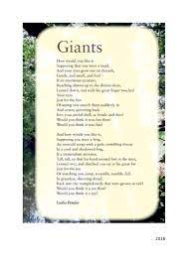
Text Types
Non Fiction Poetry Fiction

Slide 23
Areas Of Assessment:
Retrieval
Summarising
Making inferences
Explaining and justifying views on a text
Predicting
Making comparisons within the text
Explaining meaning of words and how meaning is enhanced through vocabulary choices

Slide 24
Types Of Answers
Selected Answers – you do not write anything – circle an answer, tick boxes, underline answers, rank or order events,
Short Answers – label, find and copy - one word or phrase
Several Line Answers – Short constructed response - a sentence or two
Longer Answers – Open ended response needed - a box to explain or give your opinion

Slide 25
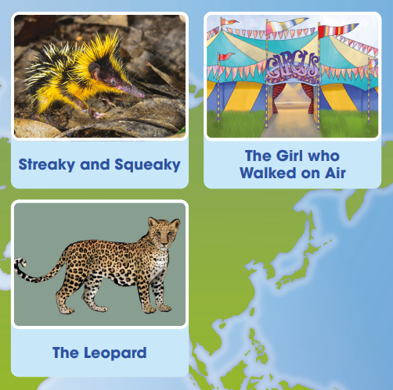
2024:

Slide 26
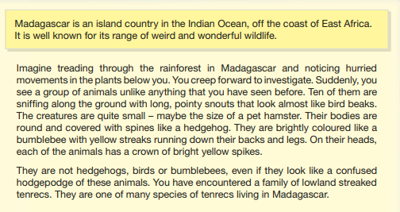

Slide 27
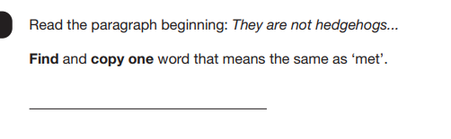
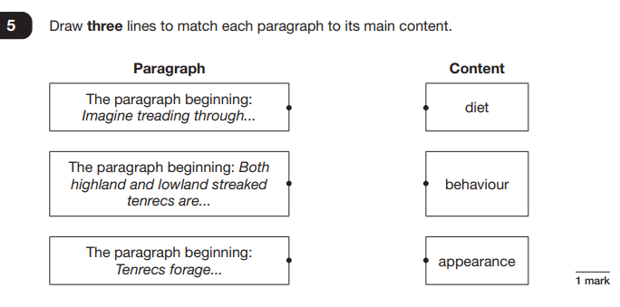

Slide 28
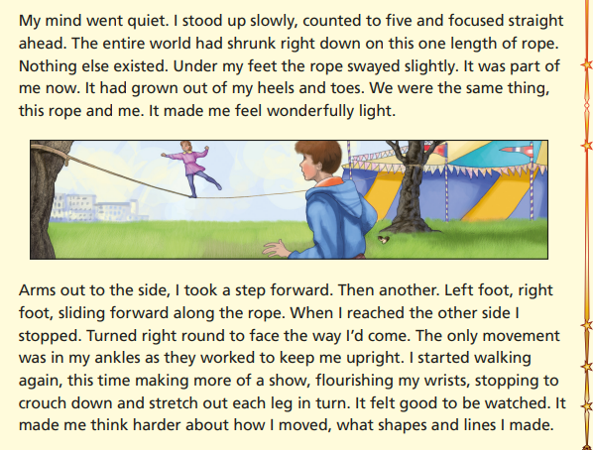

Slide 29
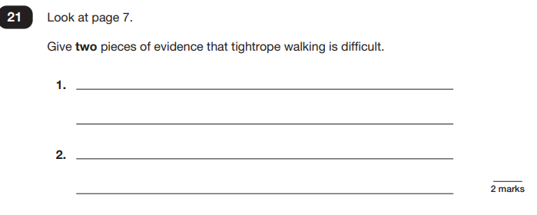

Slide 30
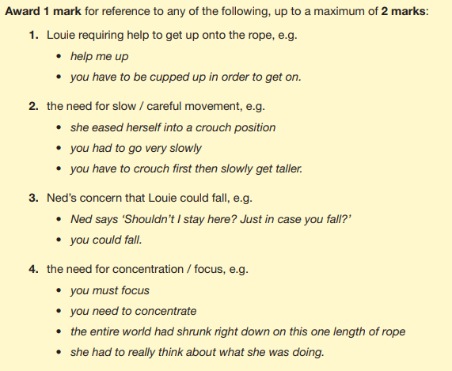

Slide 31
SPAG Paper
SPAG = Spelling Punctuation & Grammar
Two parts
Paper 1: grammar & punctuation (50 marks)
45 minutes for grammar paper
Paper 2: spelling (20 marks)
Approximately 15 minutes for the spelling paper (not strictly timed)

Slide 32
Areas Of Assessment
Grammatical terms/ word classes
Functions of sentences
Combining words, phrases and clauses
Verb forms, tenses and consistency
Punctuation
Vocabulary
Standard English and formality

Slide 33
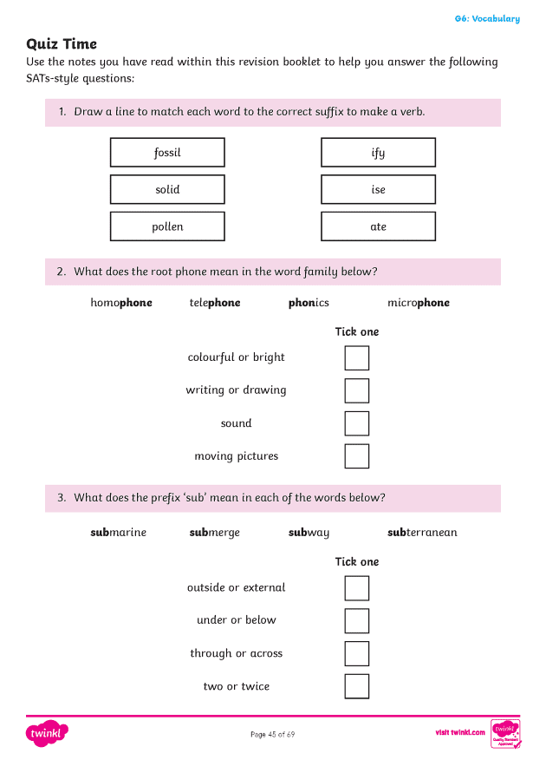
Types Of Question
Multiple choice or Selected response - tick, circle, underline, add in punctuation, draw a line or ‘Identify the adjectives in the sentence below’

Slide 34
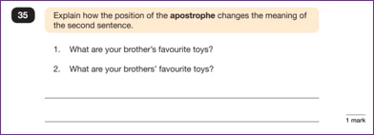
Types Of Question
Short Answers or Constructed response – write a word or phrase. ‘Correct/complete/rewrite the sentence below,’ or, ‘The sentence below has an apostrophe missing. Explain why it needs an apostrophe.’

Slide 35
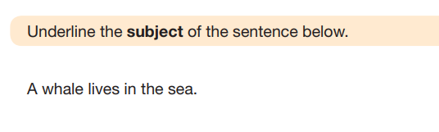
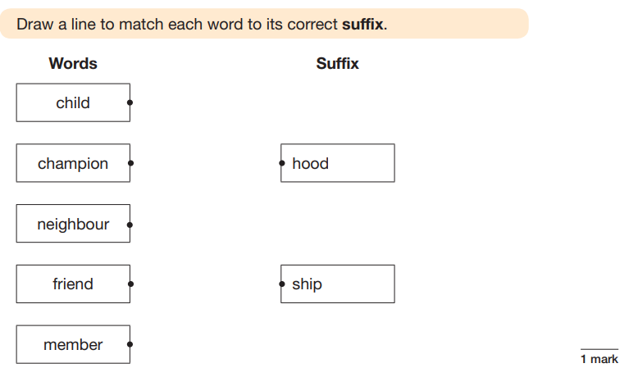

Slide 36
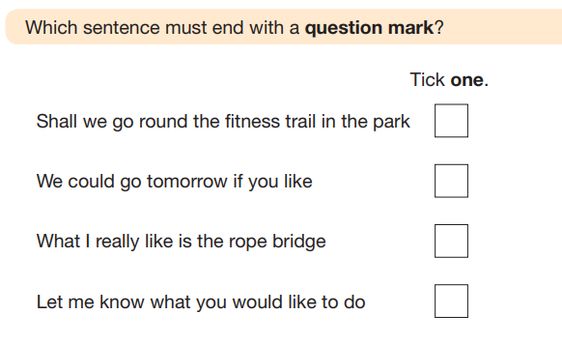

Slide 37
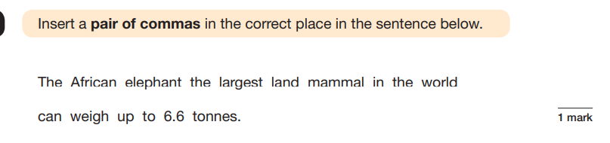
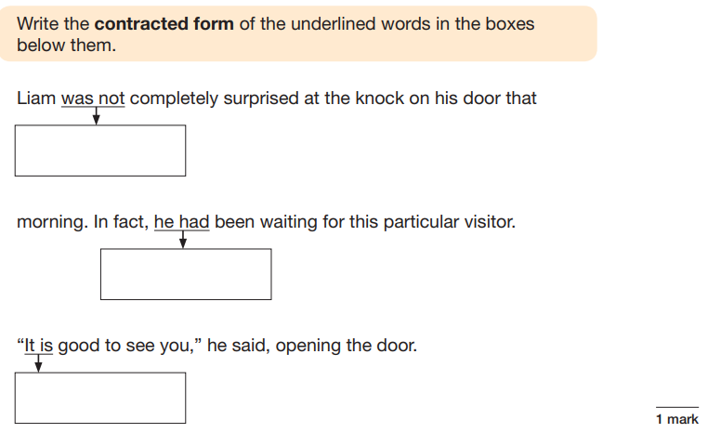

Slide 38
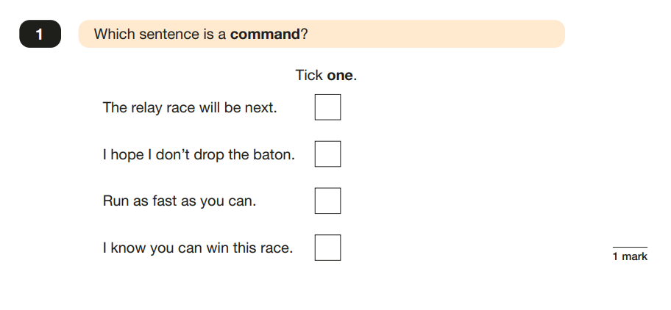
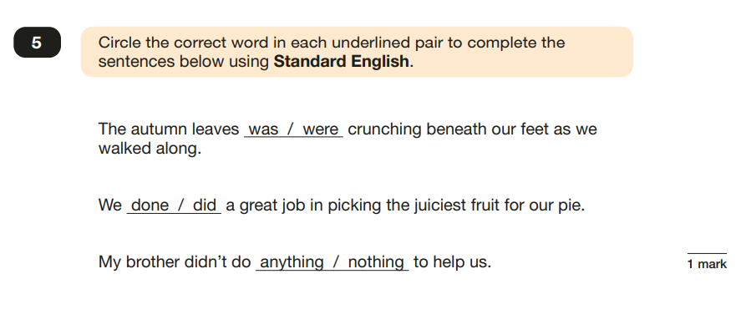

Slide 39
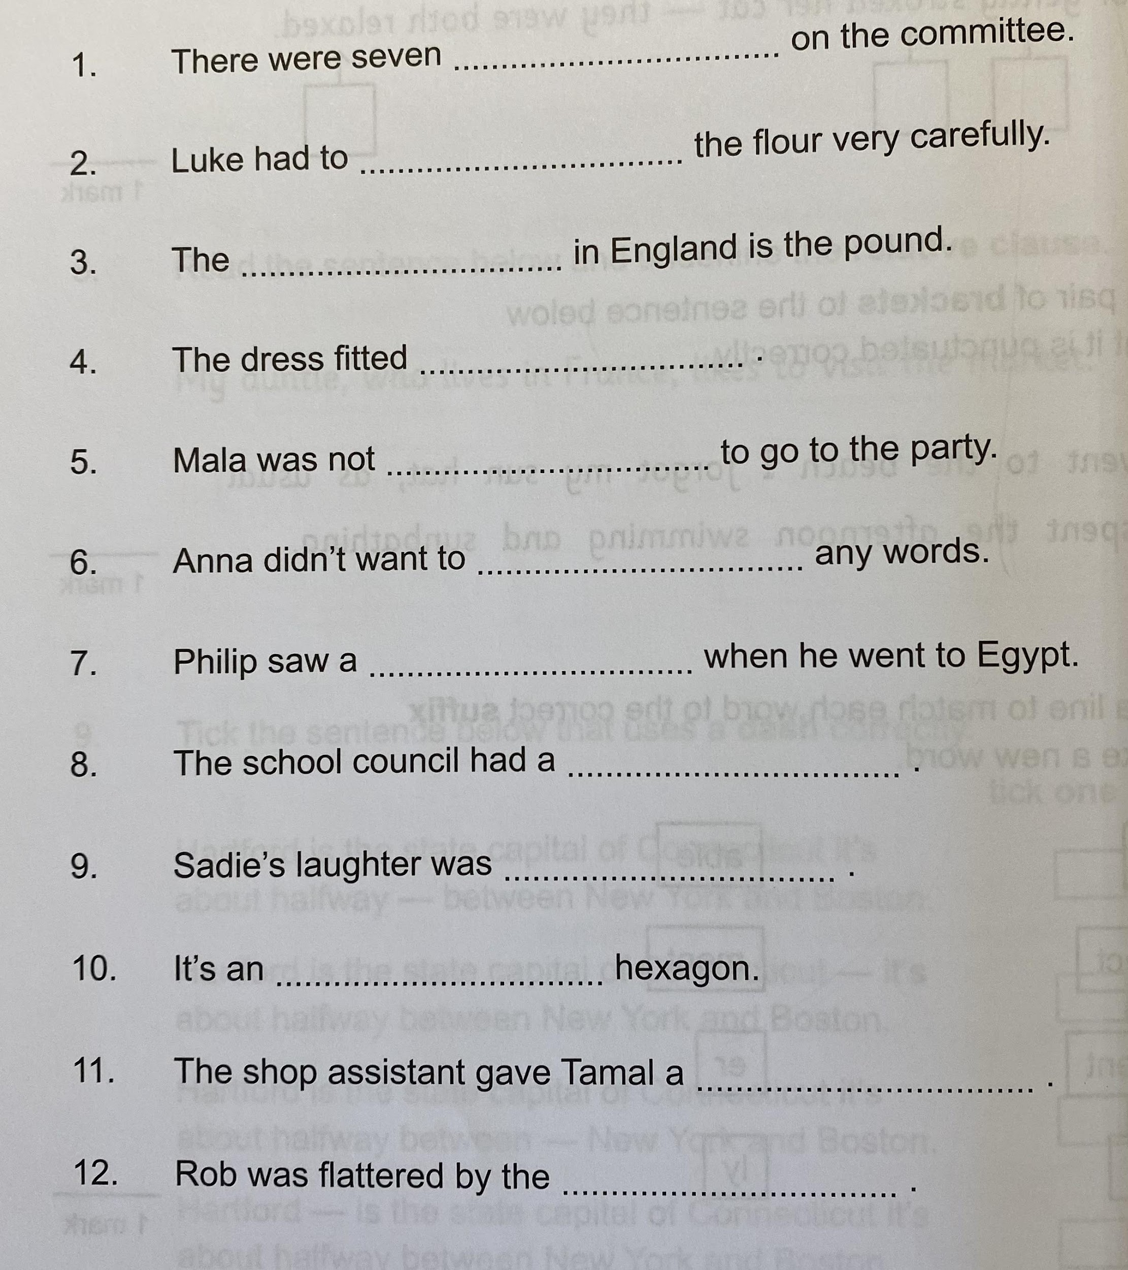
Spelling
20 words
Lasts about 15-20
minutes

Slide 40
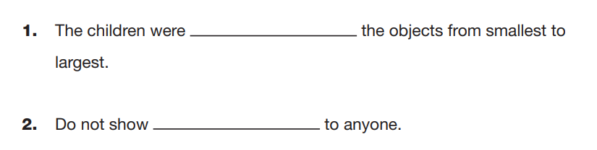
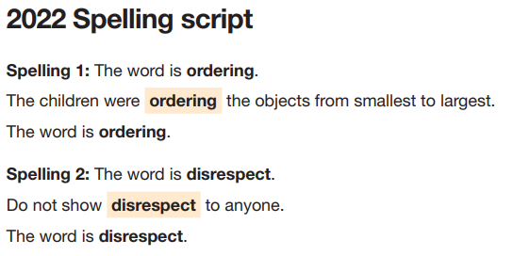

Slide 41
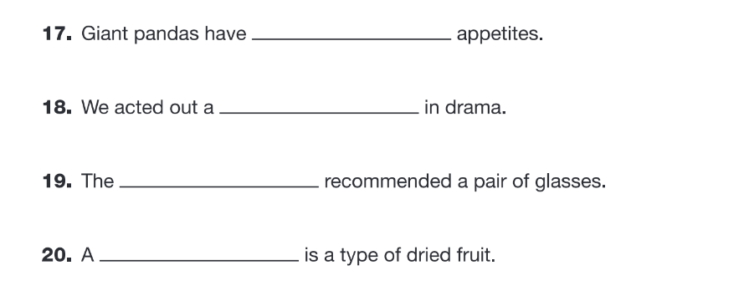
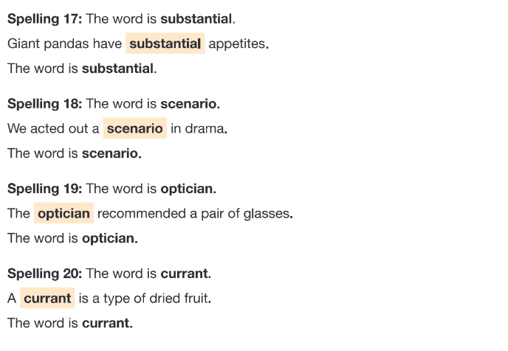

Slide 42
What Happens In Test Week?
Not tested all week - will be given a timetable of tests. Practice but also relaxing activities in the afternoons.
Breakfast at school 8.15am provided by PTA HPS staff supervise

Slide 43
What Is Reported To Parents?
Test Results of tests - a statement
Teacher assessment – writing and science – a statement
For Reading, Maths and Science children will be deemed to be:
Working at the expected standard
Not meeting National Standards
For Writing children will be deemed to be:
Not working towards the expected standard,
Working towards the expected standard
Working at the expected standard
Working at greater depth within the expected standard

Slide 44
Our HPS Approach
We provide a broad and balanced curriculum - even in Year 6. Do not ‘teach to the test’.
Will do revision and practise - minimum stress
best for each child
Preparation – SATs style, time limits, practice papers

Slide 45
Special Arrangements
The tests are for those children who are at the expected level or just below
Some children will not take the tests as they are operating below the level – their parents will be informed – the school’s decision is final.
Some children will have extra time, a reader, a scribe, be in a small group etc – this is decided by the school based on need and assessment.

Slide 46
What Next?
This coming parents evening we will discuss how your child has settled in. Next time - focus on your child’s progress towards the tests.
Discuss in more detail what is required from each of the tests for your child.

Slide 47
How Can Parents Help?
Ensure homework etc is done and handed in.
Be positive. Encourage hard work but no stress!
Practice rapid recall of multiplication tables to 12x12
Practice rapid recall of number bonds to 10, 100, 1,000 etc
Ensure that children are reading regularly – different types of texts – talk to them about what they are reading.
Sensible bedtimes.
Good nutrition & regular exercise.
Limit screen time.

