Slide 1
Holly Park School
Reception
Phonics Parent Workshop
Friday 27th September 2024

Slide 2
Welcome
What is phonics?
How does phonics help your children to read and write?
How do we teach phonics?
How can you support your children with reading and writing at home?

Slide 3
What is phonics?
Phoneme is the name of the smallest unit of sound
Every letter (grapheme) represents a sound (phoneme)
Some combinations of letters make a single phoneme. For example ch and igh

Slide 4
How does phonics help your children to read and write?
Phonics give children a strategy and system that helps them decode letters, words and sentences while reading
And it helps them to encode sounds into letters while writing.
Children can sound out each grapheme/digraph/trigraph to slowly build up the sounds in a written word and then blend them to read
For example ch i p
Most words in the English language are decodable through phonics

Slide 5
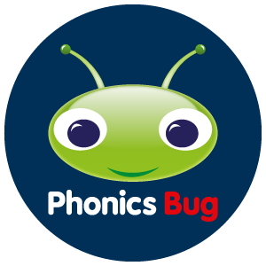
How do we teach Phonics?
We use the Bug Club Phonics Programme which is a government approved teaching scheme that uses a systemic, synthetic phonics approach.
This teaching scheme allows us to teach a carefully structured sequence of lessons that are also supported by reading materials that match sounds taught.

Slide 6
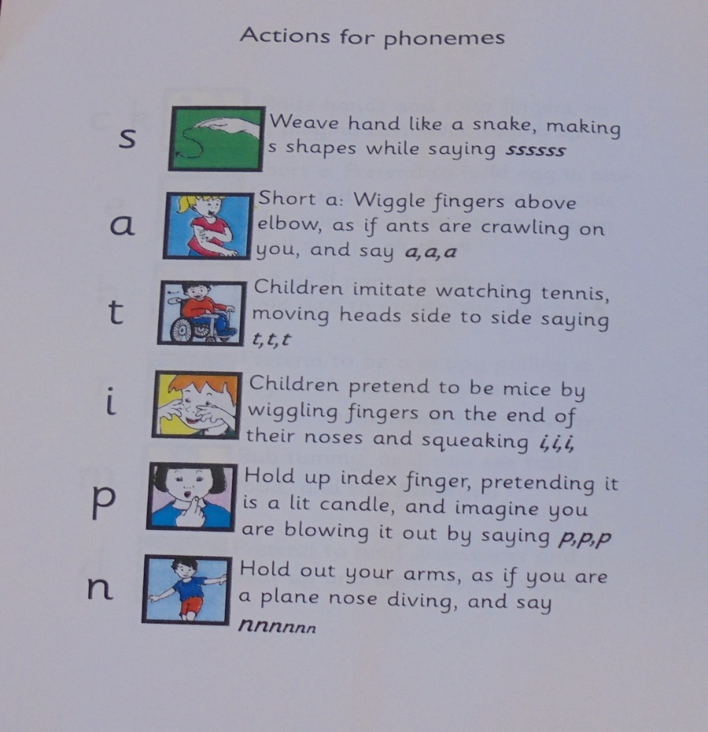
Actions for phonemes
We also link each sound (phoneme) to an
action. This multi-sensory approach helps children to link sounds to letters.

Slide 7
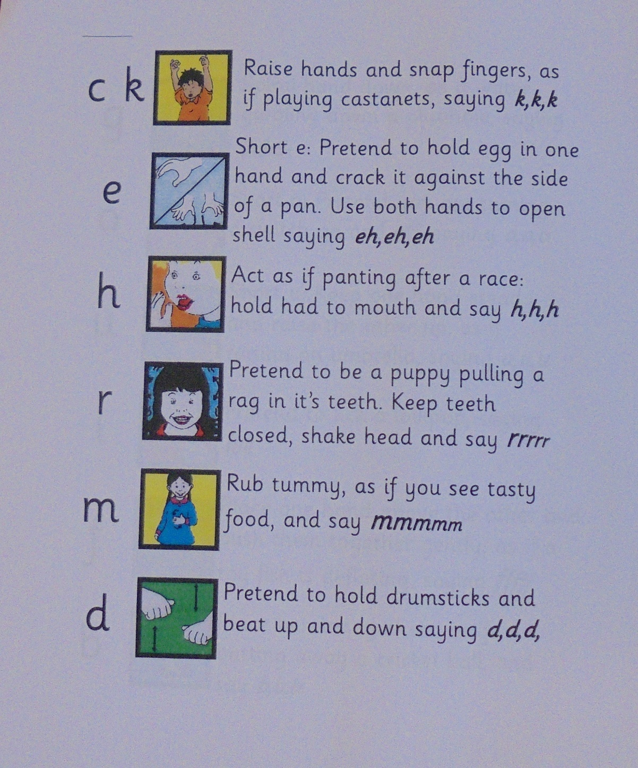

Slide 8
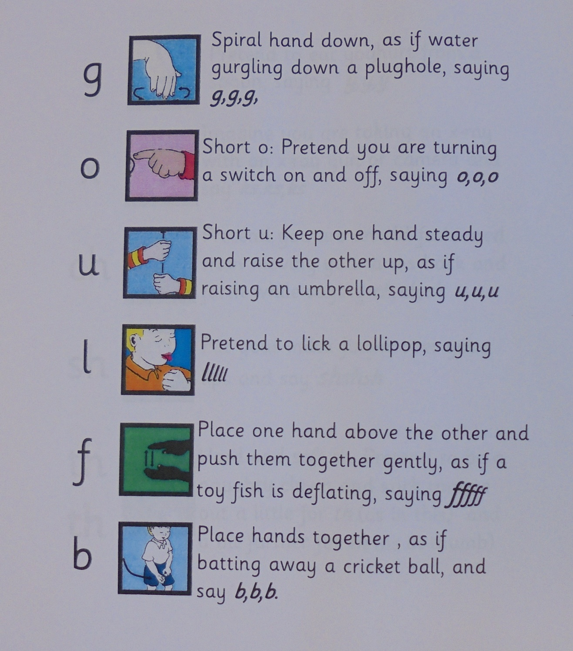

Slide 9
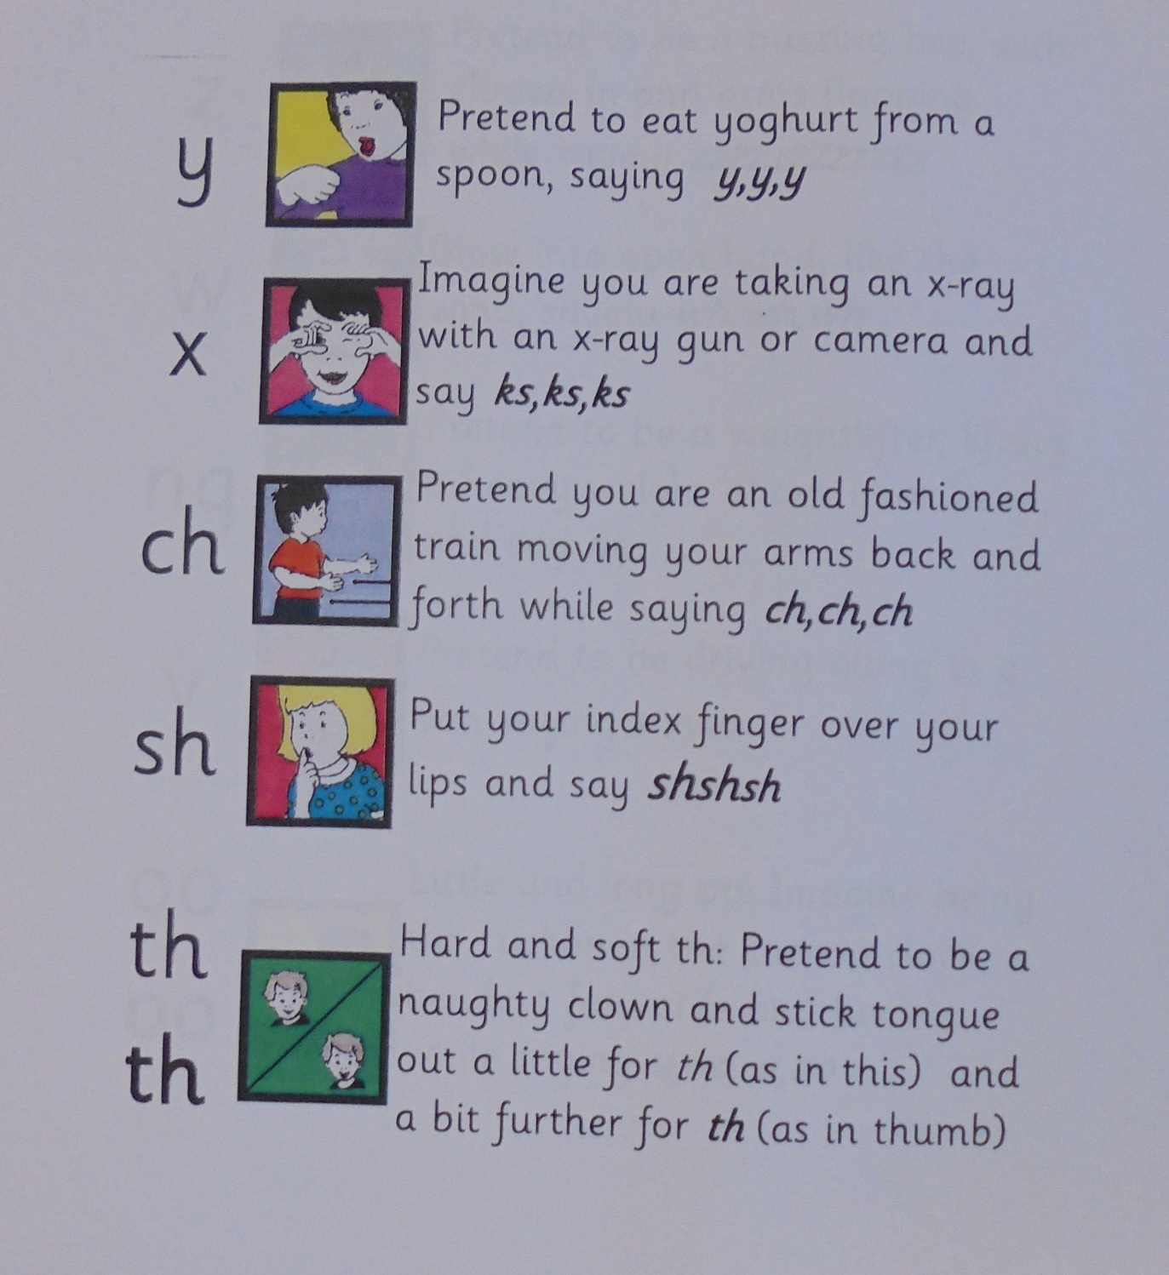

Slide 10
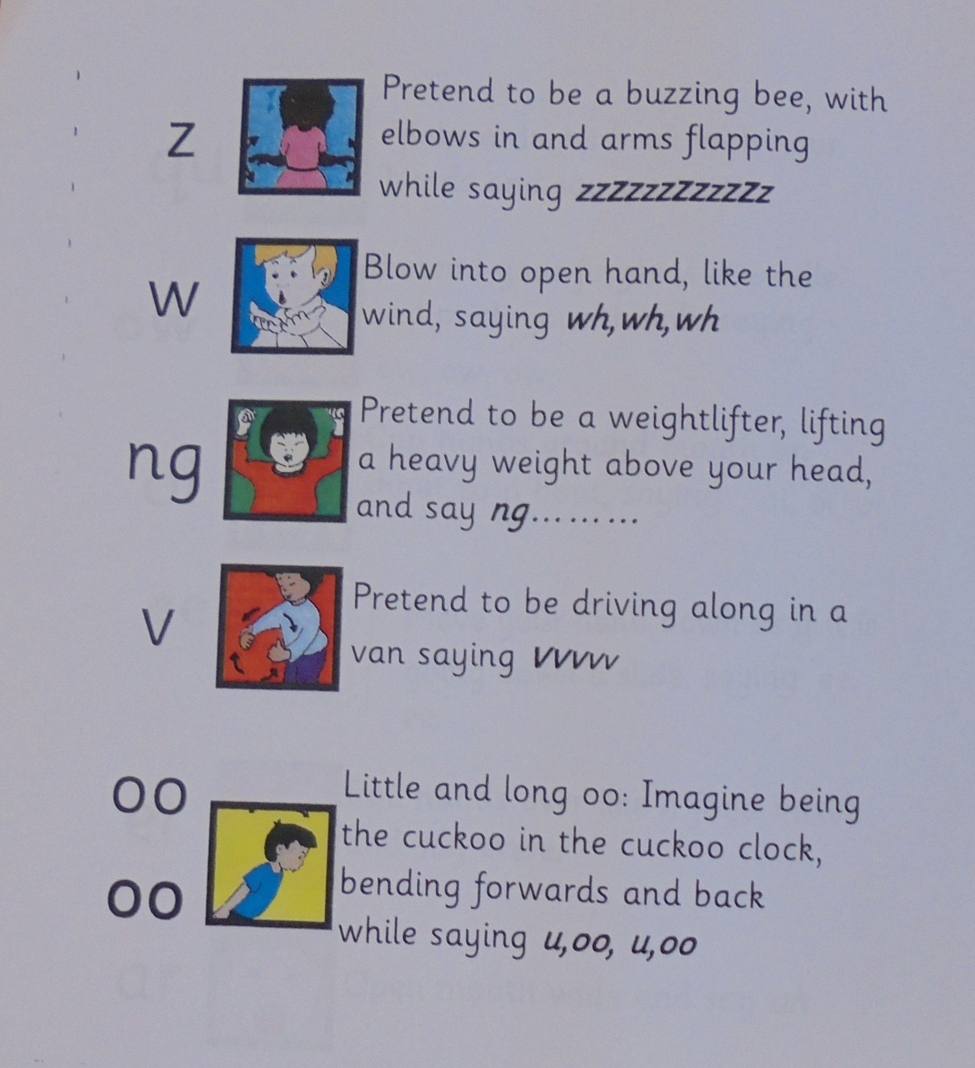

Slide 11
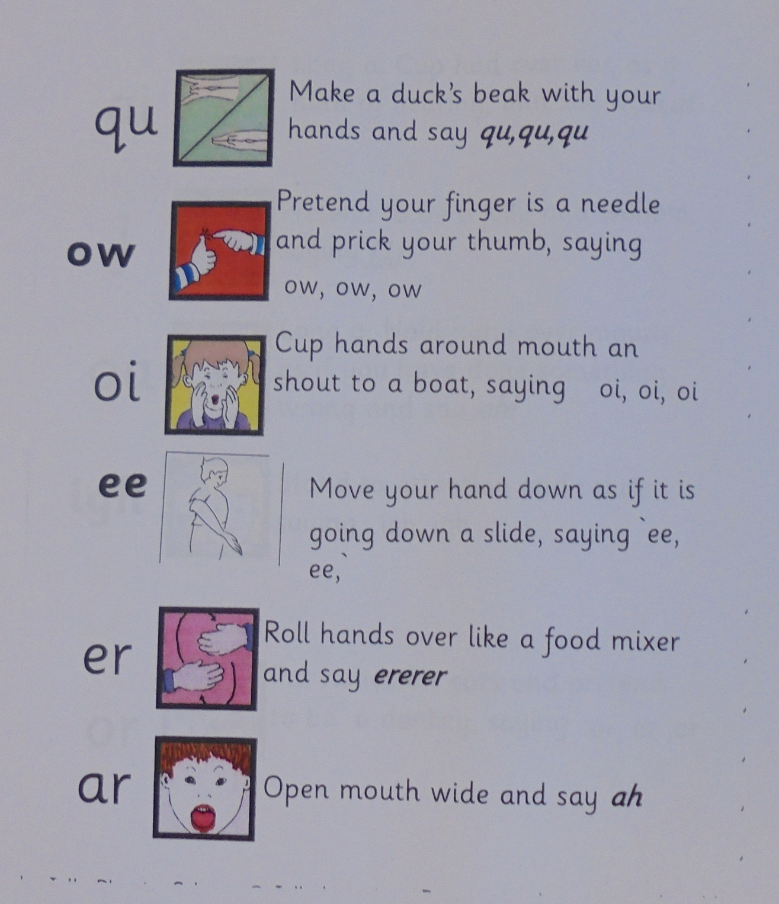

Slide 12
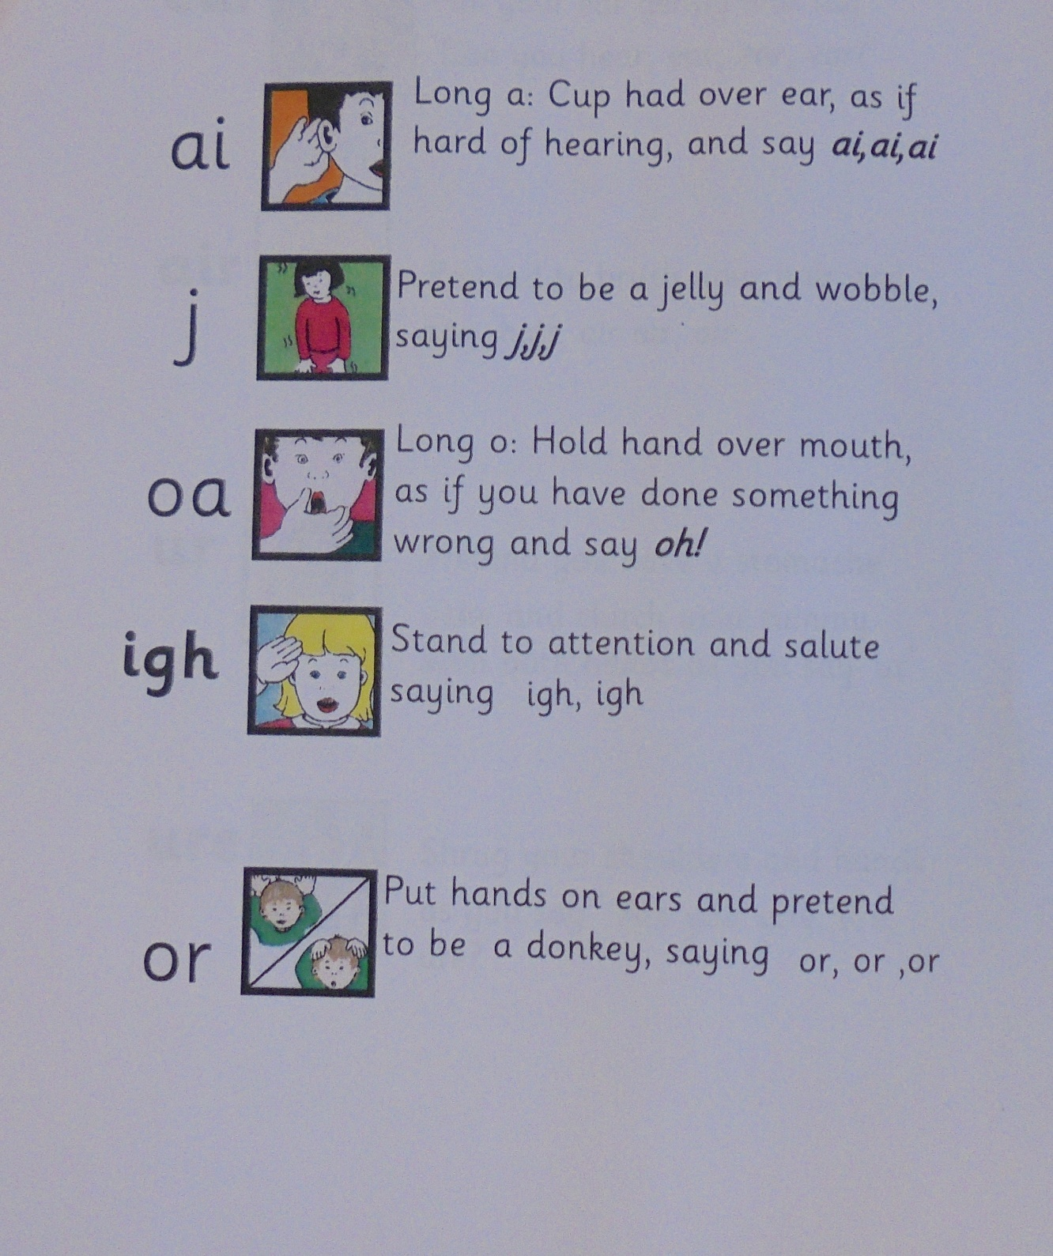

Slide 13
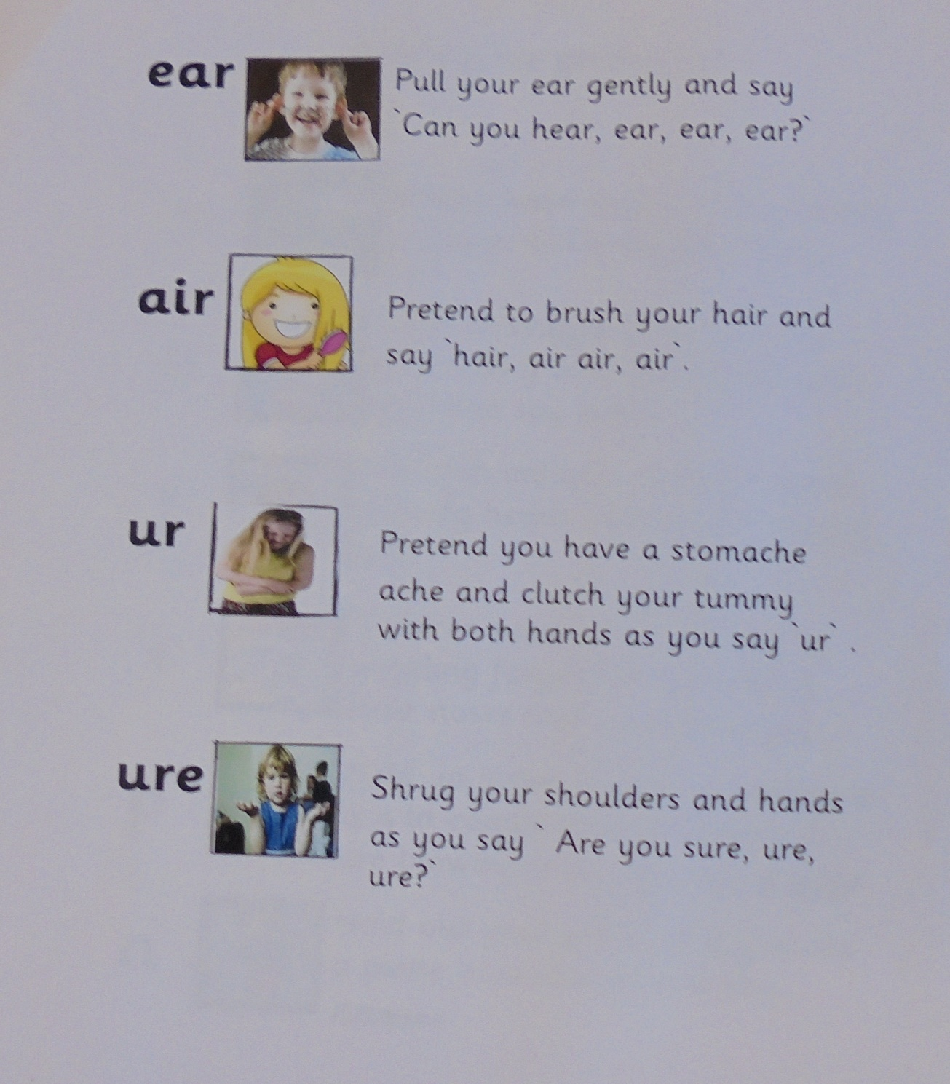

Slide 14
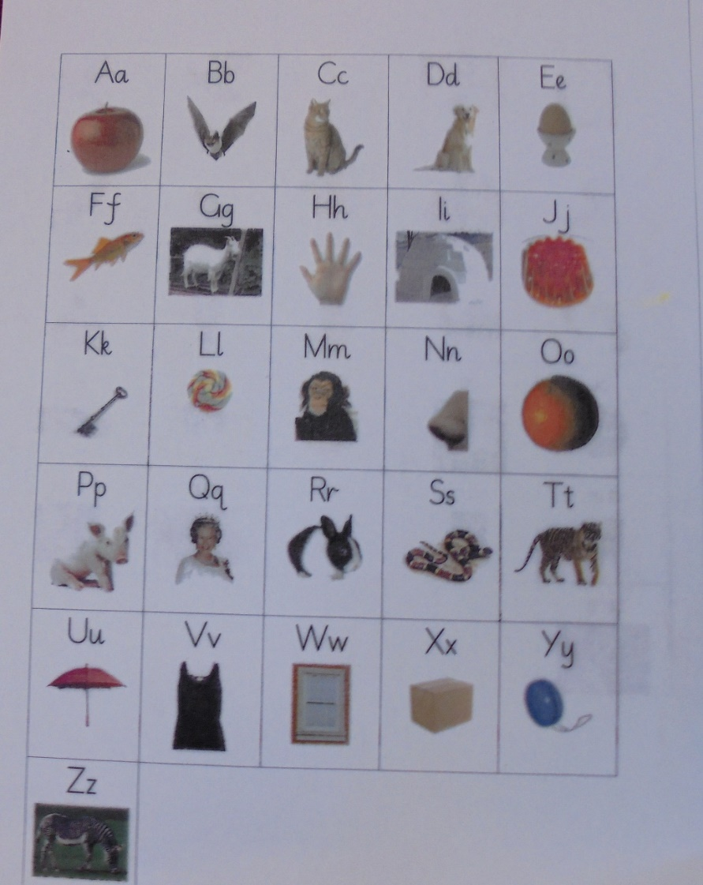
We use lots of visual prompts to support children with phonics during writing activities

Slide 15
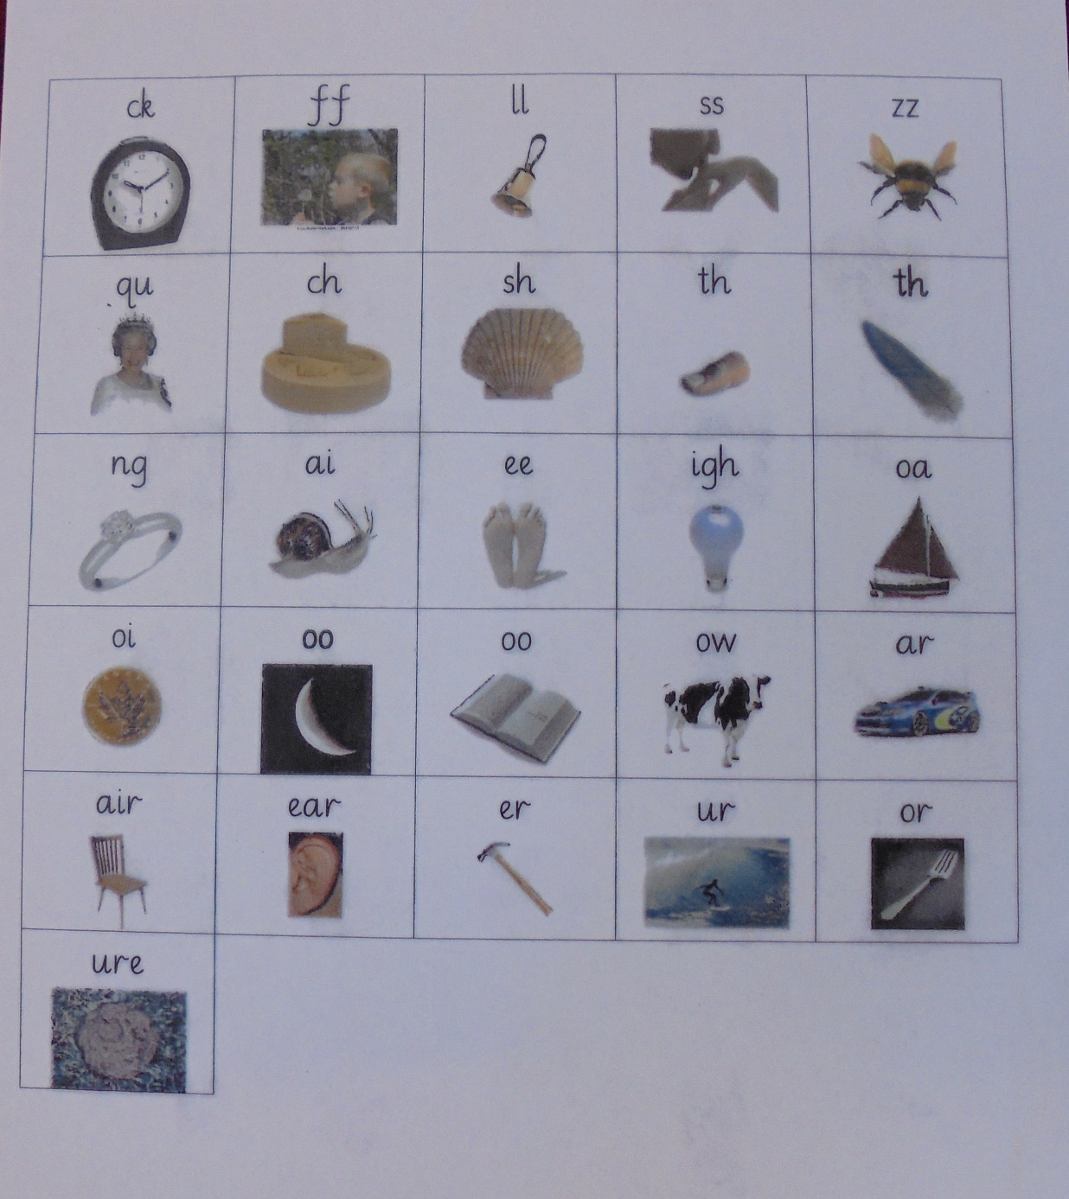

Slide 16
Daily Phonics Sessions
Your children will have a Phonics Carpet Session every day
They will….
revisit sounds,
learn new sounds,
practise sounding out and blending to read
Practise letter formation
Segment sounds in words while writing on whiteboards
They will also have lots of opportunities to practise and consolidate their phonics skills through activities in the continuous provision.

Slide 17
Letter Formation
We will teach your child a `Letter Formation Patter` for each letter. This will help your child to remember how to correctly form each lower case letter of the alphabet.
`Slither down the snake.`

Slide 18
Phonics sessions are active!
We will keep the children focused and engaged during Phonic Sessions by…
Getting them on their feet during Speedy Sounds
Keeping them engaged and amused with the use of puppets such as `Phonic Frog`
Using multi sensory approaches at all times- actions, visual cues, ICT and audio.

Slide 19
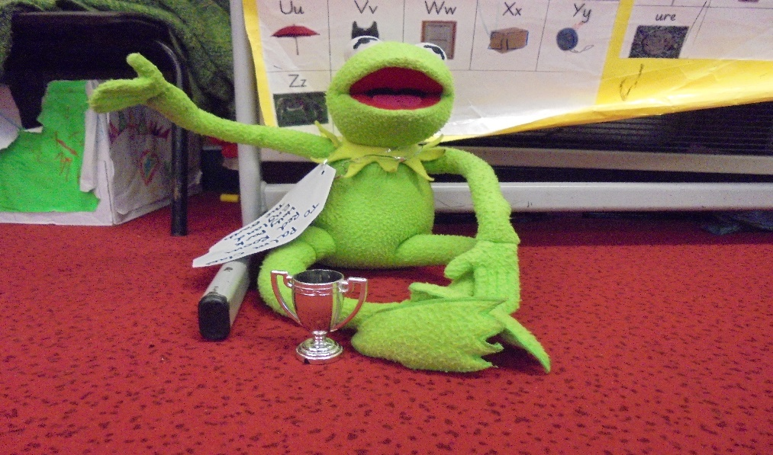
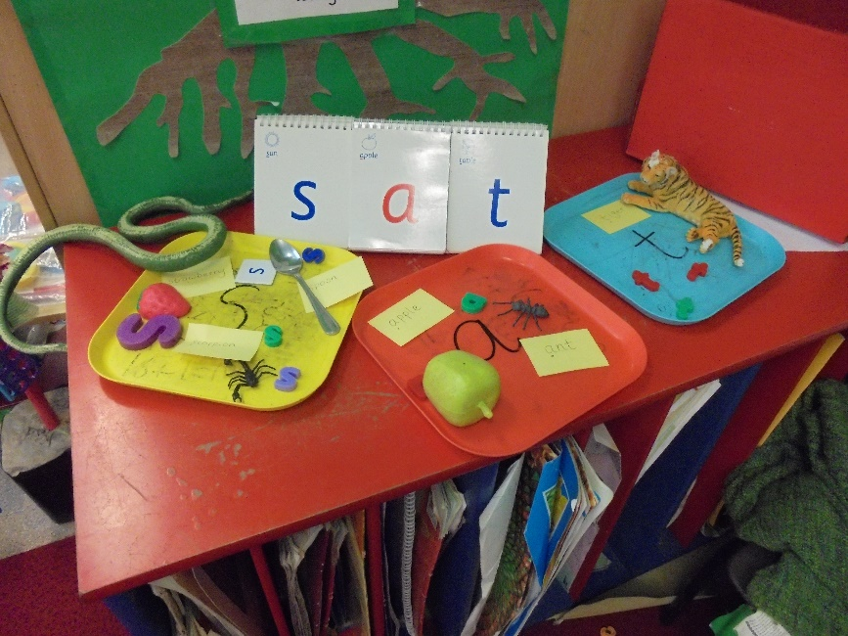
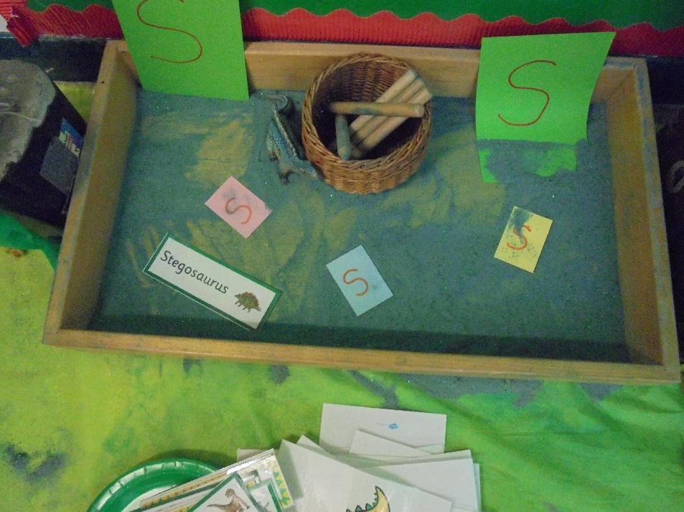
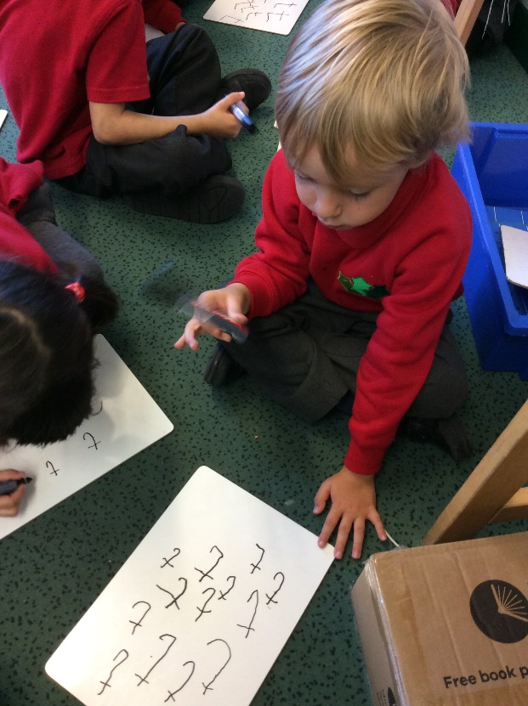

Slide 20
How can you support your children with reading and writing at home?
Your children will read with their teacher every week.
Your children will also use the Bug Club reading materials during daily shared reading opportunities.
Activities will be based around core story books, such as `Mr Gumpy`, `The Very Hungry Caterpillar……
Your children will have access to their online Bug Club books at home.
They will also be able to play online Bug Club Phonics games at home.

Slide 21
Practising Reading at Home
Your child needs to have the opportunity to read their `Bug Club` book with you every day.
Keep these sessions very short, 5 to 10 minutes is more than enough time.
Encourage your child to use a range of reading strategies; phonics, picture cues, grammatical and contextual cues.
Talk about the characters and events in stories and ask your child questions about the story.

Slide 22
Bug Club Login Details Your child will receive their Bug Club login details very soon. Please keep this information in a safe place!

