Slide 1
Holly Park School
Year 1
Phonics Parent Workshop
2nd October 2024

Slide 2
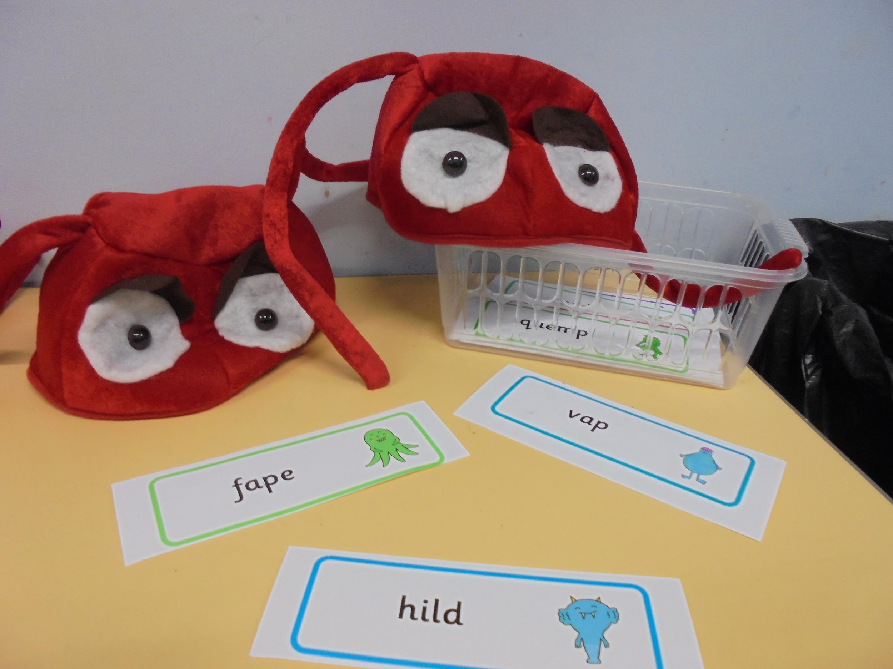
Welcome
What phonic skills do Year One children learn?
How do we teach phonics?
How can you support your children with phonics at home?
What help and support can we provide for parents?

Slide 3
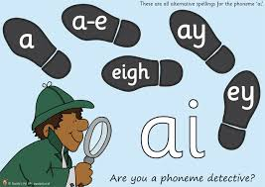
What phonic skills do Year One children learn?
Year one children learn all the alternative spellings for sounds
This means they have to learn over forty new digraphs and trigraphs!
They will learn to decode these digraphs while reading and use them in their writing

Slide 5
How do we teach Phonics?
At Holly Park we use the Bug Club Phonics Scheme
This is a government approved teaching scheme
It uses a systematic synthetic phonics approach
The scheme allows us to teach a carefully structured sequence of lessons
Teaching is supported by Bug Club reading materials that match sounds taught.

Slide 6
How do we teach phonics?
Your children have a daily phonics session.
During this session they will
Review previous learning
Learn alternative spellings of phonemes
Practise reading and writing new alternative spellings for sounds

Slide 7
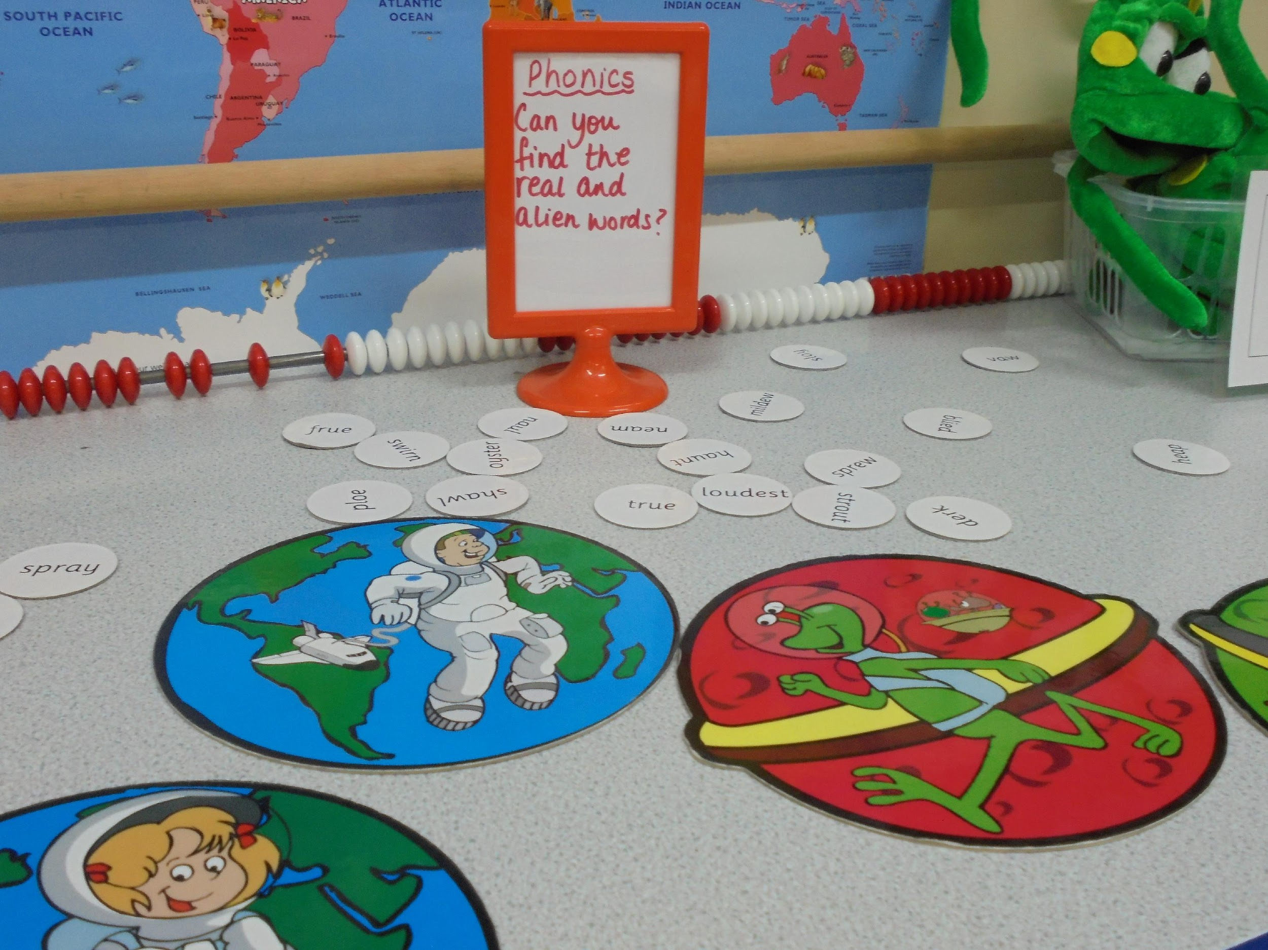
Multi Sensory Resources
Teachers will use multi sensory resources and strategies to support children’s phonic development
Children have opportunities to practise their phonic skills in class activities.

Slide 8
What kind of resources and strategies do we use?
Children are encouraged to put on their imaginary `Digraph/Trigraph Glasses`, to help them spot any two or three or four letter phoneme (sound) in a word before they sound it out.

Slide 9
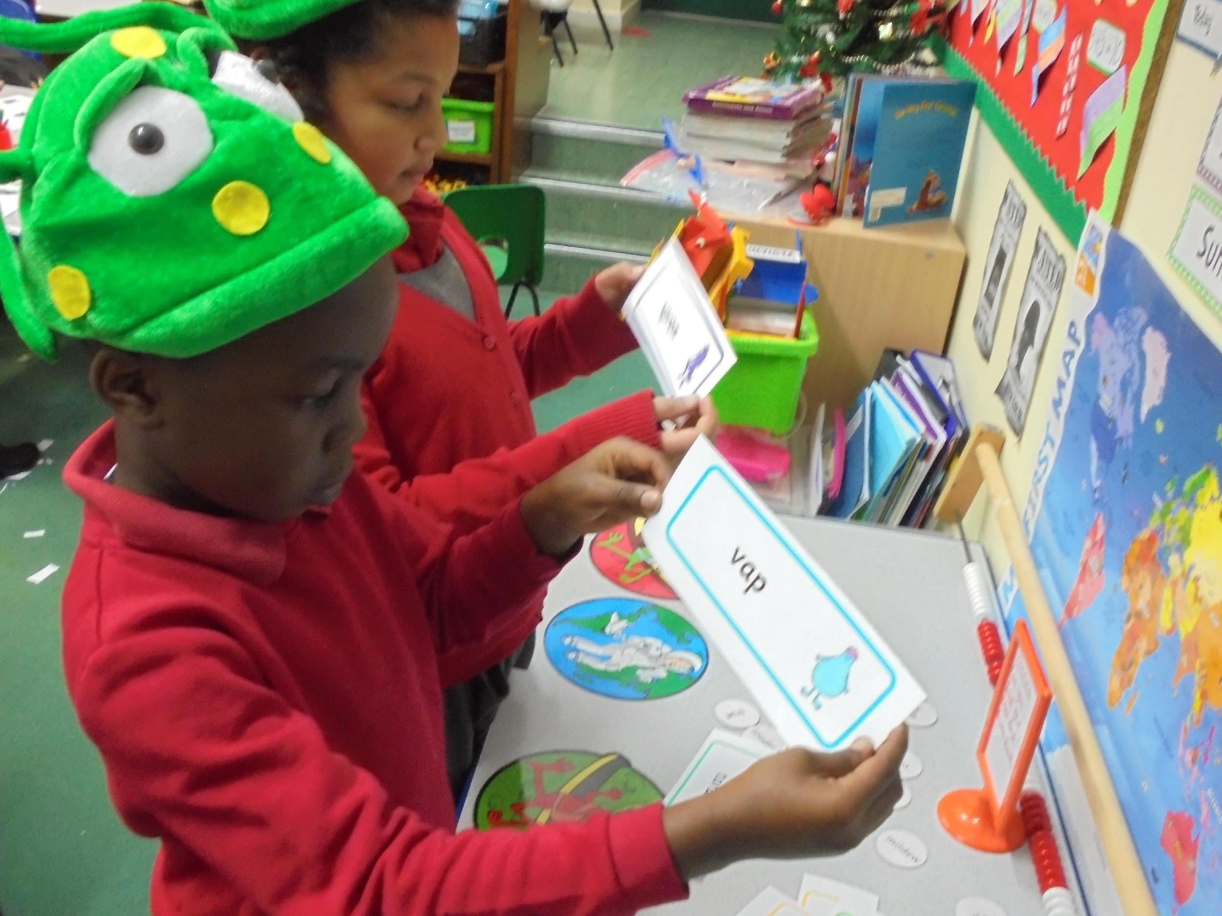
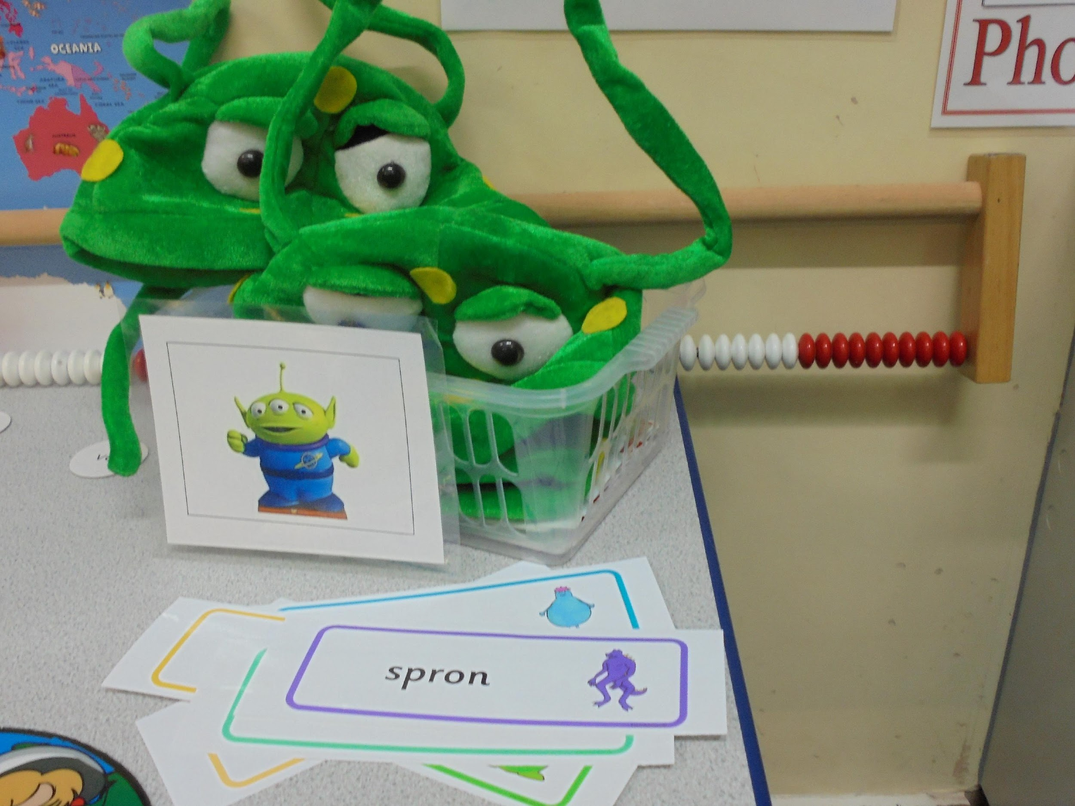
Alien Words
Children are encouraged to read pseudo - `Alien` words, which can only be decoded phonically.

Slide 10
Shared Reading Books are matched to the Phonics that are covered that week

Slide 11
What is the Phonics Screening Check?
Every Year 1 child in the country will take part in a Phonics Screening Check in June
The test will be administered by Miss Richardson, one to one in a separate room.
The test is made up of 40 words, a mixture of pseudo and real words.
Parents will be informed of their child’s score
Any child that does not pass in Year 1 will take the test again in Year 2

Slide 12
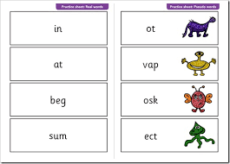
Year 1 Phonic Screening Check

Slide 13
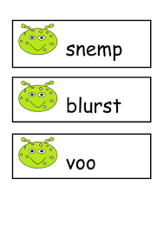
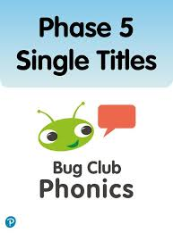
How can you support your children with phonics at home?
Please encourage your child to practise reading the Alien Word Sheets that are sent home every week.
Your child will be allocated Bug Club Phonic games to play at home.
Please encourage your child to practise reading their Bug Club books at home every day.
These books are carefully matched to the content of their Phonic lessons.
The books will give your children the opportunity to apply newly acquired Phonic knowledge.

Slide 14
Use phonic strategies at home
Remind your children to `put on their digraph/trigraph glasses` before they read with you.
Play `Digraph/Trigraph` spotter games; How many different digraphs can they find in a page of their favourite comic or magazine.

Slide 15
spotting digraphs, trigraphs and quadgraphs!
zlay
weight

Slide 16
Split digraph
cake

Slide 17
Websites
There are many websites that provide lots of fun phonic activities and we would strongly recommend that you sign up to..
www.phonicsplay.co.uk/

