Slide 1

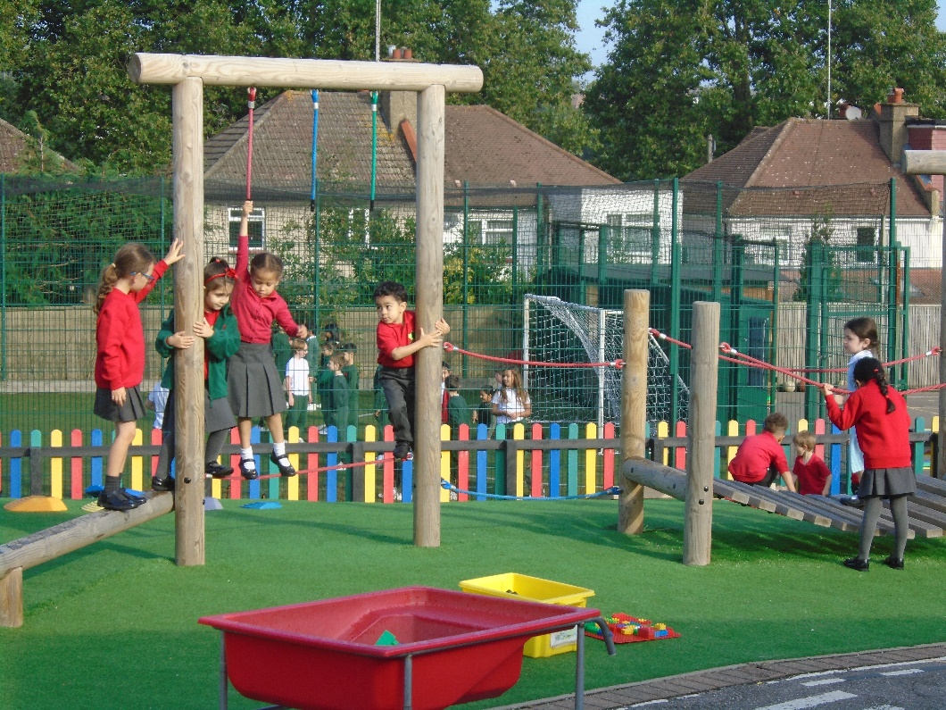
EYFS Curriculum at Holly Park School
Meeting for Nursery and Reception Parents
Wednesday 18th September 2024
This presentation aims to give an introduction to the Early Years Foundation Stage (EYFS) at Holly Park School. It includes information which we hope you will find useful .

Slide 2
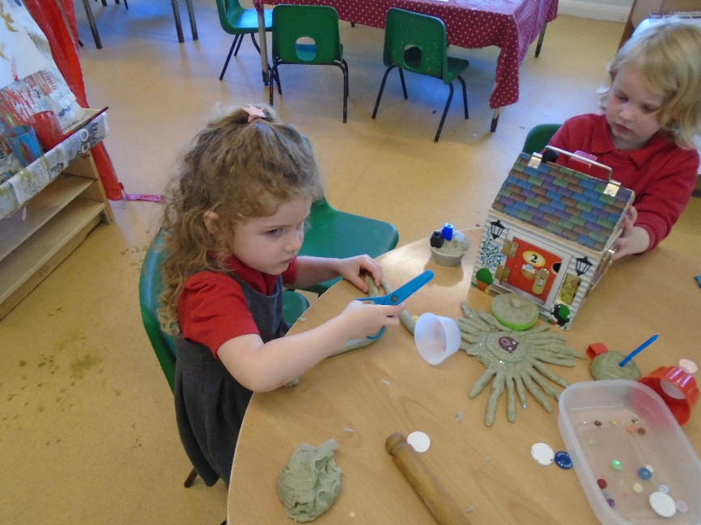
What Is the EYFS?
The Early Years Foundation Stage covers the first stage of a child’s care
from birth to five years old. It sets the standards to ensure that all children
learn and develop, as well as keeping them healthy and safe.
Also included in the EYFS are the seven Areas of Learning. They are:
  Communication and Language
  Personal, Social and Emotional Development
  Physical Development
  Literacy
  Mathematics
  Understanding the World
  Expressive Arts and Design
At the end of the EYFS, there are 17 Early Learning Goals that children are expected to achieve.

Slide 3
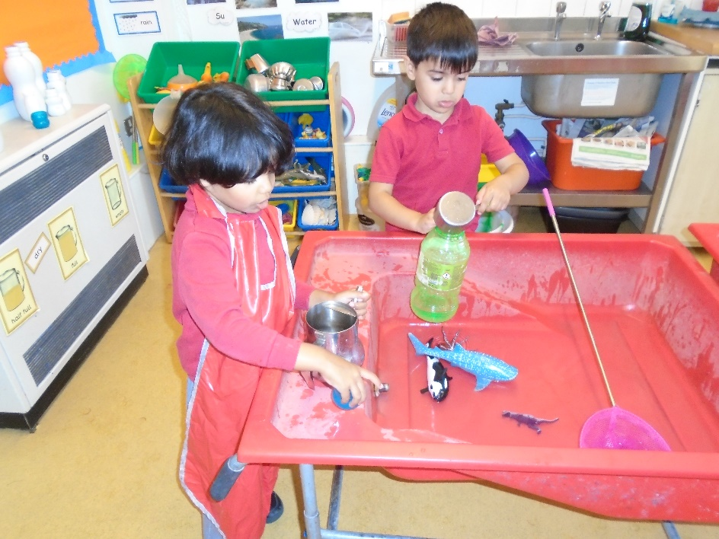
The Prime Areas are fundamental as they run through and support development and learning in all other areas.
  Communication and Language
  Personal, Social and Emotional Development
  Physical Development

Slide 4
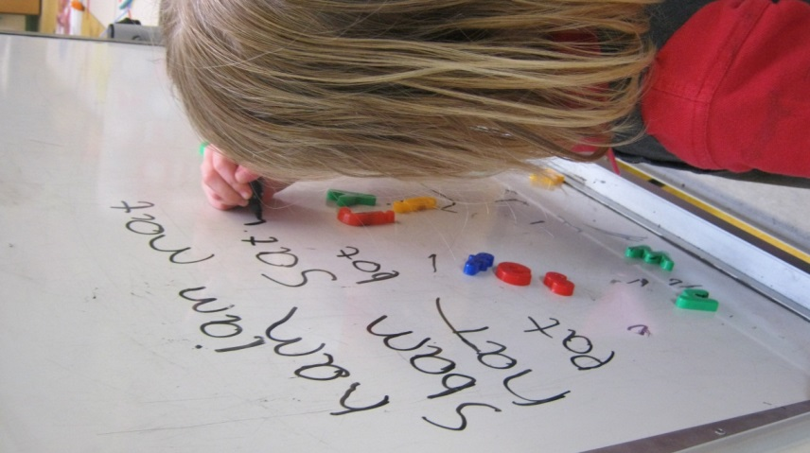
Assessment for Learning
adult observes the children
asks questions, challenges,
develops understanding,
supports thinking,
plans next steps
sees what they can do
thinks about what the child needs to do next

Slide 5
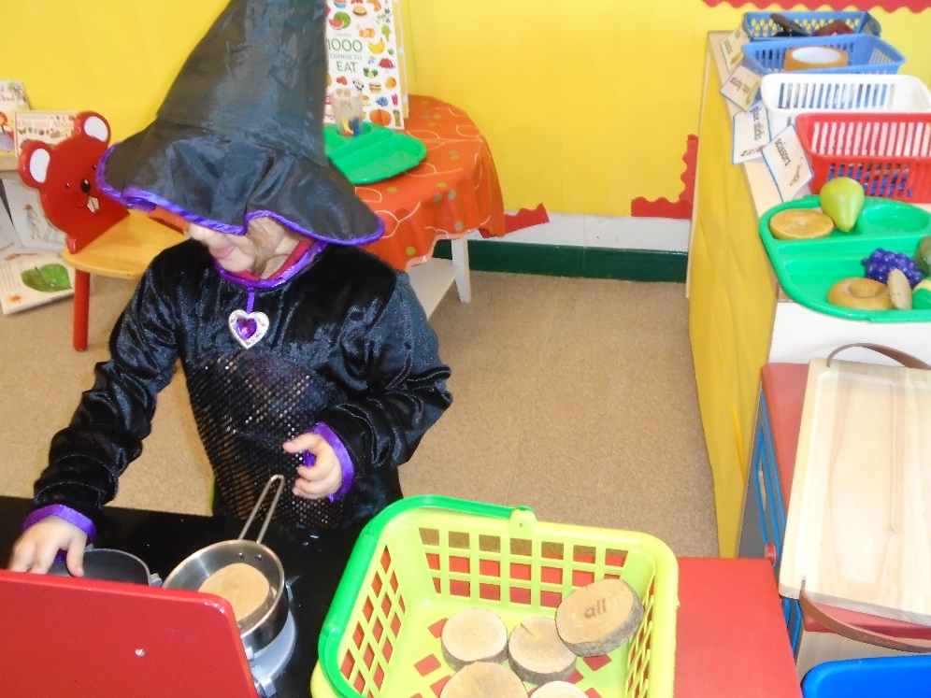
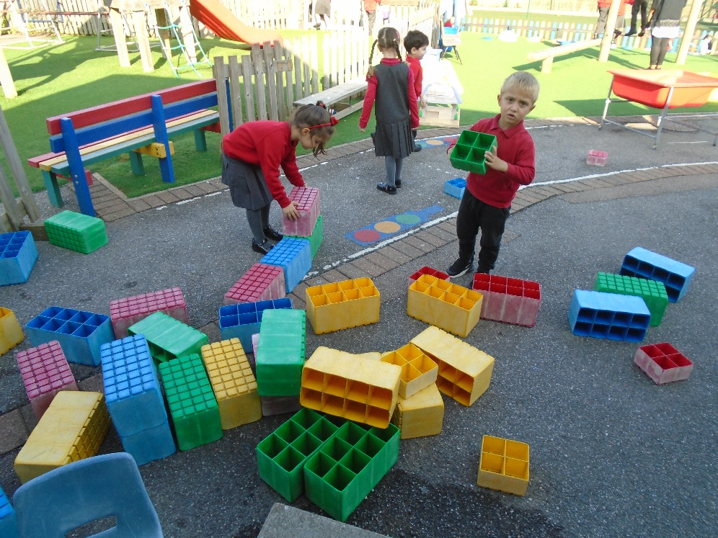
Play
Every child has the right to relax and play. (article 31)
Children need to play!
They need to practice their skills in a fun, hands on, practical way.

Slide 6
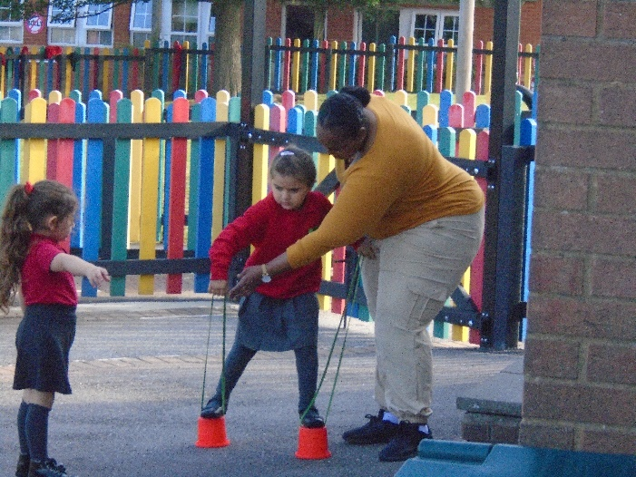
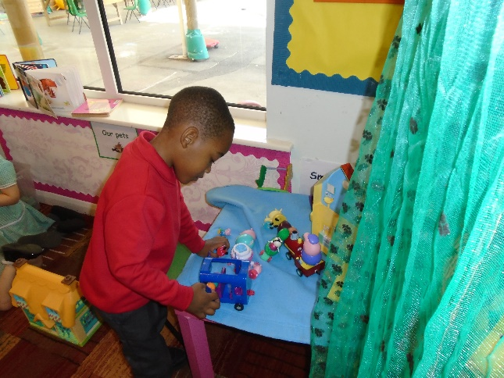
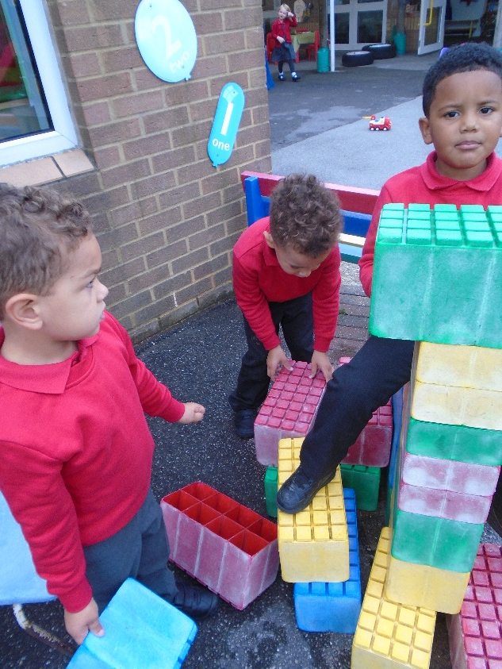
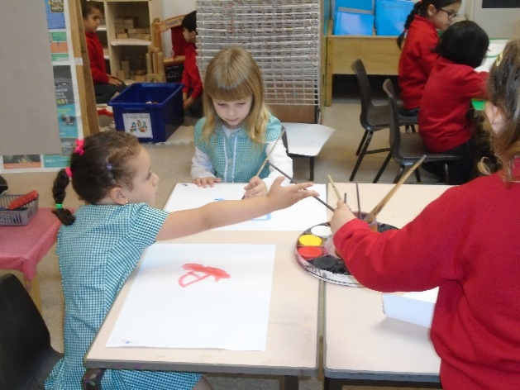
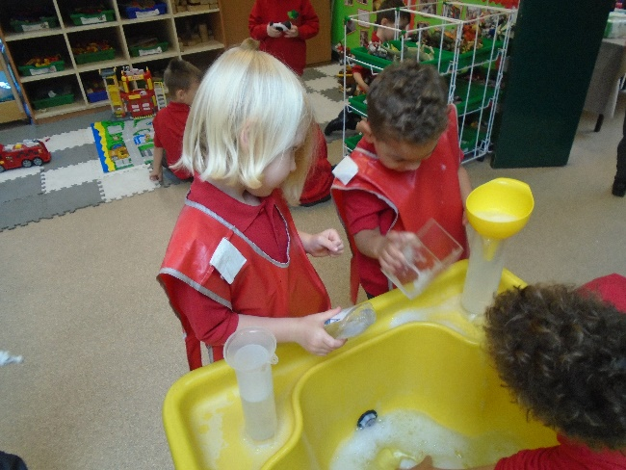
Learning in the EYFS
Working Independently
Learning Outside
Working with an Adult
Working and Playing with Friends
Learning Inside

Slide 7
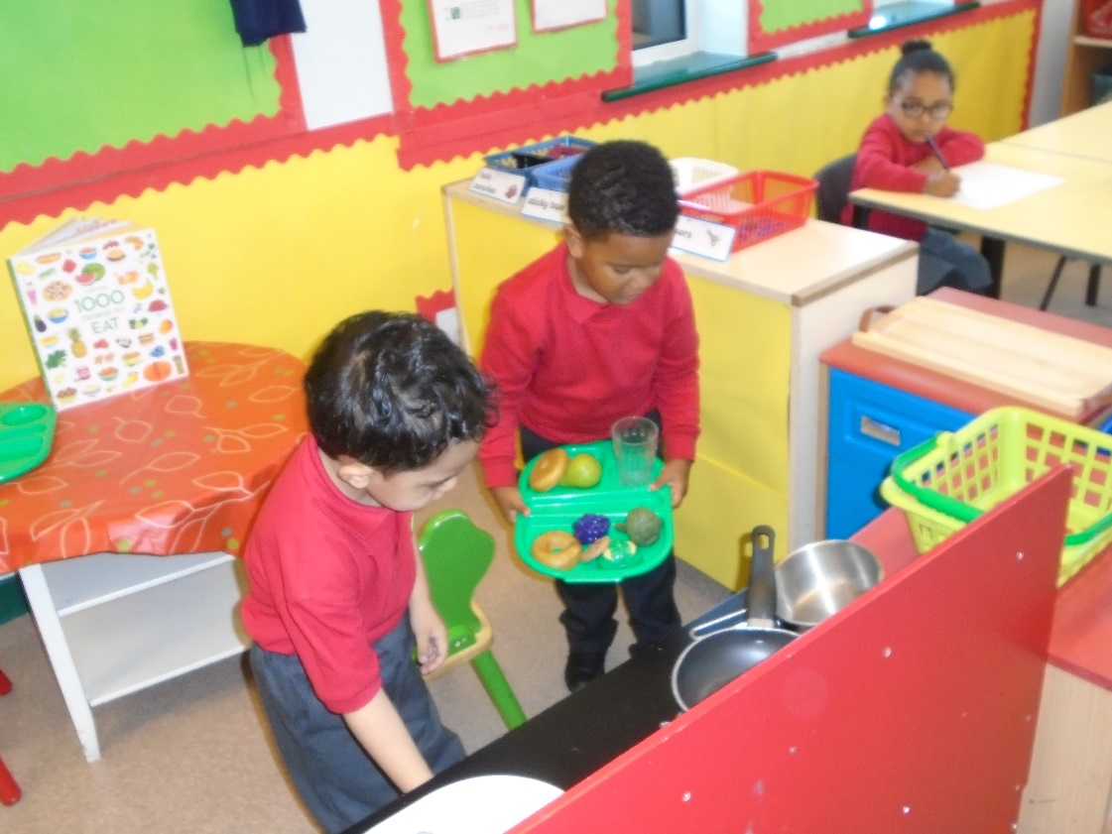
Learning Activities
Some Adult Led Activities
But mostly Child Initiated Activities through…
  Water
  Role play
  Construction
  Continuous Provision

Slide 8

Outdoor Play
Important part of the curriculum
Children go out in all weathers
Need for physical activity

Slide 9
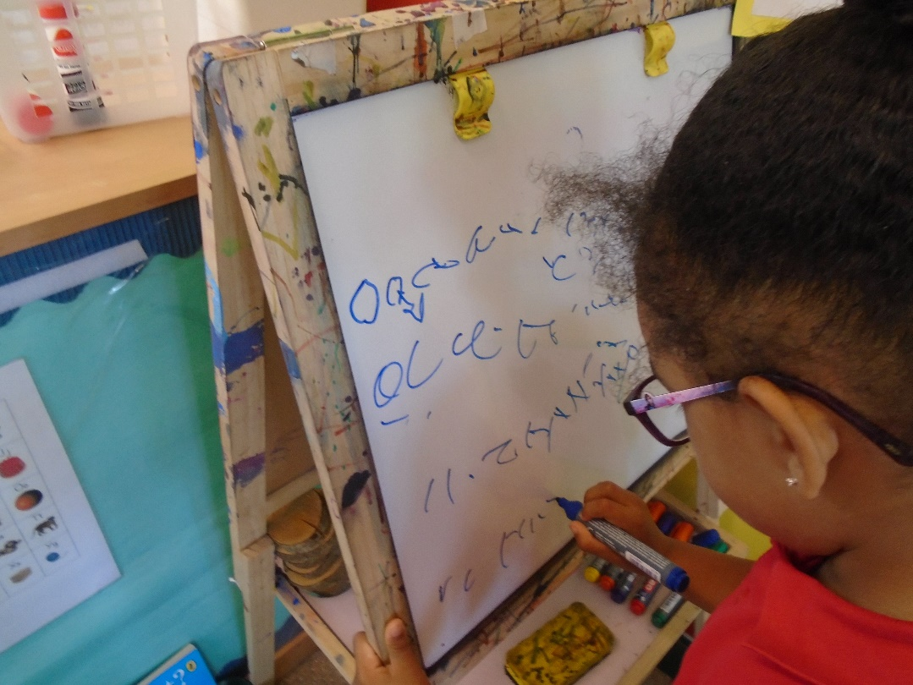
Parents as Partners
Parent Consultations
Urgent messages communicated
through the office

Slide 10
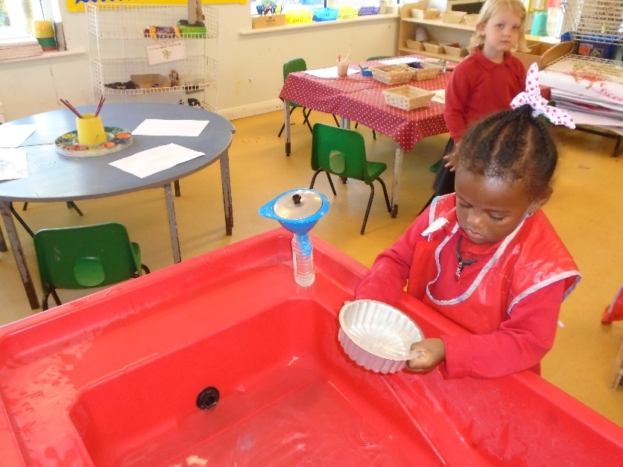
Helping Your Child to Play
Turn off the screens
Think about limiting the choice of toys available
Play with your child
Talk about what you are doing
Be fair, they need to learn to win and lose
Read lots of stories and sing rhymes and songs
Allow independent play
Get dirty!

Slide 11
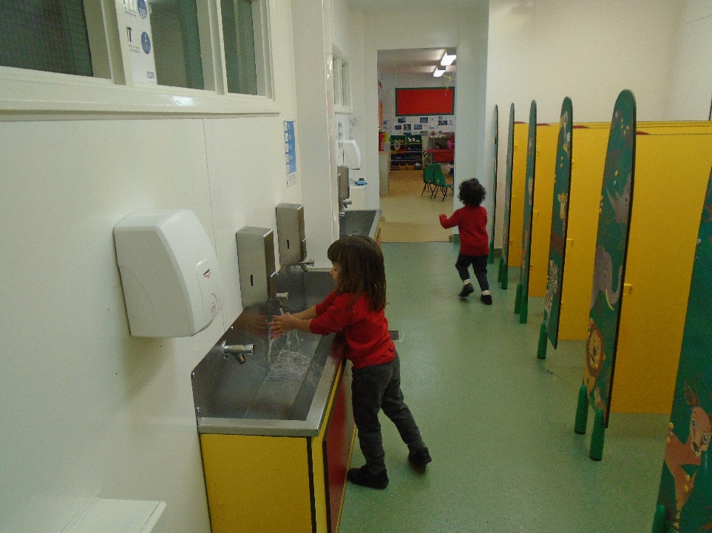
Developing Independence
Give your child simple chores
Ask your child to tidy away toys
Encourage your child to put on their coat by themselves
Teach your child to eat independently including scraping their plate
Teach them how to ask for help

Slide 12
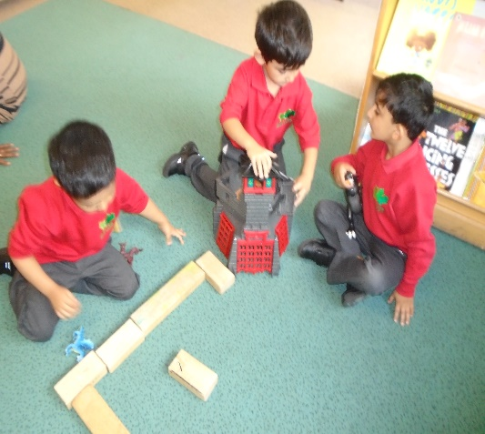
Developing Communication Skills
The EYFS Statutory Framework has a strong emphasis on the importance of developing communication and language skills.
Children should be supported in building up vocabulary by increasing the amount of words they know and can use.
Encourage more conversations between adults and children, but also children and their peers.
Good language skills are the basis for all other learning and social interaction, so this is vital to focus on.
So at home you can…
Talk, talk and talk some more!
Think about how much of your talk is functional each day.

Slide 13
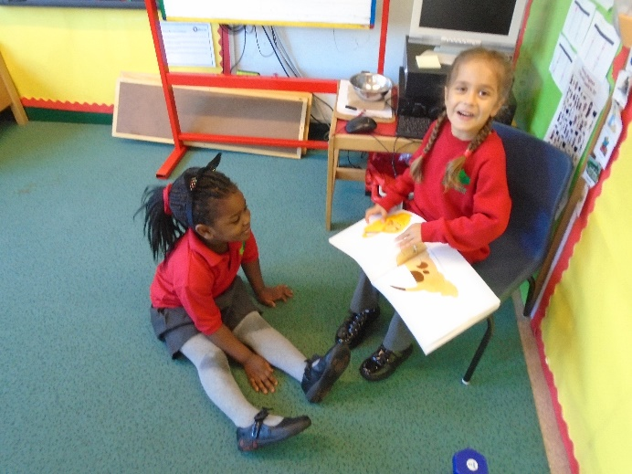
Developing Literacy Skills
The EYFS Statutory Framework also gives a strong emphasis on the importance of reading stories to help children develop in all of Areas of Learning.
Daily reading of stories encourages an enjoyment of reading from a young age.
Lots of other learning opportunities happen when looking at books, for example comparisons of culture or the past.
Listening to stories develops imagination, ideas and language.
Reading is an essential skill and so should be shown to children, as well as practised by them regularly.
Children are also encouraged to use story ideas in their play.
So at home you can…
Be a reader, show how much you enjoy reading and how reading is a necessary part of your life.
Be a writer, show how much you need to write
WITH A PEN AND PAPER!

Slide 14
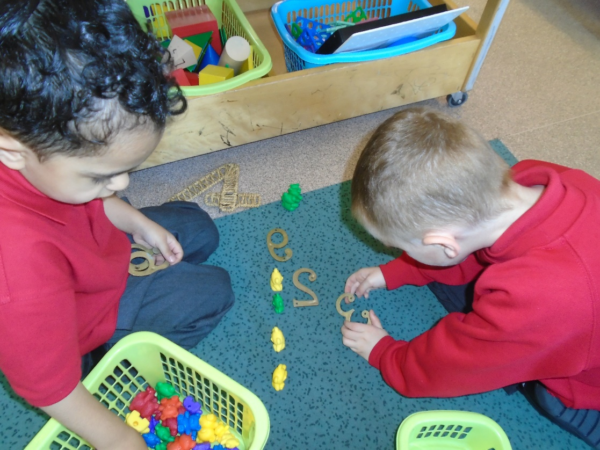
Developing Maths Skills
Talk about the maths you are using in your day to day life…
  Telling the time
  Weighing
  Looking at the temperature
  Finding door numbers
  Using phone numbers

Slide 15

Healthy Lifestyles
There is a focus on encouraging healthy choices overall and an understanding of oral health.
Teach children the importance of brushing teeth. .
Focus on helping children to understand which choices to make that will help them to be healthy, for example which foods to eat and why.
Getting into good routines from a young age is important as these often continue into adult life.

Slide 16
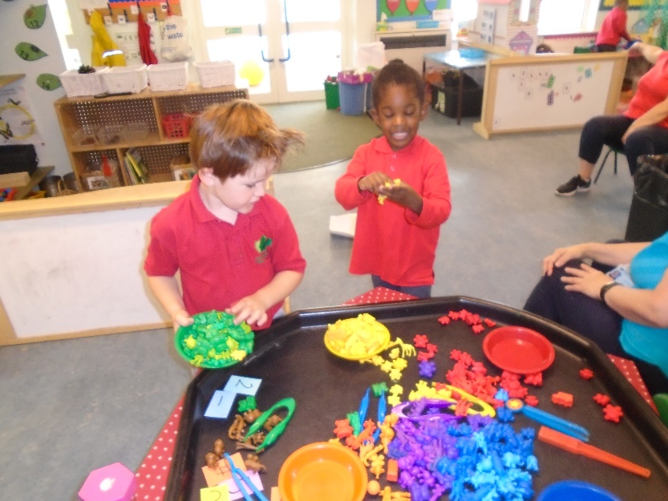
Development Matters
At Holly Park we use the non statutory Development Matters document to help us assess and support our children make progress across all the Areas of Learning.
This document acknowledges that children don’t develop in a linear fashion.
Children develop in different ways and at different rates.
This document supports staff in using their knowledge of child development to assess and support children on their next steps.

Slide 17
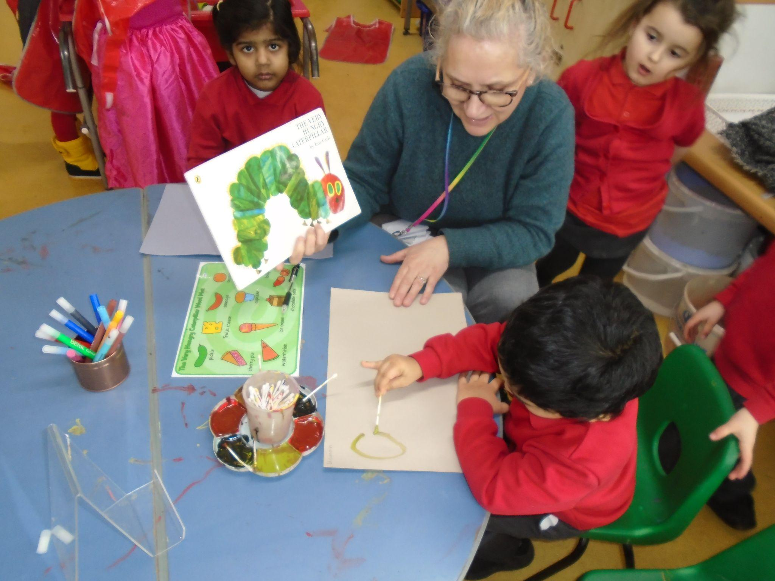
The Holly Park EYFS Curriculum
At Holly Park we have created our own bespoke curriculum that encompasses all the statutory elements from the EYFS framework
This curriculum enables us to tailor learning opportunities that meet the needs of individual children.
This curriculum ensures progression from Nursery through to the end of Reception. It prepares children for their transition into Year One.

Slide 18
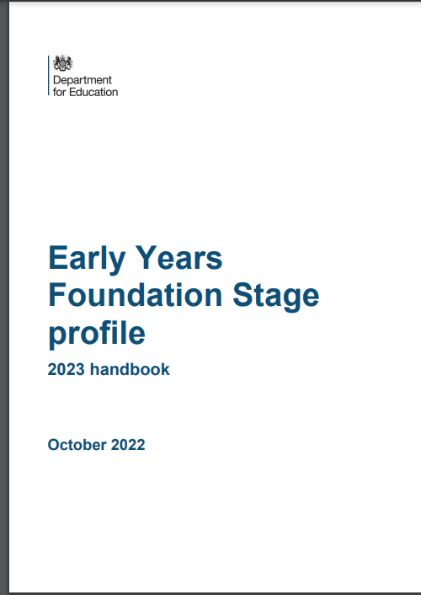
The Early Learning Goals
During the summer term Reception staff start the Foundation Stage Profile. During this time children are assessed against the 17 Early Learning Goals.
It is important to remember that:
  The ELGs are not a test. Staff will use what they already know about a child to make their decisions.
  These assessments are used to help Year 1 staff plan next steps for children as they move into Year 1

