Slide 1
Resilience
Meeting for parents

Slide 2
https://www.youtube.com/watch?v=07d2dXHYb94

Slide 4
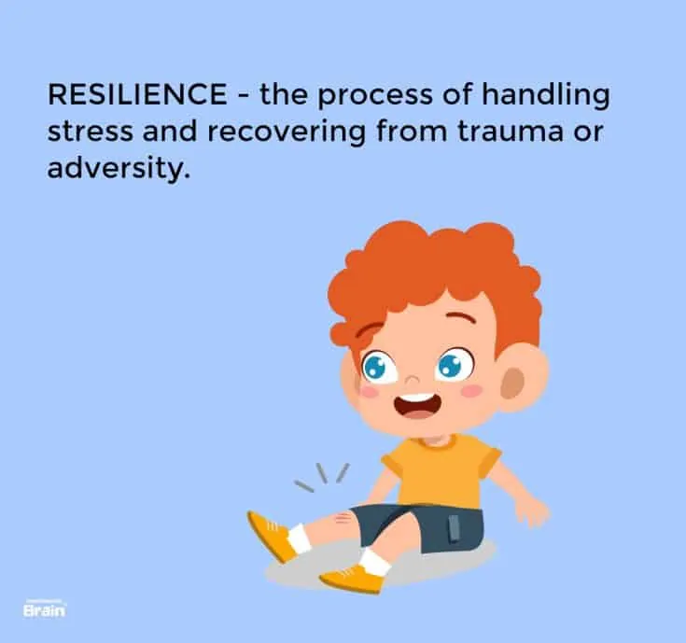

Slide 5
A resilient child is…

Slide 6
A resilient child is…

Slide 7
A resilient child is…

Slide 8
A resilient child is…

Slide 9
A resilient child is…

Slide 10
A resilient child is…

Slide 11
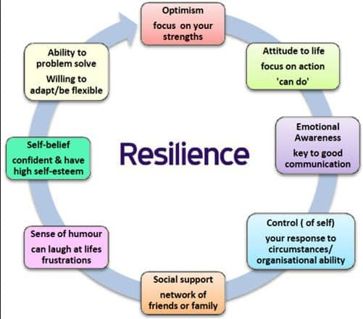

Slide 12
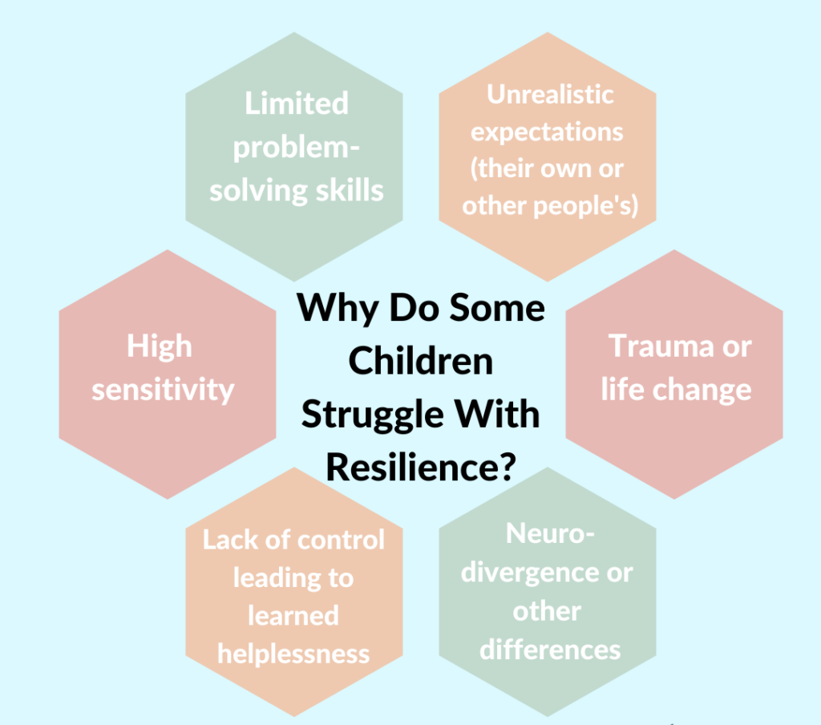

Slide 13
They have limited experiences when dealing with difficulties, set backs and small conflicts

Slide 14
What happens when children do not have resilience?
Figures released by NHS Digital show a worrying rise in young people’s mental health problems; sadly, my experience as a GP confirms this. One in eight children aged between five and 19 in England has a diagnosable mental health condition; the prevalence of emotional disorders, including anxiety and depression, has risen by 48% since 2004. “The pressures young people face range from school stress, bullying and worries about job and housing prospects, to concerns around body image,” says Emma Saddleton, helpline manager at the charity YoungMinds.
The Guardian 2019

Slide 15
While we may not be able to remove all these challenges, we can pass on skills to help young people cope with stress and adversity. “It’s what’s known as resilience,” Saddleton says. “The ability to overcome difficult experiences and be shaped positively by them.” Our brains respond to the information around us, so resilience can be taught, modelled and nurtured at any age. “By doing this, through strong support networks and encouraging communication, we can help young people understand when they feel down and know what they can do to make themselves feel better,” she adds.

Slide 16
How can you help your child?

Slide 17
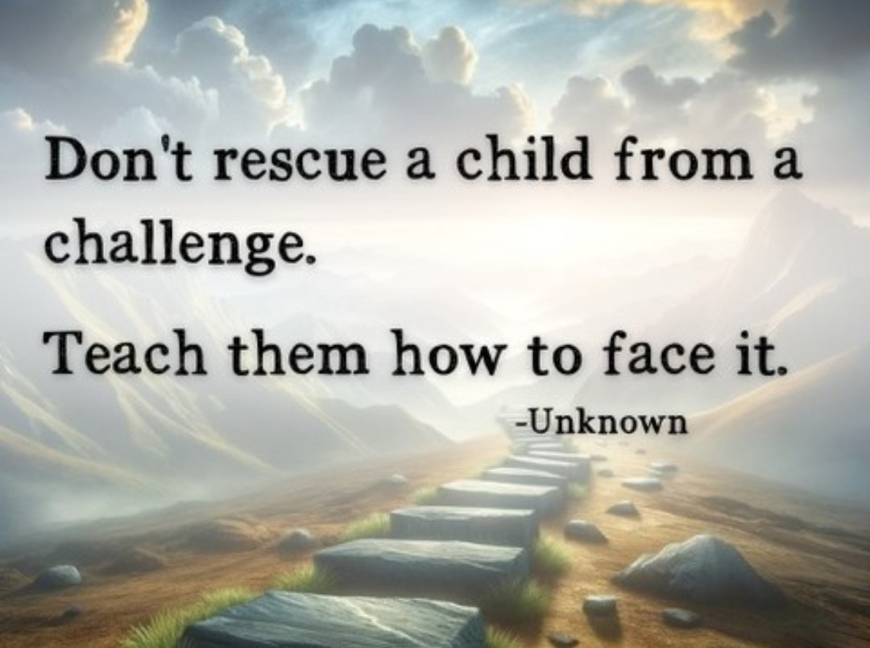

Slide 18
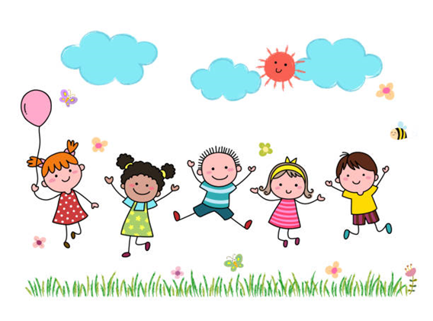
Build positive relationships
Help them to strengthen and build positive relationships with their friends and other adults. This will help them to understand, think and communicate with others, as well as contribute to social and emotional development.
Give them space to spend quality time with their network of friends and loved ones.

Slide 19
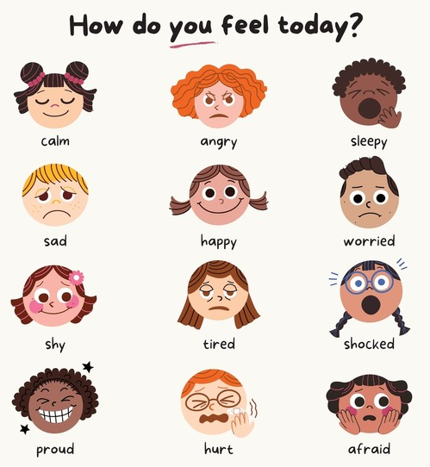
Build Emotional Awareness
Encourage them to understand, express and manage their emotions. Children who learn to handle their emotions tend to have better physical and emotional health, do better at school and get on better with friends. Let them know it is ok for them to seek help and support too if they need this.

Slide 21
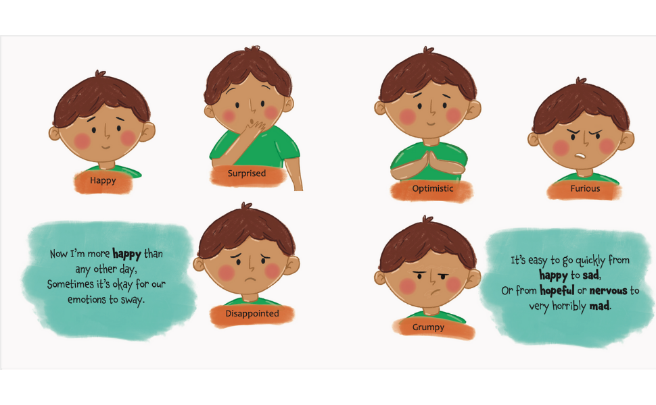
Let your children feel a range of emotions

Slide 22
Build Independence
Help them learn to be independent in their actions and thoughts. This will help to develop their confidence, self efficacy and self-esteem. It will also boost motivation and help them to work through challenges.

Slide 23
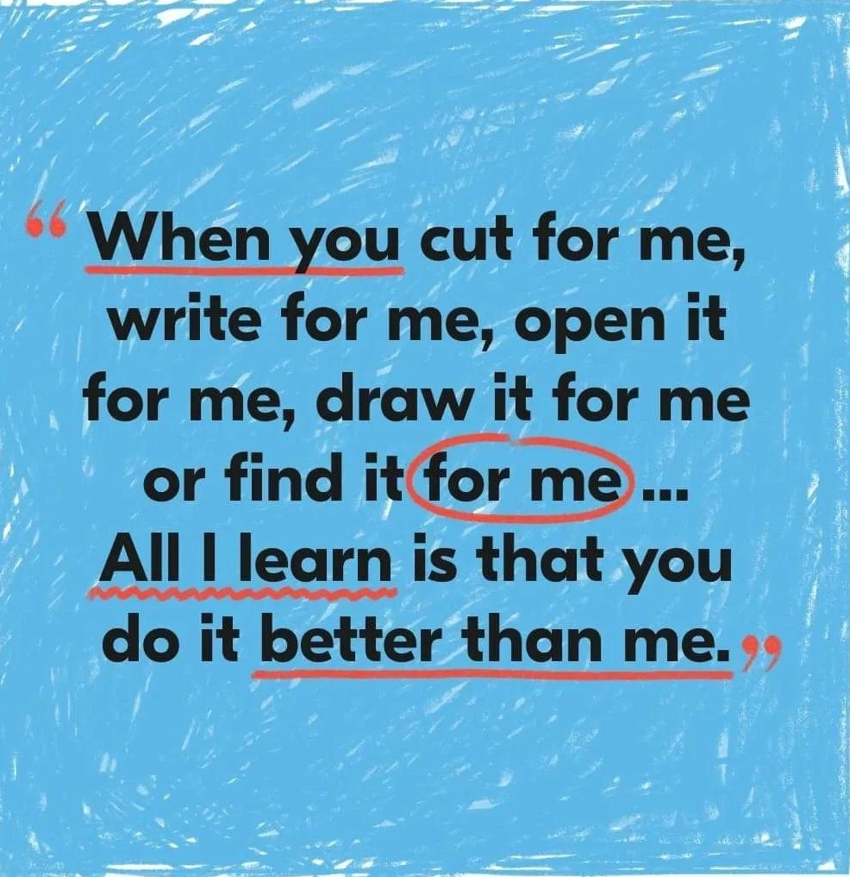

Slide 24
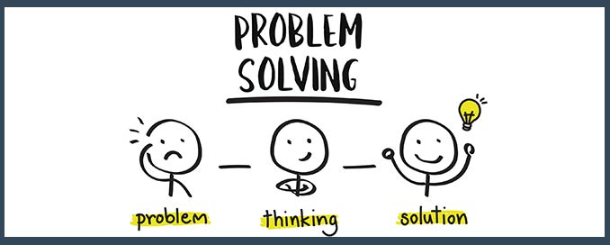
Build problem-solving skills
Encourage them to learn problem-solving skills as that is key to building resilience. No matter what the situation or issue is, there is always a resolve for it.

Slide 26
Let them fail or lose!
Resilience is all about being able to cope when things don’t go the way you expected them to or the way you wanted them to.
Resilience is all about being able to pick yourself up and carry on!

Slide 27
How are we helping the children to develop their resilience at school?

Slide 30
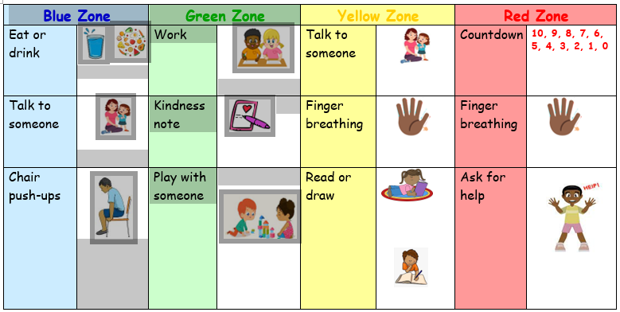
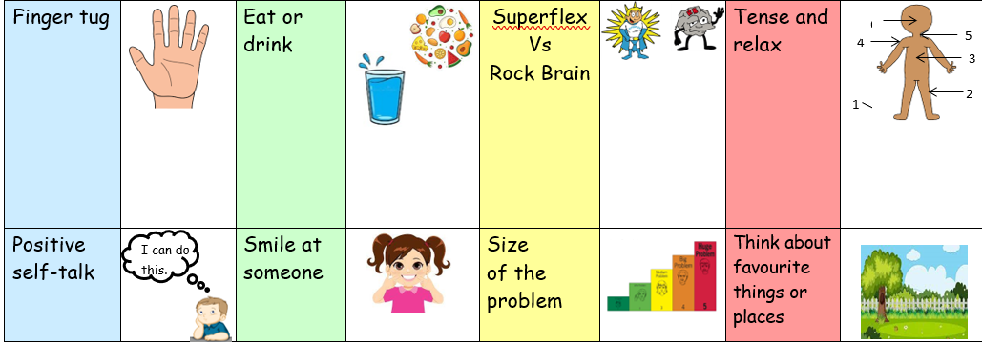

Slide 31
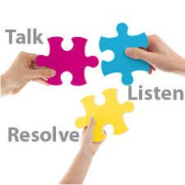
Restorative Approach
Through restorative conversations, the children fix the problem themselves

Slide 32
Mrs Puzey’s Resilience sessions

Slide 33
Resilience builds confidence and helps children feel more capable next time a problem comes up
In our sessions, we looked at ways to build resilience and what being resilient meant.
We also discussed the importance of relationships and belonging, places where we feel valued and safe.
The children drew maps of the school and marked out areas where they felt safe and had a sense of belonging. Together as a group we looked at what made these areas a safe place.

Slide 34
Resilience sessions
Understanding emotions and developing strategies and tools - how we feel scenarios & emotions pallet
Managing big feelings and emotions
Sitting with feelings and knowing that we can experience these emotions and that they will not last forever - body mapping, 5 steps for daily check in
Reframing struggles as opportunities to grow and think through challenges, brainstorm solutions, and seek help when needed
Reframing mistakes, mistakes happen to everyone sometimes, they are opportunities to learn and proof that you are trying
Positive self talk gratitude jar
Problem solving

Slide 35
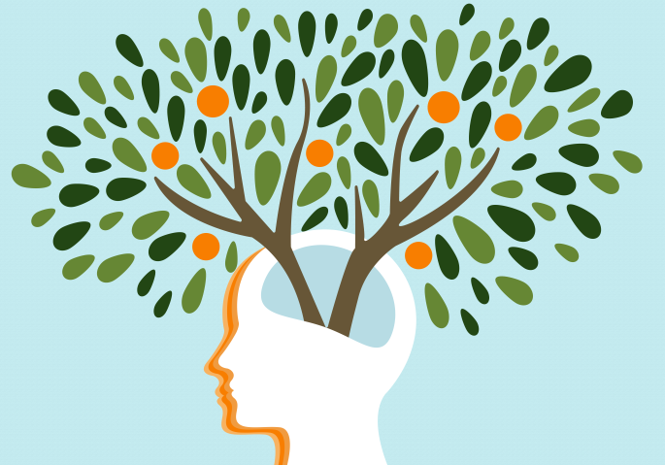
Growth Mindset
A set of beliefs or a way of thinking that determines one's behaviour, outlook and mental attitude. Carol Dweck professor of psychology at Stanford university identified 2 types of mindset in her research. We looked at how the two types growth and fixed differ and how the brain can grow and strengthen in response to challenges

Slide 36
Growth Mindset
A person with a growth mindset believes they can improve their knowledge, skills and talents if they work hard and try new things.
If you have a growth mindset you may say things like:
I’m going to figure this out
Is this my best work?
Mistakes help me learn better
I can always improve

Slide 37
Fixed Mindset
A person with a fixed mindset lacks confidence in learning and believes that they cannot improve on current knowledge, skills and talents.
A person with a fixed mindset might say things like:
I will never understand
I’m not good at this
I’m not good enough

Slide 38
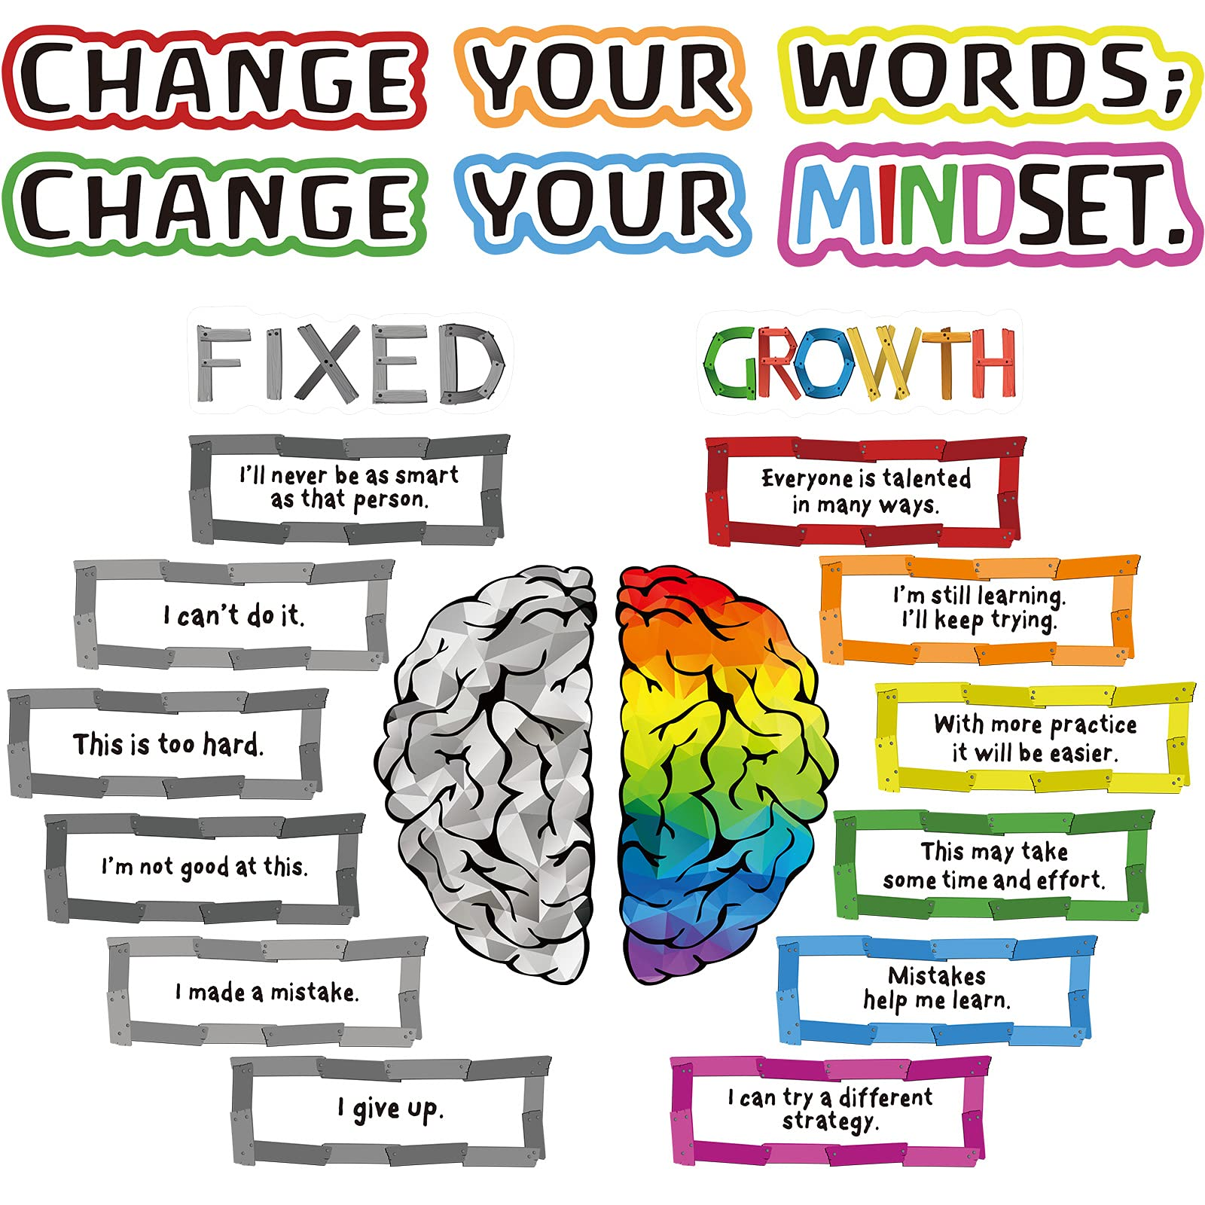
Fixed Mindset Growth Mindset
We looked at alternative phrases that reflect a growth mindset, switching from a fixed mindset to a growth mindset with the power of" YET" not giving up until we get there

Slide 40
A person with a growth mindset:
Is more motivated to learn Has greater confidence Embraces new challenges Is more persistent Listens to feedback Believes they can grow and change Develops a sense of achievement
Thinks positively

Slide 41
Assemblies

Slide 42
Erika loves dancing and joins a new dance club. In the first lesson, she finds it really difficult. What should she do?

Slide 43
It is the class assembly and Rosa has a leading part. She is feeling nervous.
Does she:
Ask the teacher to change her part
Rehearse every day until she knows it inside out
Remind herself not to worry and that it will all be okay on the night

Slide 44
Amir scores an own goal at playtime and the team is annoyed at him. Does he:
Leave the game
Keep playing and try his best because everyone makes mistakes
Offer to play in goal instead
Have an argument with his team. Tell his parents that his team argued with him and ask his parents to speak to his teacher at school.

Slide 45
Irfan is losing in a computer game against a friend.
Does he:
Give up and only play against people he can beat next time
Have a rematch but as k his friend to share some of their tips for playing better
Play by himself to practise

Slide 46
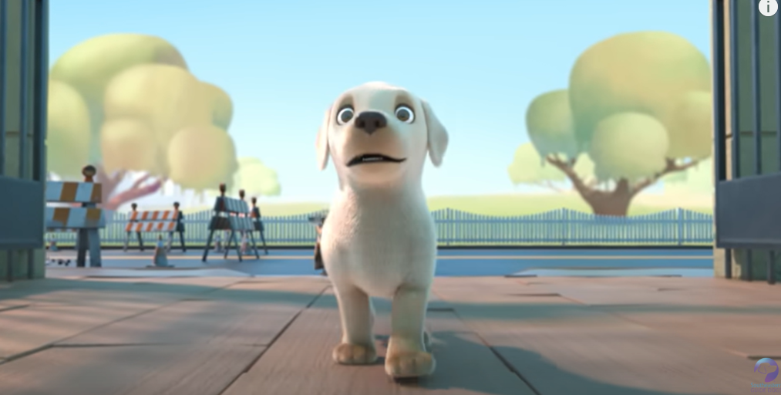
Think about a time when something went wrong for you.
What happened?
How did you feel?
What did you do?
Were you resilient?
Was Pip resilient?

