Slide 1

Transfer to Secondary School September 2024

Slide 2

Choosing a school
Have you
started
looking
at schools
yet?

Slide 3
Choosing a school
How do I know which school is right for my child?
Who can help me make that decision?

Slide 4
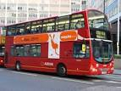
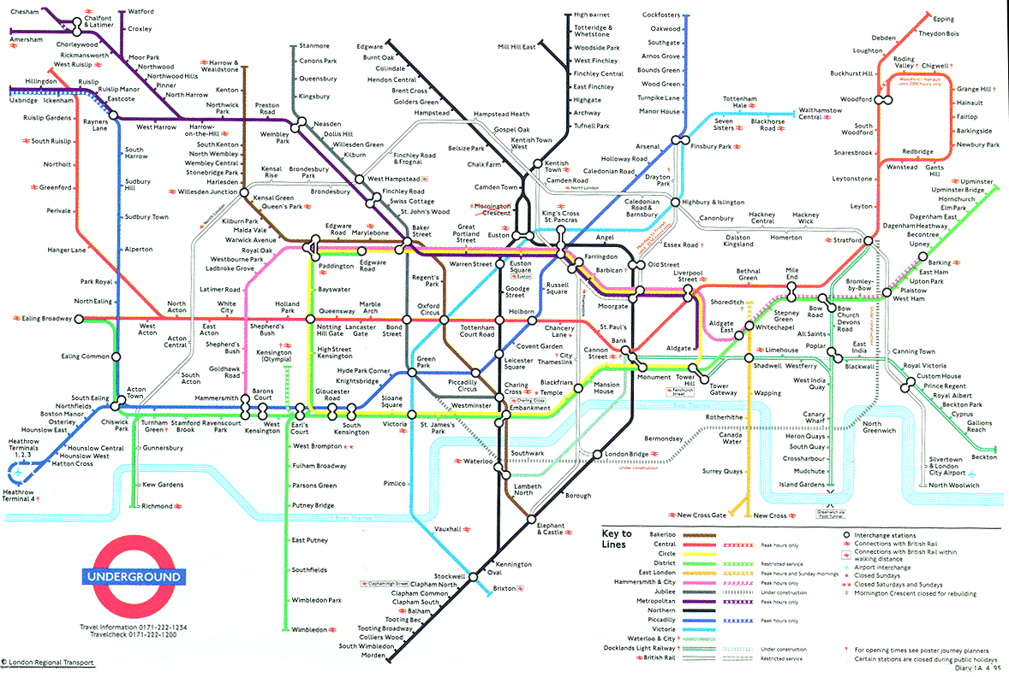
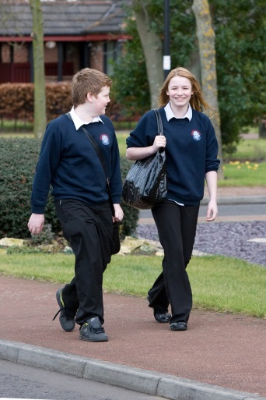
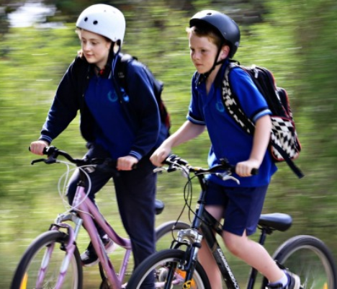
Choosing a school
Talk to your child
  find out what they want
  consider how they will travel to school

Slide 5
Choosing a school
Visit the schools
Attend open evenings
Talk to the teachers
Talk to the pupils

Slide 6

Choosing a school
It will have detailed information about:
Read the school prospectus
    how the school is run
    which subjects are taught
    the admissions criteria
The prospectus will be available at the open evenings.
You can also download from the school website.

Slide 7
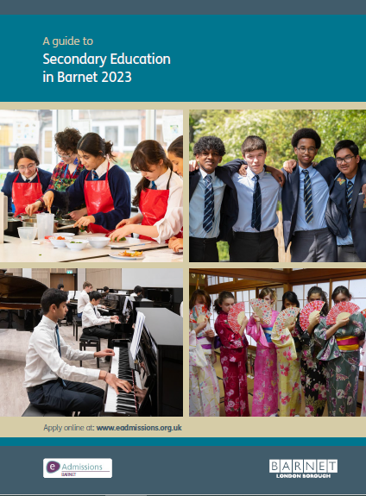
Choosing a school
Read the secondary education guide
(published by your home local authority)
The 2024 guide will be available online, in September 2023
Download Barnet’s guide from the Local Authority’s website

Slide 8

Choosing a school
Talk to the Customer Service Team
  the team can offer you advice and answer your questions
  how do I contact them?
    tel: 020 8359 7651
    Contact Us online
If you live outside Barnet, visit your Local Authority’s website

Slide 9


Choosing a school
Look at performance information online
the latest Ofsted reports are available from the Ofsted website www.ofsted.gov.uk
achievement and attainment tables are available at www.gov.uk/school-performance-tables

Slide 10

Choosing a school
Look carefully at the admission criteria for each school
  selection by aptitude
  faith criteria
  siblings
  distance
Remember most schools get more applications than they have places available.………

Slide 11
Choosing a school
Geographical distance for most schools that were unable to offer to all applicants
Name of School | Furthest distance offered (Miles)
Archer Academy | 0.255 (N2) 0.992 (N3) 1.062 (NW11)
Ark Pioneer | 1.409
Ashmole Academy | 0.517
Christ College, Finchley | 1.109
The Compton School | 0.744
East Barnet | 1.072
JCoSS | 1.749
London Academy | 2.099
Mill Hill High | 1.343
Queen Elizabeth’s Girls’ | 3.141
Saracens High | 0.915
The Totteridge Aacdemy | 1.646
Wren Academy | 0.247
Full Secondary 2023 Allocation Table can be viewed at:
https://www.barnet.gov.uk/schools-and-education/school-admissions/apply-secondary-school/transferring-secondary-school

Slide 12


How do I apply?
How soon can I apply?
  The application process begins on
  1 September 2023
Where do I apply?
  apply online at www.eadmissions.org.uk

Slide 13
How do I apply?
How many schools can I apply for?
Can I apply to schools outside Barnet?
  You can apply for up to six schools
  You must rank the schools in your order of preference
  It is important to think carefully about the order as you will not be able to change it after the closing date
Yes, you should include all your preferred schools, whether inside or outside the borough where you live

Slide 14
How do I apply?
Choosing school preferences sensibly
if you only list one school, it will not increase your chances of getting a place at the school and your child will be considered for that one school only
if this is unsuccessful, you may miss out on an offer which could have been made at another school which may no longer be available
it is important to make realistic school choices to avoid disappointment
check how places were offered last year, but remember the cut-off distances are just a guide and will change every year
just because you live nearer to the school than the last child offered a distance place last year, it doesn’t mean your child is guaranteed a place.

Slide 15

How do I apply?
Do I need to fill in any other forms?
All voluntary aided schools and some foundation schools, free schools & academies will ask you to complete a Supplementary Information Form (SIF)
  the SIF will ask for additional information, for example
    faith schools will ask about church attendance and require a priest’s reference
    selective schools may ask about any medical condition that needs to be taken into account at the test and they may also require a photograph
  Jewish schools will also ask you to complete a Certificate of Religious Practice (CRP), which must be signed by a Rabbi
  SIFs and CRPs must be returned to the individual schools

Slide 16
How do I apply?
What else do I need to provide?
  Proof of address
  your child’s main address must be used on the application form
  you must not use a temporary address or an address of convenience, such as a child minder’s address, a business address or the address of a relative or friend
  if you own a property previously used as a home address and apply from another address, the second address may be treated as an address of convenience
  if you have moved within the last two years you may be asked to provide proof of the new address and proof that you have disposed of the previous property
  any address suspected of being used to gain advantage of securing a place at a preferred school, will be investigated and may be rejected.

Slide 17
Fraudulent addresses
Each year a small number of parents provide a false address to get a school place
In doing so they could be depriving your child of their rightful place
Providing false information is a criminal offence
If you know someone who intends to use a false address, you can report this in confidence
Report it online to the Corporate Anti-Fraud Team at www.barnet.gov.uk/anti-fraud
call the fraud hotline on 020 8359 2007

Slide 18

Selection Tests
Schools must give parents the test results before the closing date for applications
  applications to sit the tests should be made directly to the individual school

Slide 19
Selection Tests
When will the tests be held?
  Selection tests for Barnet schools (Ashmole Academy, Friern Barnet, The Henrietta Barnett, Mill Hill County High, Queen Elizabeth Boys’, St Michael’s Catholic Grammar), will be held from May to September 2023
  Banding tests (St Mary’s & St John’s CE, Hendon) are likely to be held in October / November 2023 (dates to be confirmed)

Slide 20
Selection Tests (Barnet Schools)
(please check individual school websites for updated information)
School | Test | Deadline to apply (2023) | Test date (2023)
Ashmole Academy | Musical Aptitude | Fri 26 May | Sun 11 June
 | Musical Auditions |  | Tues 4 to Thurs 6 July
Friern Barnet | Enhanced Arts Programme | TBC | Please check school website
The Henrietta Barnett | Academic Selection Test (Round One) | Fri 14 July (5pm) | Mon 4 and Tues 5 September
 | Academic Selection Test (Round Two) |  | Mon 2 October
Mill Hill County | Technology Aptitude Test | Fri 12 May (3pm) | Sat 9 September
 | Music Aptitude Test |  | Sat 10 , Sat 17 and Sun 25 June; Sun 2 July
 | Dance Aptitude Test |  | Sun 18 June and Sat 1 July
Queen Elizabeth Boys | Academic Selection Test | Fri 14 July (12pm) | Wed 20 and Thurs 21 September
St Michael’s Catholic | Selection Test | Tues 4 July (4pm) | Fri 15 September

Slide 21
Selection Tests (Other Boroughs)
(please check individual school websites for updated information)
School | Test | Deadline to apply (2023) | Test date (2023)
Dame Alice Owen’s (Hertfordshire) | Musical Aptitude Test (Part 1) | Thurs 9 Jun (5pm) | Mon 4 Sep
 | Music Aptitude Test (Part 2) |  | W/c Mon 25 Sep
 | Academic Selection Test (Part 1) |  | Mon 4 Sep
 | Academic Selection Test (Part 2) |  | Sat 23 Sep
The Latymer (Enfield) | Academic Selection Test | Fri 16 Jun | Fri 1, Sat 2 and Sun 3 Sep

Slide 22

Closing Date?
The closing date is 31 October 2023
  The online system will close at 12 midnight on 31 October

Slide 23

Late applications
What happens if I miss the deadline?
  Late applications will not be considered until after all ‘on time’ applicants have been offered a place
  if there is an exceptional reason for a late application, it may be treated as on-time
  you must let the Admissions Team know your reason by Friday 12 December 2023.

Slide 24
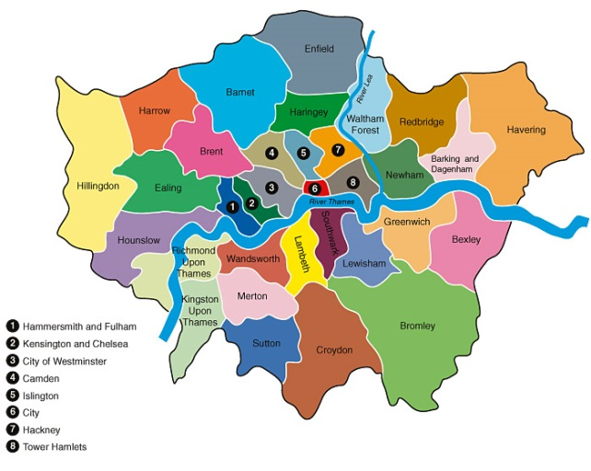
What happens next?
Co-ordinated admissions
  all 33 London boroughs and surrounding county councils are included in the co-ordinated admissions process
  application lists are exchanged
  offer lists are drawn up
  offer lists are exchanged

Slide 25
What happens next?
How will places be allocated?
  If the school receives more applications than places available, the published admissions criteria will be applied to decide who can be offered a place
  each school listed on the application form is equally considered against the school’s admissions criteria regardless of the preference order
  your ranking order is not passed on to the individual schools.

Slide 26
Offers
Will I be offered more than one school place?
  All children will be offered one school place
  if your child qualifies for more than one school place, you will be offered the school which you ranked higher on your application form
  any school ranked lower than the one you have been offered will automatically be withdrawn and offered to another child.

Slide 27
Offers
Are there enough school places available?
  Yes
  the increased demand for secondary school places was expected
  Barnet has planned for the additional places needed
  every child will be provided with a school place
  it may not always be possible to offer a preference school.

Slide 28
Offers
National Offer Day is
Friday 1 March 2024
You will receive an email with the outcome of your application during the evening of 1 March
You can then login into your eAdmissions account for further information

Slide 29
Offers
Accepting offers
places must be accepted or declined online by Friday 15 March 2024

Slide 30
No Preference Offer?
What happens if I don’t get any of my preferred schools?
Their name will remain on the waiting lists for your selected schools
You will have the right to appeal
Your child’s name can be added to additional school waiting lists
Your child will be allocated a place at school with a vacancy

Slide 31
Appeals
Every parent has the right of appeal
Appeals are heard by an independent panel
You will have the opportunity to present your case in person
You will need to convince the panel that your child’s needs are more important than the school’s need to limit the admission number
Appeals are unlikely to be successful unless there are exceptional grounds

Slide 32
Transfer to Secondary School September 2024

