Slide 1
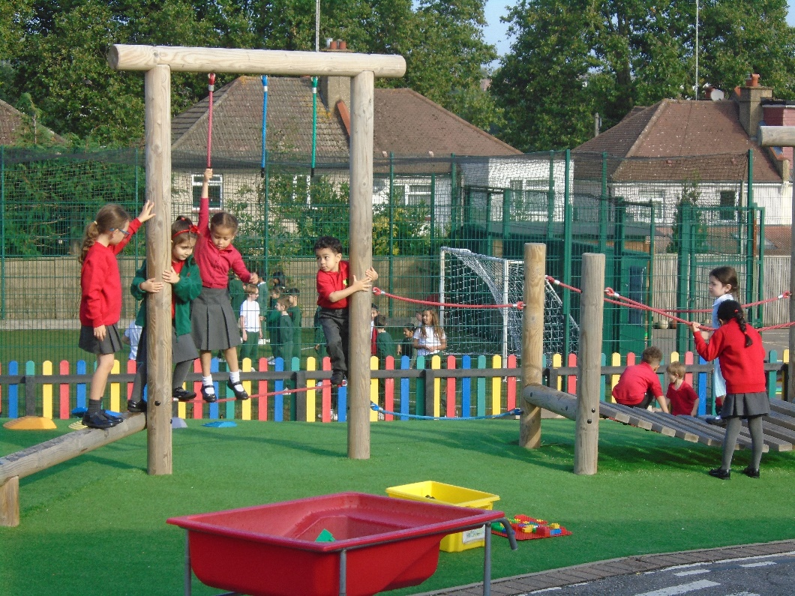
EYFS Curriculum at Holly Park School Meeting for Nursery and Reception Parents Wednesday 22nd September
This presentation aims to give an introduction to the new, updated Early Years Foundation Stage (EYFS) at Holly Park School. It includes information which we hope you will find useful .

Slide 2
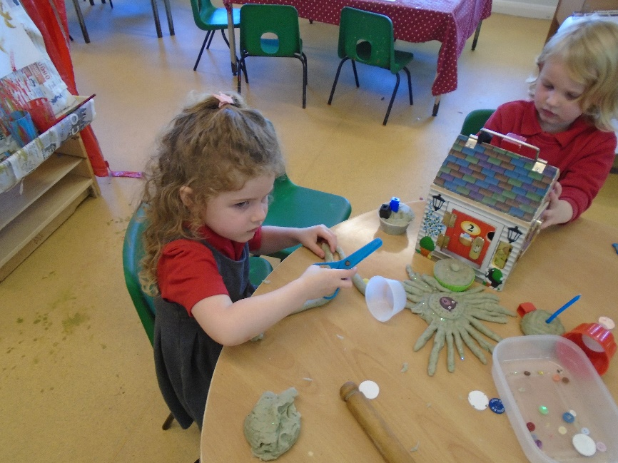
What Is the EYFS?
The Early Years Foundation Stage covers the first stage of a child’s care
from birth to five years old. It sets the standards to ensure that all children
learn and develop, as well as keeping them healthy and safe.
Also included in the EYFS are the seven Areas of Learning. They are:
Communication and Language
Personal, Social and Emotional Development
Physical Development
Literacy
Mathematics
Understanding the World
Expressive Arts and Design
At the end of the EYFS, there are 17 Early Learning Goals that children are expected to achieve.

Slide 3
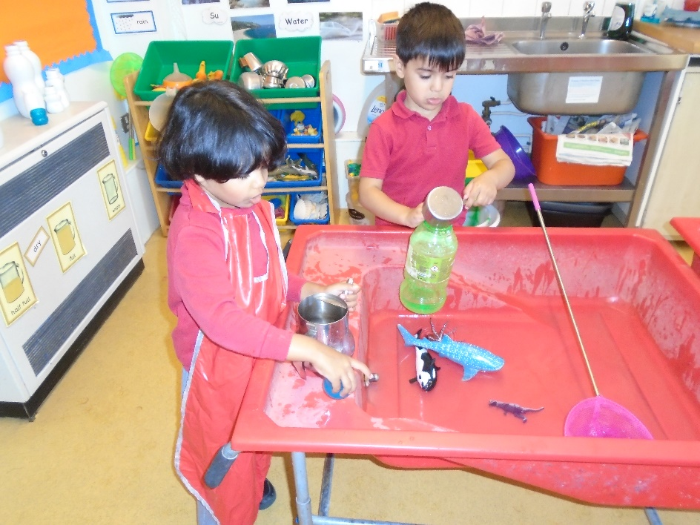
The Prime Areas are fundamental as they run through and support development and learning in all other areas.
Communication and Language
Personal, Social and Emotional Development
Physical Development

Slide 4
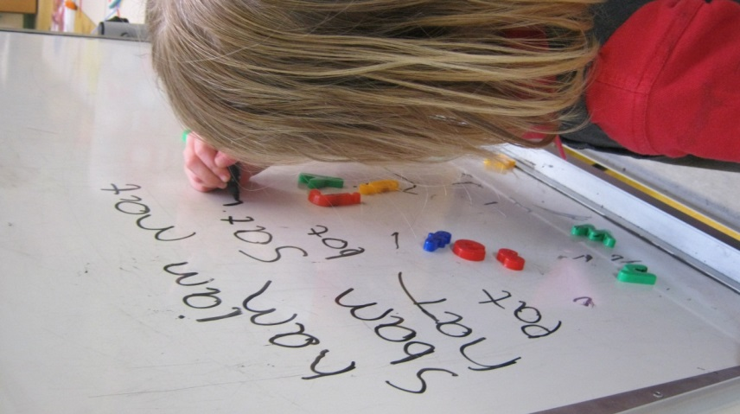
Assessment for Learning
adult observes the children
asks questions, challenges,
develops understanding,
supports thinking,
plans next steps
sees what they can do
thinks about what the child needs to do next

Slide 5
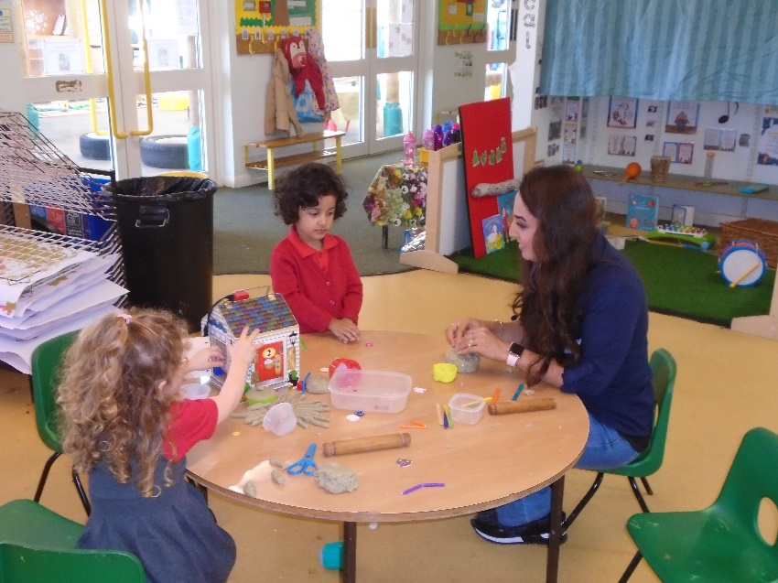
Some Key Changes to the EYFS
Reduced the amount of unneeded written recordings and assessment of children by staff.
This means staff do not need to keep a large amount of written evidence that proves children are able to do lots of things.
Staff still know the abilities and skills of each child, and know how to support them to develop. However, now they do not need to write this down unnecessarily.
This frees up more time for staff to spend directly with the children.
By taking away the need for constant recording, it helps to develop more natural play, conversations and interaction between adults and children.

Slide 6
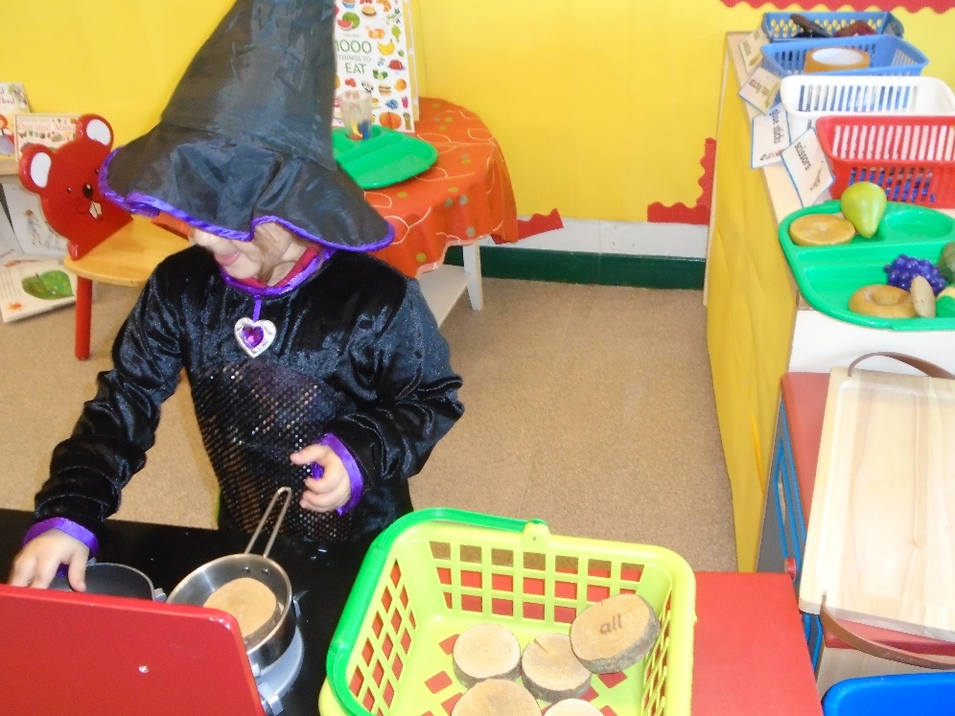
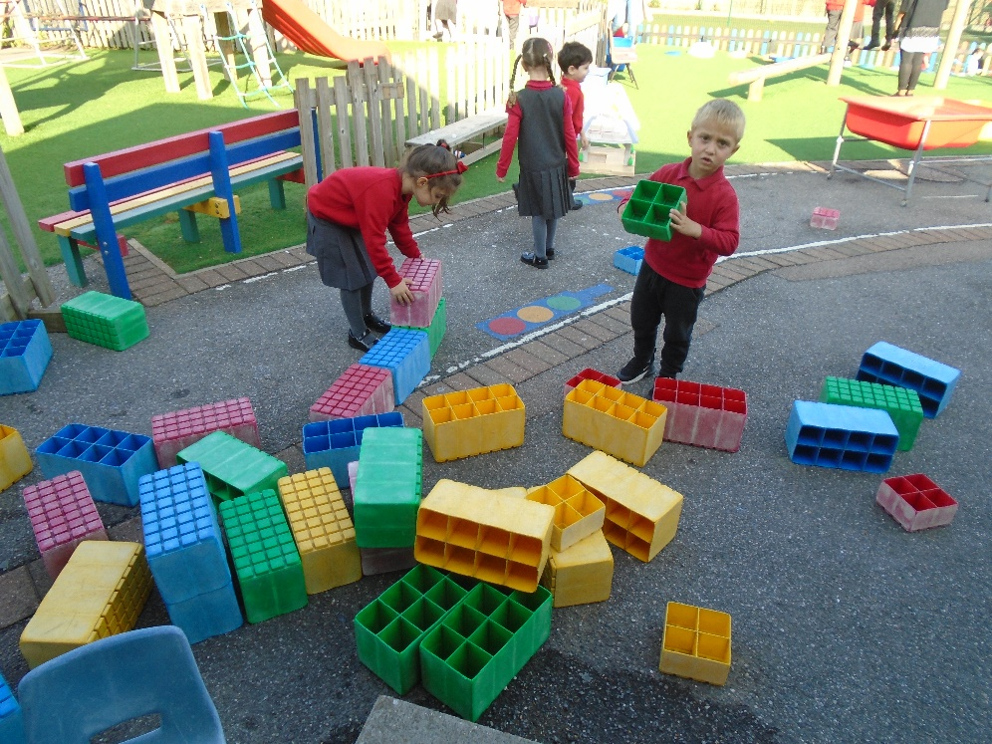
Play
Every child has the right to relax and play. (article 31)
Children need to play!
They need to practice their skills in a fun, hands on, practical way.

Slide 7
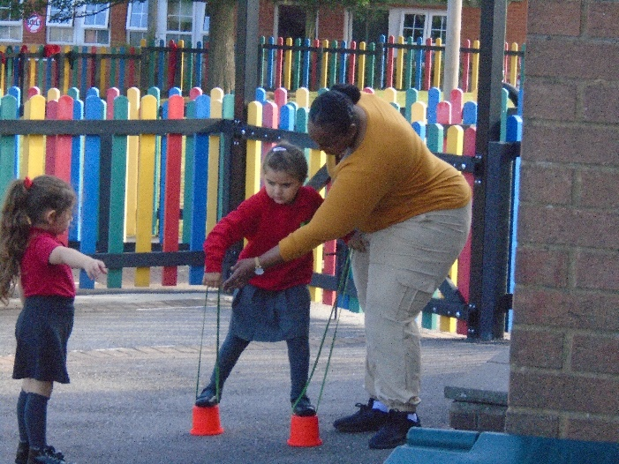
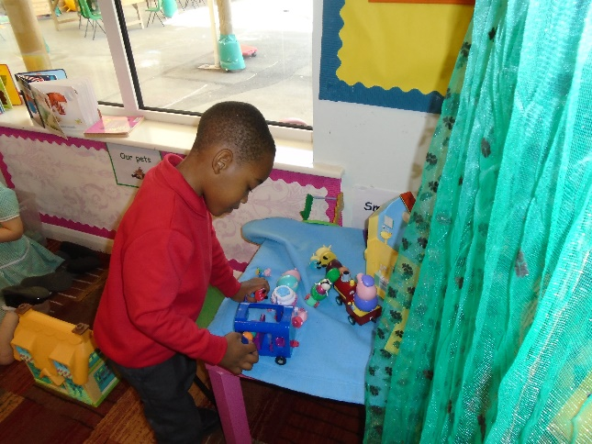
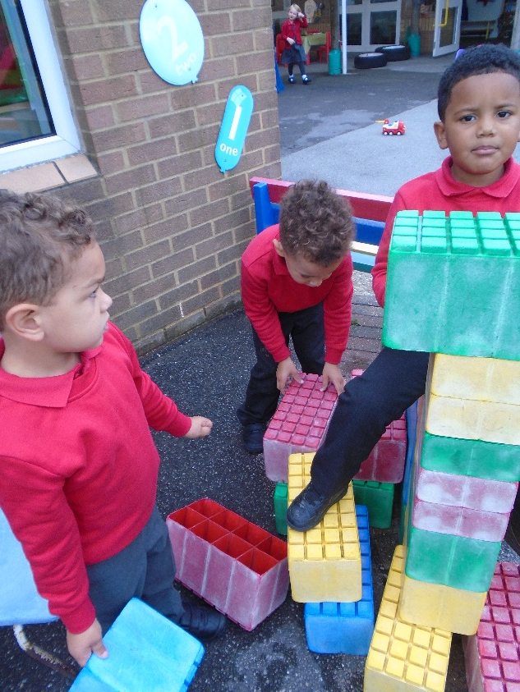
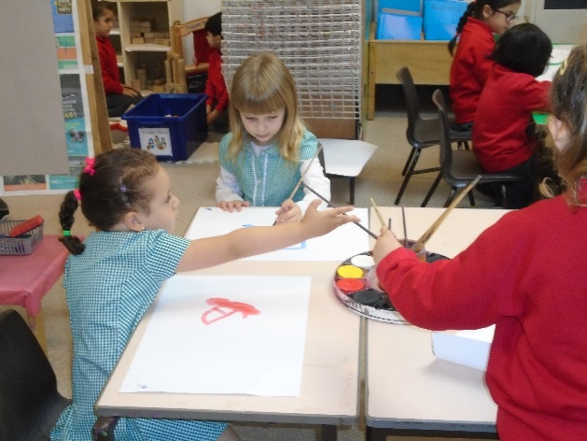
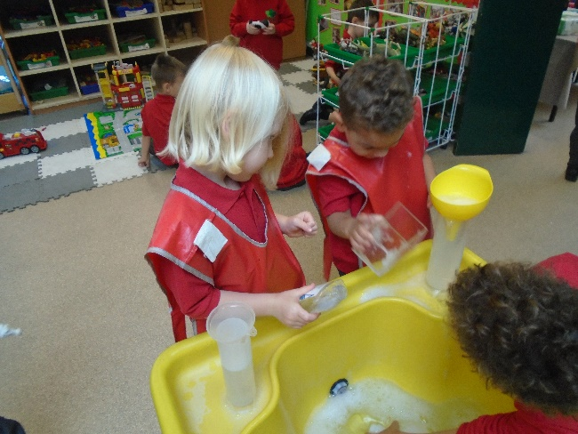
Learning in the EYFS
Working Independently
Learning Outside
Working with an Adult
Working and Playing with Friends
Learning Inside

Slide 8
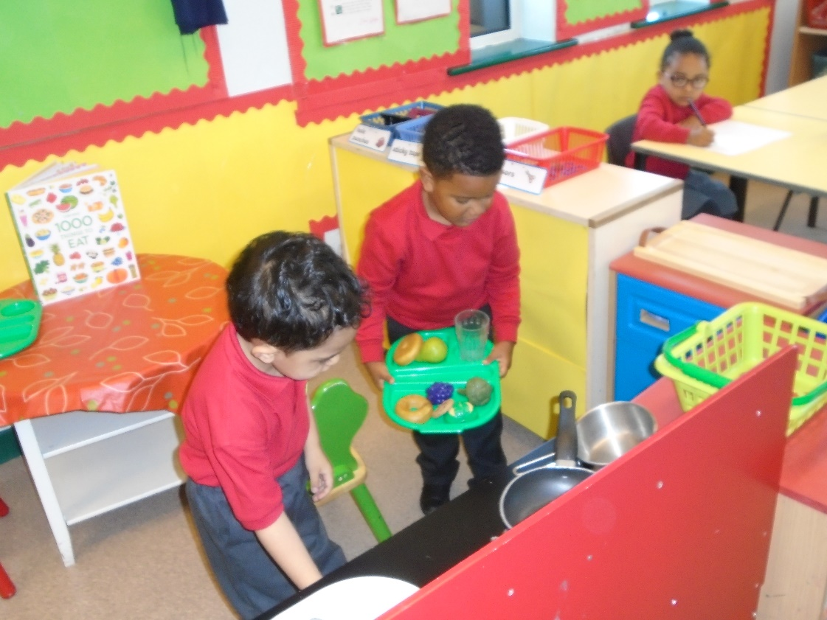
Learning Activities
Some Adult Led Activities
But mostly Child Initiated Activities through…
Water
Role play
Construction
Continuous Provision

Slide 9
Outdoor Play
Important part of the curriculum
Children go out in all weathers
Need for physical activity

Slide 10
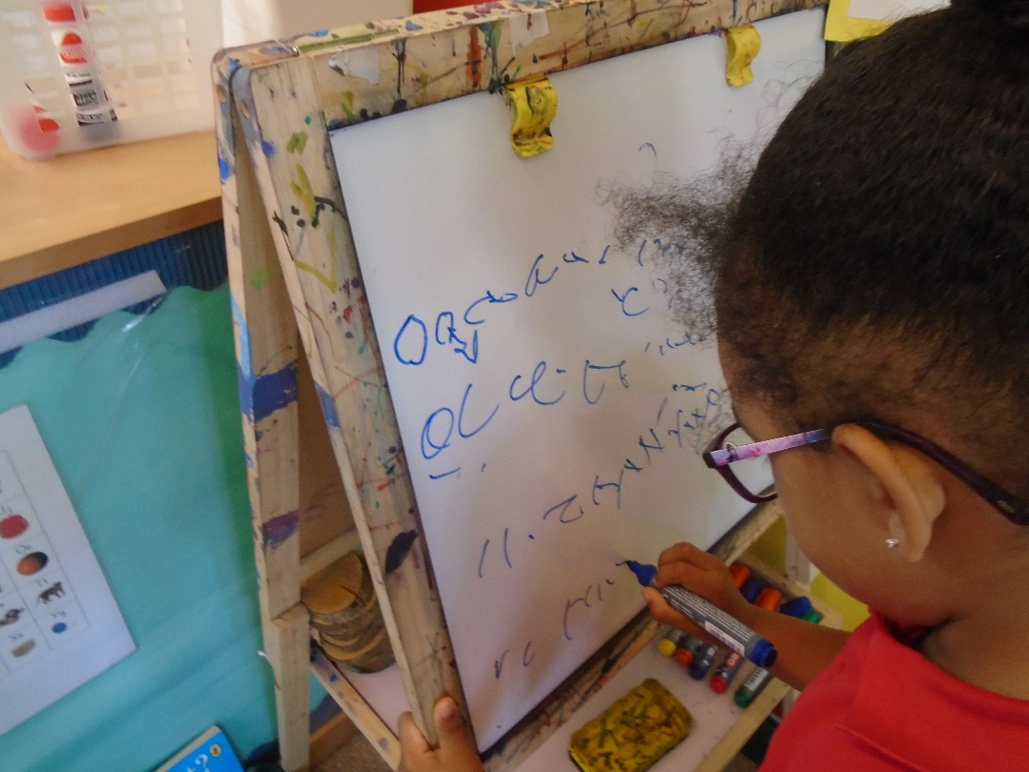
Parents as Partners
Parent Consultations
Urgent messages communicated
through the office

Slide 11
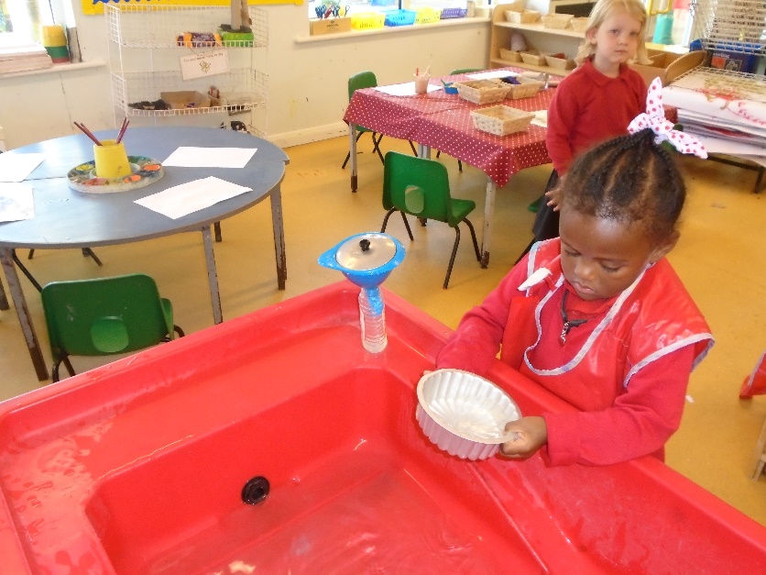
Helping Your Child to Play
Turn off the screens
Think about limiting the choice of toys available
Play with your child
Talk about what you are doing
Be fair, they need to learn to win and lose
Read lots of stories and sing rhymes and rhymes
Allow independent play
Get dirty!

Slide 12
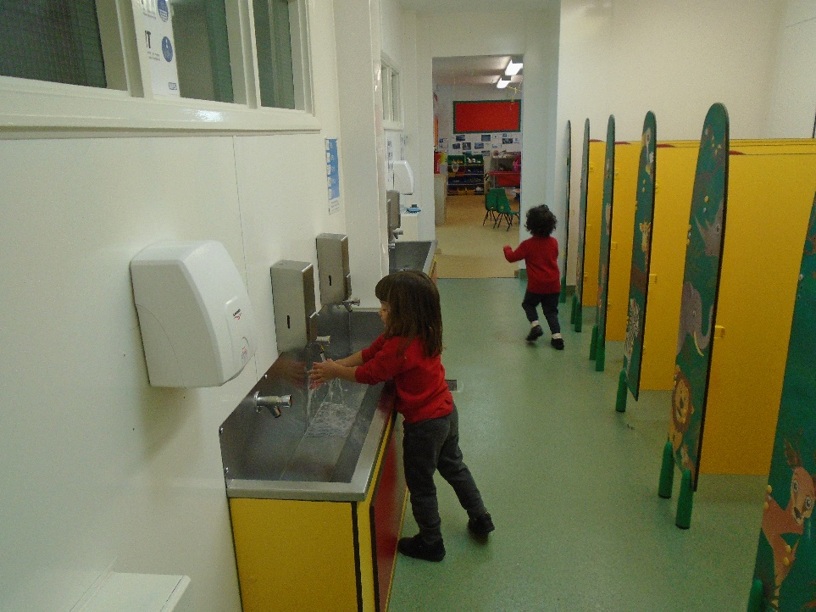
Developing Independence
Give your child simple chores
Ask your child to tidy away toys
Encourage your child to put on their coat by themselves
Teach your child to eat independently including scraping their plate
Teach them how to ask for help

Slide 13
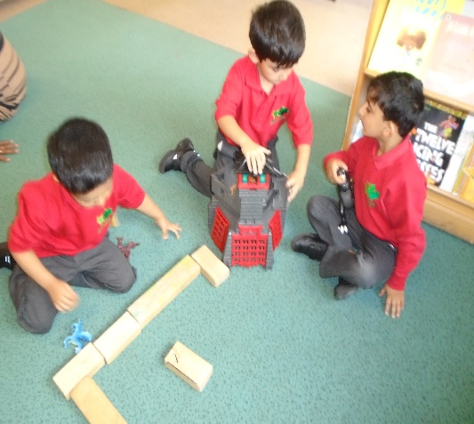
Developing Communication Skills
In the New EYFS Curriculum there is more of an emphasis on the importance of developing communication and language skills.
Children should be supported in building up vocabulary by increasing the amount of words they know and can use.
Encourage more conversations between adults and children, but also children and their peers.
Good language skills are the basis for all other learning and social interaction, so this is vital to focus on.
So at home you can…
Talk, talk and talk some more!
Think about how much of your talk is functional each day.

Slide 14
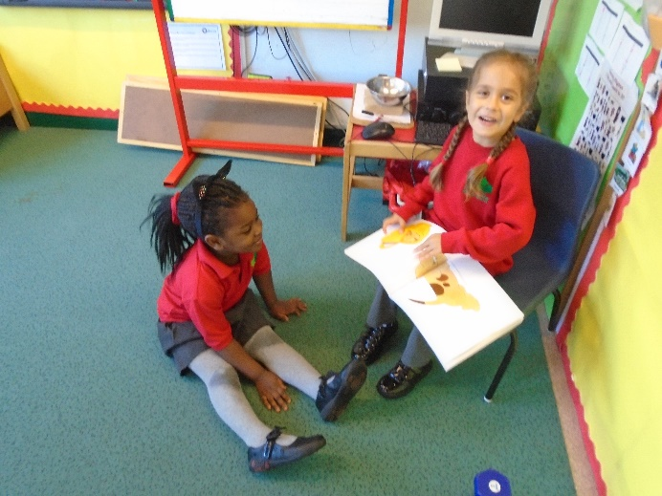
Developing Literacy Skills
The new EYFS curriculum has a real emphasis on the importance of reading stories to help children develop in all of Areas of Learning.
Daily reading of stories encourages an enjoyment of reading from a young age.
Lots of other learning opportunities happen when looking at books, for example comparisons of culture or the past.
Listening to stories develops imagination, ideas and language.
Reading is an essential skill and so should be shown to children, as well as practised by them regularly.
Children are also encouraged to use story ideas in their play.
So at home you can…
Be a reader, show how much you enjoy reading and how reading is a necessary part of your life.
Be a writer, show how much you need to write
WITH A PEN AND PAPER!

Slide 15
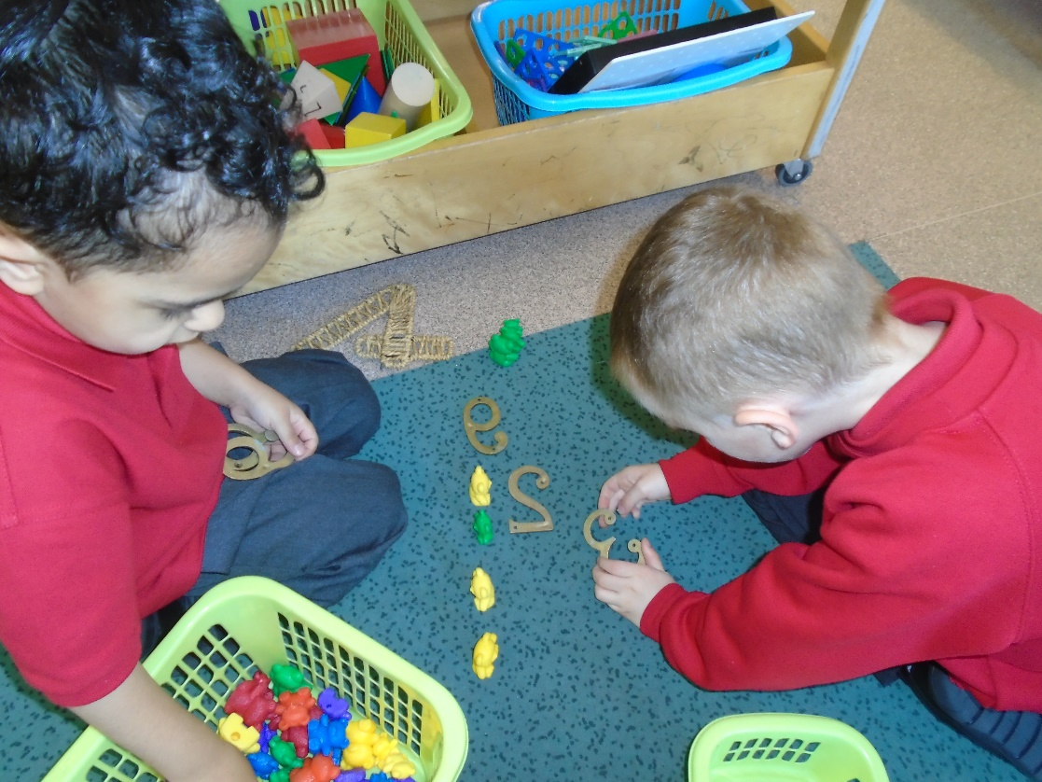
Developing Maths Skills
Talk about the maths you are using in your day to day life…
Telling the time
Weighing
Looking at the temperature
Finding door numbers
Using phone numbers

Slide 16
Healthy Lifestyles
There is a focus on encouraging healthy choices overall and an understanding of oral health.
Teach children the importance of brushing teeth. .
Focus on helping children to understand which choices to make that will help them to be healthy, for example which foods to eat and why.
Getting into good routines from a young age is important as these often continue into adult life.

Slide 17
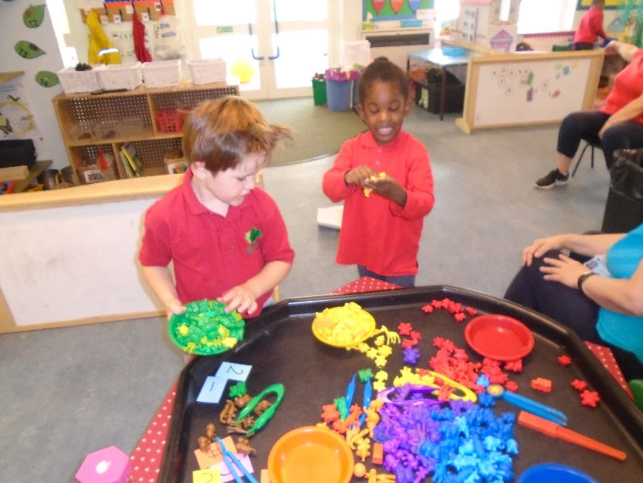
Changes to Informal Assessments
There have also been changes to a document called ‘Development Matters’.
This document is not compulsory but it can be used by staff to support them to understand child development in the different Areas of Learning.
Linked to this document change, children are no longer assessed against an age band. It’s now accepted each child develops in different ways, so the use of the age bands before did not fit everyone fairly.
Staff can now use their own knowledge of child development to decide each child’s next steps and support needs.
These changes allow more freedom for
adults to plan to the learning and interests
of the children in their class.

Slide 18
Overview of Changes to the Early Learning Goals
At the end of the reception year, children are assessed against the 17 Early Learning Goals.
It is important to remember that:
The ELGs are not a test. Staff will use what they already know about a child to make their decisions.
The ELGs are not the EYFS curriculum. They should not be used to be taught to, they are just an end point.
Changes have been made to the Early Learning Goals so that they are now clearer, easier to use and understand.
They have also been adapted to better match up with the national curriculum in year 1. This will help children to be better prepared for their move to the next key stage.
Exceeding judgements have also been removed. Children are now encouraged and challenged to have a greater depth and understanding of things before moving onto new learning.

