Slide 1
Online Safety Meeting – Y6 parents 12th January 2020

Slide 2
Why are we having this meeting now?
We are all relying on technology more and more, especially since COVID 19
To stay in touch with others
To do our jobs – have meetings
For children to learn – Google Classroom
For entertainment and relaxation – Netflix, games, streaming music

Slide 3
During Lockdown 1 everyone relaxed the rules

Slide 4
What happened when children returned to school?

Slide 5
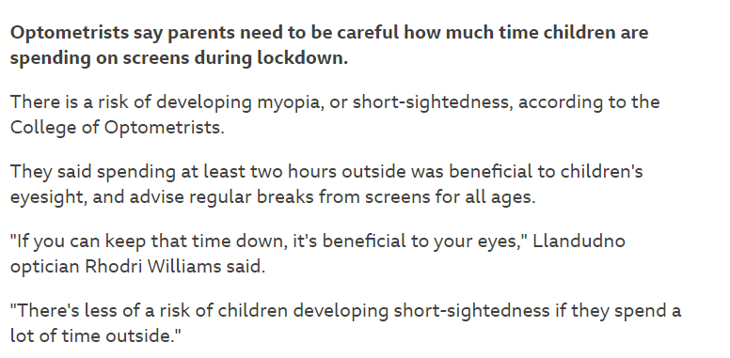

Slide 6
Applications: The Evolving Landscape!

Slide 7
Staying Safe on Social Media
Consider your privacy settings.
Think carefully about location settings.
Keep personal info personal.
Once posted, always posted.
Create at atmosphere for two-way communication.

Slide 8
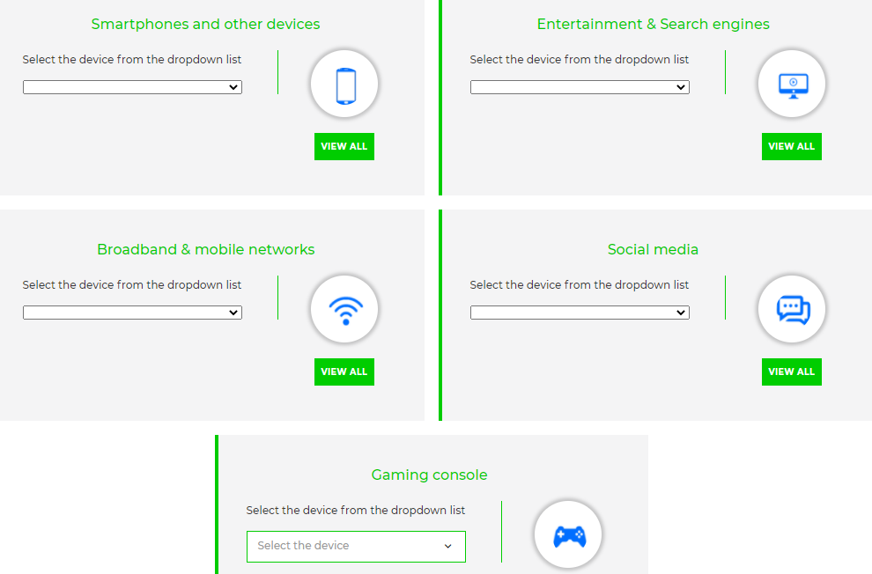
What Can You Do From Home?
https://www.internetmatters.org/parental-controls/

Slide 9
Family Rules!
You may be unpopular but safety comes first!!!
Set a limit on screen time
Sync your child’s phone to yours
Check their phone regularly
Check that the material they are accessing is age appropriate eg TikTok is for 13+
Who are they talking to?
Model good screen time yourself

Slide 10
Family Rules!
All devices should be in a shared room in the house
Ask yourself if your child really needs a phone
Really Important – no phones and access to the internet in their bedrooms at night!!

