Slide 1
While we are waiting….
Changing one letter at a time can you
get from
FOUR to FIVE?
F
O
U
R
Change one letter at a time
How many moves?
F
I
V
E

Slide 2
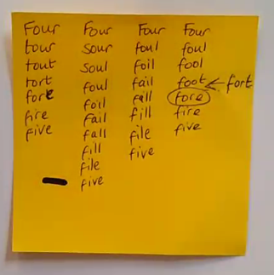
While we are waiting….
Changing one letter at a time can you get from
FOUR to FIVE?
F
O
U
R
Change one letter at a time
How many moves?
F
I
V
E

Slide 3
Mathematics
Parents Workshop
Year 4

Slide 4
Aims of Today’s Session
To get an understanding of the Year 4 Math curriculum.
To get an insight into how Math is taught at Holly Park.
To take away some ideas to support your children at home.

Slide 5
Key aims of the Maths Curriculum
Fluent recall of mental maths facts e.g. times tables, number bonds. Etc.
To reason mathematically – children need to be able to explain the mathematical concepts with number sense; they must explain how they got the answer and why they are correct.
Problem solving – Routines and non- routine problems. Applying their skills to real-life contexts.

Slide 6
Mastery
‘A mathematical concept or skill has been mastered when through exploration, clarification, practice and application over time, a person has the mathematical language to be able to communicate related ideas and think mathematically with the concept so that they can independently apply it to a totally new problem in an unfamiliar situation.’
Helen Drury ‘ Mastering Mathematics’
Oxford University Press 2014 page 9

Slide 7
Math Curriculum
The Math curriculum is divided into 8 strands
Number and Place Value
Addition and Subtraction
Multiplication and Division
Fraction and Decimals
Geometry – Shapes and Angles
Geometry – Position and Direction
Measurement – including Time and Money
Statistics

Slide 8
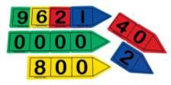
Number and Place Value
Place value is at the heart of the number system. All digits have a value and a secure understanding of this will enable children to use and understand different calculation methods.

Slide 9
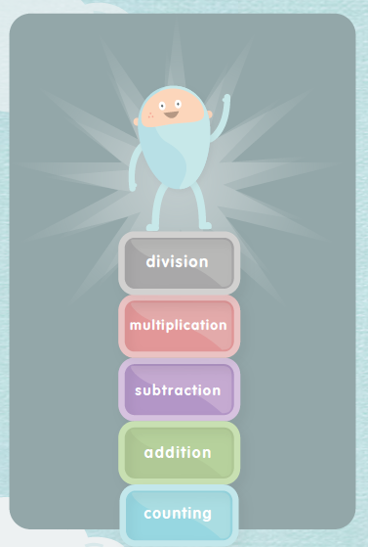
Building on concepts
Maths is a hierarchical subject so learning a new concept often relies on a sound understanding of what came before.
Division for example it relies on understanding multiplication. If a learner doesn’t really understand an important concept it can impact later and when things are particularly shaky it can result in collapse in confidence which can be hard to fix.

Slide 10
Number and Place Value
Year 4
Children will learn to:
count in multiples of 6, 7, 9, 25 and 1000
find 1000 more or less than a given number
count backwards through zero to include negative numbers
recognise the place value of each digit in a four-digit number (thousands, hundreds, tens, and ones)
order and compare numbers beyond 1000
identify, represent and estimate numbers using different representations
round any number to the nearest 10, 100 or 1000
solve number and practical problems that involve all of the above and with increasingly large positive numbers
read Roman numerals to 100 (I to C) and know that over time, the numeral system changed to include the concept of zero and place value.

Slide 11
Year 4 Math – a synopsis
Children are taught
Place Value of four-digit numbers
(thousands, hundreds, tens, and ones)
Rounding any number to 10, 100 or1000 and decimal numbers with one decimal place to the nearest whole number
Roman numerals to 100
Negative numbers in context (temperature)
Multiply two-digit and three-digit numbers by a one-digit number
Division of two and three-digit numbers by a one-digit number
Fractions and decimal equivalence to , ,

Slide 12
Continued…
Add and subtract fractions with the same denominator
Addition and subtraction with number up to four-digits
Time – Analogue and Digital
Measurement (mass, length, capacity, temperature, perimeter) - problems involving fractions and decimals to two decimal places
Money – problems involving fractions and decimals to two decimal places
Statistics – Discrete and Continuous Data
Geometry - Shape and Space, Angles
Geometry- Co-ordinates

Slide 13

Year 4 Math Curriculum
The Year 4 Math curriculum with details of all the strands can be found on the Holly Park website under the links
Learning – Our Curriculum - Math
You will also find a parents guide, the progression of skills in each strand of Math and the Holly Park calculation policies under this link.

Slide 14
What is a good Mathematician?
"There is a common and damaging misconception in mathematics – the idea that strong math students are fast math students“
Jo Boaler
Professor of mathematics education
Stanford Graduate School of Education

Slide 15
What is a good Mathematician?
A good mathematician needs to be able to…
Procedural and conceptual understanding
Use of technical language
Explain ideas and evaluate outcomes
Make connections
Use fluency and recall
Solve problems (routine and non-routine) and reason
Predict and justify
Accept and challenge ideas
Work systematically
Trial and improvement
Logical
Spot Patterns
Wonder and question
Be independent
Collaborate with others
Not scared of making mistakes
Show resilience
Identify. Explain and correct mistakes
Draw
Use resources and be able to show thinking
Prove
Use prior knowledge – known facts
Self assess
Teach others /peer learning
Variety of methods
Have fun!

Slide 16
In what number parking spot is the red car parked?
16 06 68 88 98
We want children at Holly Park to become thinkers and collaborators.

Slide 17
In what number parking spot is the red car parked?
ANSWER: 87
7
(The number line is upside-down)
87
16 06 68 88 98
We want our children to become thinkers and collaborators.

Slide 18
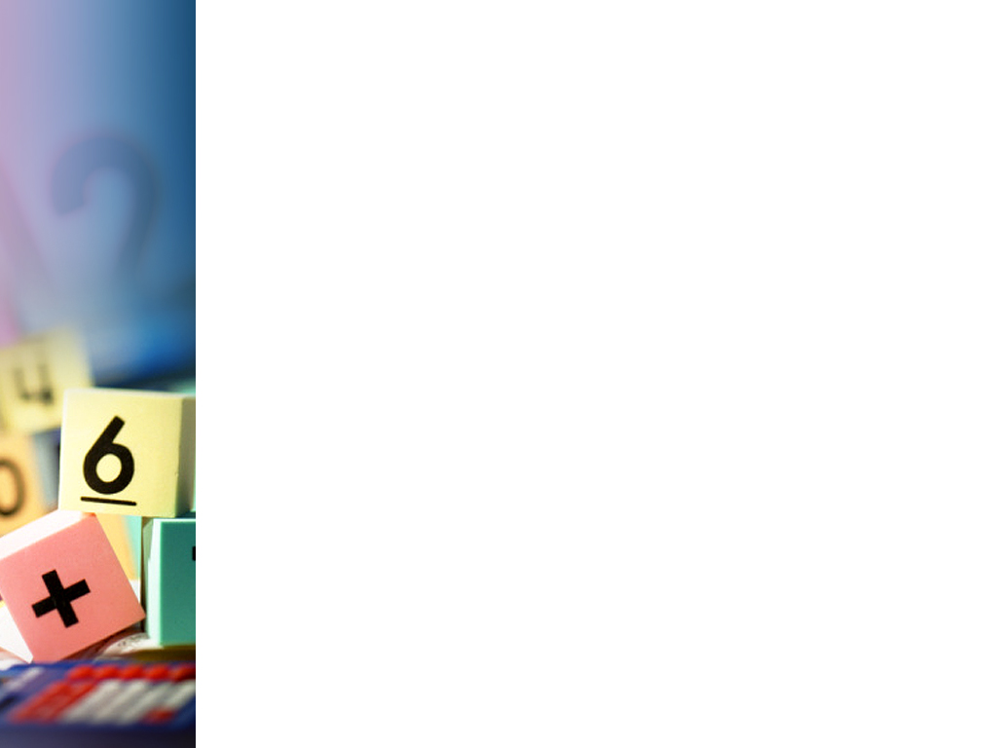
Math at Holly Park
At Holly Park we follow the CPA approach to Math teaching
Concrete – real life objects, practical resources
Pictorial – drawing pictures of practical resources, bar models
Abstract – number lines, equations with numbers and symbols
At every stage of calculation, we need to switch between the concrete, pictorial and abstract (CPA) as appropriate.

Slide 19
Math at Holly Park
By the end of KS2 (Year 6) in the NC children are expected to be using formal written methods (abstract).
At Holly Park we believe it is paramount that children have a sound understanding of the concepts, before being taught the formal methods, in order to avoid misconceptions forming.
Therefore “concrete” and “pictorial” are taught first.

Slide 20
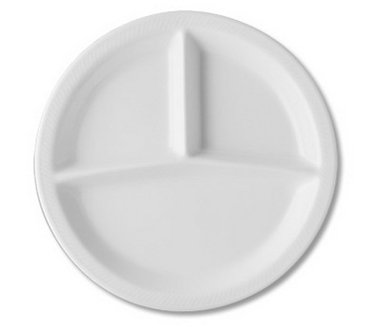


CPA - concrete
The first step when teaching any calculation strategy is always to demonstrate it using concrete apparatus (e.g. Dienes). This helps to ensure conceptual understanding, not just procedural recall.
20 + 13 =

Slide 21
CPA - pictorial
Once confident with the concrete, move to the pictorial - first by drawing the apparatus alongside manipulating it and then just drawing it to as a guide. 20 + 13 =
33
+

Slide 22
CPA - abstract
When the pictures are no longer needed, move to the abstract (the formal written procedures).
20 + 13 = 33
It is important that the movement between each step is flexible.
For example, when children encounter a complex problem or new situation that they are uncomfortable solving solely in the abstract, they should draw a representational picture or use concrete apparatus to guide them.
+10
+1
+1
+1
20
30
33

Slide 23
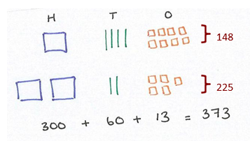
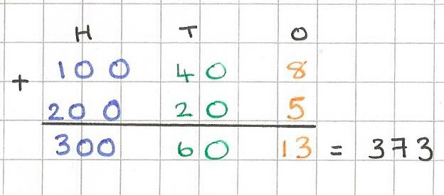
Expanded Addition by
Partitioning numbers
Partition (split up) each number according to their place value
e.g. 148 is made up of one hundred, four tens and eight ones.
Line up the hundreds, tens and ones of each number and find the total of each, starting with ones and working left.
Recombine to give the final sum.

Slide 24
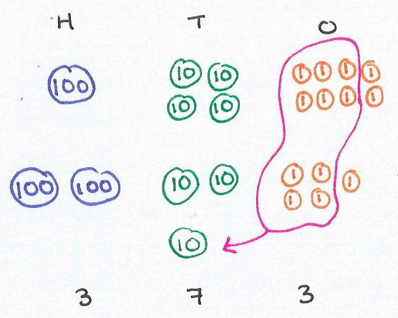
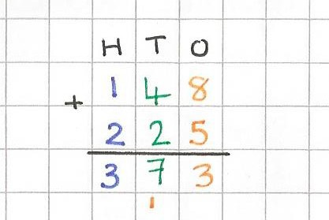
Compact Addition by
Partitioning numbers
Partition each number according to their place value and line up in columns.
We can ‘regroup’ the ones to make the numbers easier to work with. Bundle up ten (1) discs and exchange them for one (10) disc.
Now instead of 6 tens and 13 ones, we have 7 tens and 3 ones. The total value has not changed; we have just renamed it.
Add up how many hundreds, tens and ones there are altogether. Recombine to give the final sum.
148
225
Record the exchange underneath

Slide 25
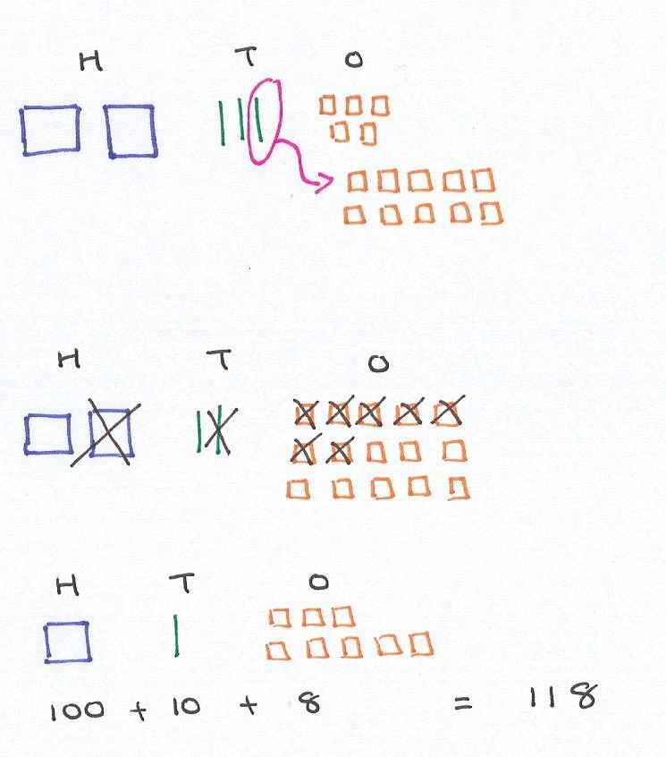
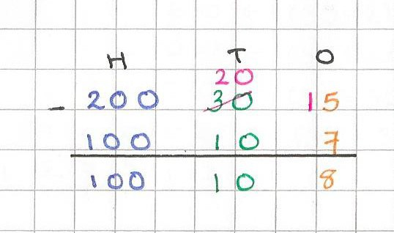
Expanded Subtraction by Partitioning numbers
Partition the first number according to its place value.
Start with the ones column and subtract (physically take away) the amount of ones in the second number.
Warning! We cannot physically take 7 ones away from 5 ones. So we need to regroup. Exchange 1 ten for 10 ones.
We now have 15 ones and can easily take away 7.
Then subtract the amount of tens from the new amount of tens in the first number.
Likewise for the hundreds.
The amount left is the difference.
235
subtract
117
Record the exchange like this

Slide 26
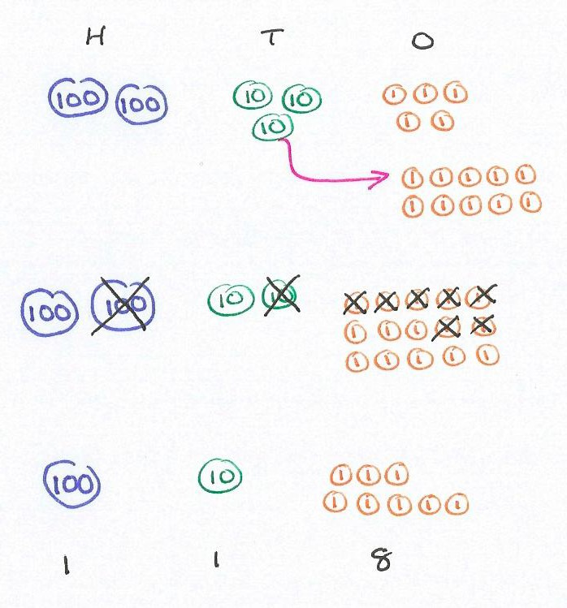
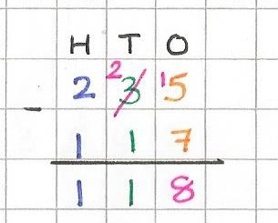
Compact Subtraction by Partitioning numbers
Partition the first number according to its place value.
Start with the ones column and subtract (physically take away) the amount of ones in the second number.
Warning! We cannot physically take 7 ones away from 5 ones. So we need to regroup. Exchange one (10) disc for ten (1) discs. We now have 15 ones and can easily take away 7.
Note that the total value of the first number does not change.
It is always 235; we just change how it is partitioned (3 tens and 5 ones or 2 tens and 15 ones).
Then subtract the amount of tens from the new amount of tens’
Likewise for the hundreds.
The amount left is the difference.
235
subtract
117
Record the exchange like this

Slide 27
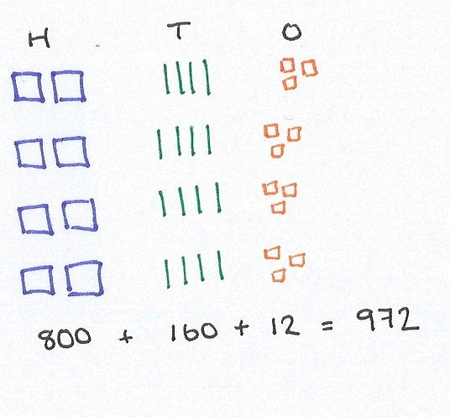

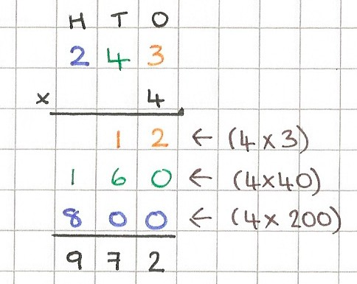
Expanded Multiplication by Partitioning numbers
243 x 4 =
Partition (split up) the number according to its place value e.g. 243 is made up of two hundreds, four tens and three ones.
We want this 4 times – we are multiplying the ones by 4, the tens by 4 and the hundreds by 4.
Line up the hundreds, tens and ones and find the total of each.
Recombine to give the final product.
243

Slide 28



How much do you honestly enjoy mathematics?

Slide 29
Research suggests that as many as
60% of adults would rather clean the toilet than work out a maths problem.
An even larger percentage say:
I was never any good at maths.

Slide 30
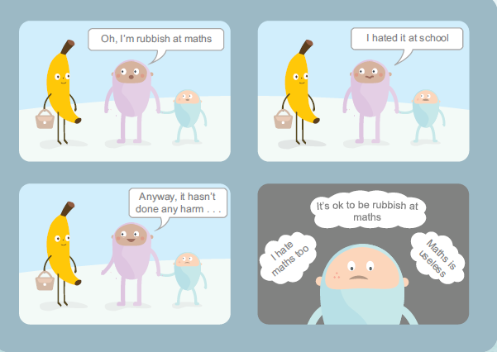
Attitude to Maths
Many parents find the prospect of helping their children with maths quite daunting - even
if they are pretty good at maths. With a little confidence parents can make a big difference.

Slide 31
What you can do…..
Number and Place Value
It is still important to count in multiples of 3, 4, 50 and 100 from Year 3 to ensure children do not forget (and it does happen).
A way to challenge a child who is secure with counting in these multiples is to challenge him/her to count on and back in 4s from a different number, such as 54. This will establish whether the child can calculate mentally by adding on 4 each time and also if he notices the repetitive pattern that starts to emerge – 54, 58, 62, 66, 70, 74, 78, 62.

Slide 32
Number and Place Value
Numbers should be seen and represented in numerous ways to allow children to build visual images in their brain and to build understanding, which they can recall at a later date.
When discussing values of digits we often ask children questions, such as:
What does the 5 represent in 8357? Response: 50
How many tens are in 8357? Response: 5
For children who are secure in recognising the position of Th H T U (thousands, hundreds, tens and units) and its relative value, we could challenge this last statement by saying actually there are 835 whole lots of tens in 8357

Slide 33
Number and Place Value
To support recognising values of digits, ordering and comparing you could look at and order and compare
Town populations
Animal weights
Endangered species lists
Lengths of rivers
Heights of mountains
Prices
Footballers – games played, goals scored, tackles and other football statistics
Whatever a child is interested in there are statistics!

Slide 34
Negative Numbers
Put a thermometer on a window and challenge your child to keep a weather chart.
Watch the weather forecast and discuss what minus 2 means outside
Discuss and ask questions
The temperature on Monday morning is -5˚C. The temperature on Friday morning is 1˚C. How much warmer is it on Friday morning than on Monday morning?

Slide 35
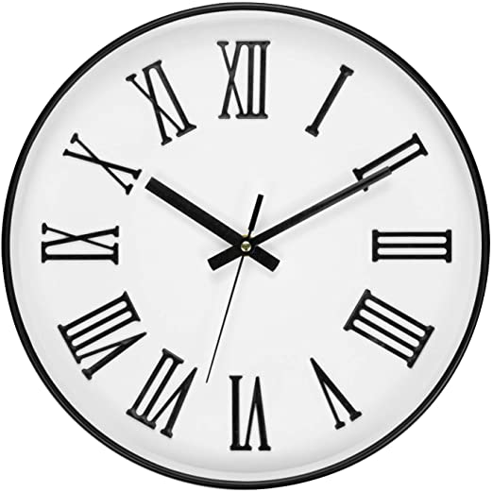
Roman Numerals
Children often meet Roman Numerals for the first time on watches and on clock faces. Roman Numerals are also met when studying history in class. Teaching children that numbers have been represented in different ways during different periods of history teaches children the richness and diversity of mathematics.
Symbol | Value
I | 1
V | 5
X | 10
L | 50
C | 100
To create the values the symbols are combined. However there are some ones to watch out for 3 = III 4 = IV 5 = V 6=VI
For four the I is placed before the V to show 5-1=4. For six it is placed after V and is represented as VI to show 5+1=6.
This logic can be applied to large values, such as
fifty four which is LIV, 50 +(5-1) = 54.

Slide 36
What you can do…..
Your child will be dealing with decimals, fractions, and money.
So
Include them in decisions around household finances - “which one is best value?”, “how much is the window cleaner per year?”
Play Monopoly involves handling money in hundreds
Ask them to read the dietary information on various foods and ask “how many grams of fat in 100 grams of . . . ”?
Give them responsibility for their own money. Open a bank account for them allowing them to track their savings.
Get them involved in any DIY projects you’re doing you can secretly check their measurements!

Slide 37
Year 4 - Multiplication
In England children will be expected to know
Year 1: count in multiples of 2, 5 and 10.
Year 2: be able to remember and use multiplication and division facts for the 2, 5 and 10 multiplication tables, including recognising odd and even numbers.
Year 3: be able to remember and use multiplication and division facts for the 3, 4 and 8 multiplication tables, including recognising odd and even numbers.
Year 4: be able to remember and use multiplication and division facts for the multiplication tables up to 12 x 12.
The new Year 4 Multiplication tables check will take place in June 2021. Your child will need to take a short online test to make sure their times tables knowledge is at the expected level.
There will be no “pass mark” and no child will “fail” the test. The DfE says the purpose of the check is to help teachers identify which children are falling behind. School-level results won’t be made publicly available or be used in league tables.

Slide 38
Multiplication
When children know their times tables, mental arithmetic becomes easier.
Practising times tables also helps children to understand number and number relationships, and to see patterns in numbers.
These skills will help them to master key concepts and move quickly through more complex maths problems with confidence.
There is less cognitive overload and children can focus on the concepts they are learning.

Slide 39
Understanding not memorization
Students learn math best when they approach the subject as something they enjoy. Speed pressure, timed testing and blind memorization pose high hurdles in the pursuit of math.
Jo Boaler, professor of mathematics education
Stanford Graduate School of Education
While research shows that knowledge of math facts is important,
Boaler said the best way for students to know math facts is by using them regularly and developing understanding of numerical relations. Memorization, speed and test pressure can be damaging.

Slide 40
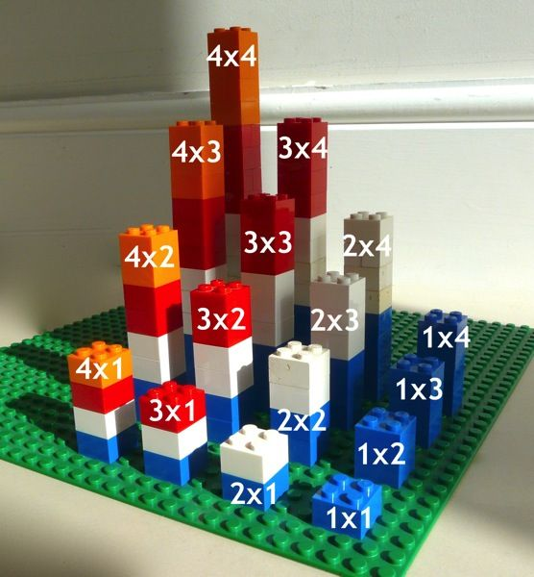
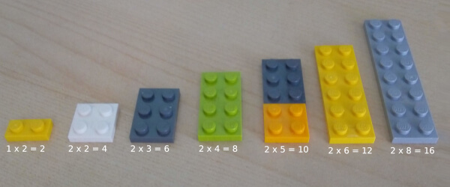
What you can do…
Using Lego to build up the tables and develop children’s understanding of what it means.
Discuss what the next lot would be and compare to identify the relationship between 2, 4 and 8 times tables and 3, 6 and 9 times tables.

Slide 41
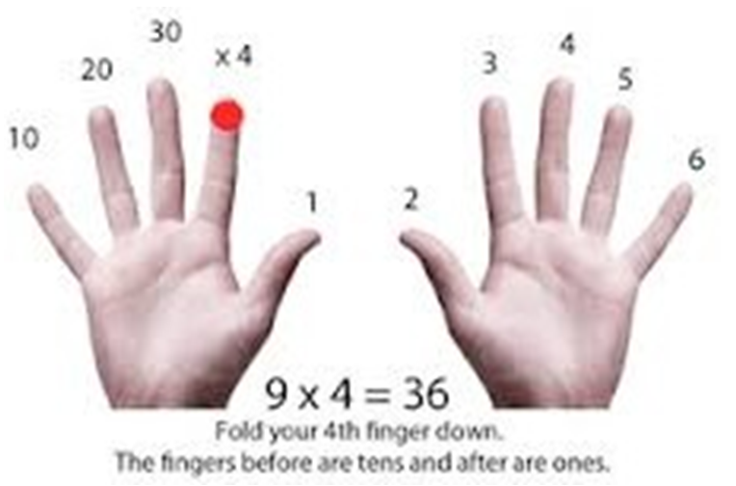
What you can do…
Use the context of a week and a calendar to support the 7 times table e.g. how many days in 5 weeks?
The 2 times table and doubling
Multiplying by 2 is so useful, and is used so often, that it’s got its own name − doubling. Think of how often you need two lots of something.
Children learn that multiplying by 2 is doubling. 4 × 2 = 8 Double 4 = 8
Use of finger strategy for 9 times table.

