Slide 1
Exploring identity online
Assembly for ages 7-11
Notes:
Freepik- doodles
Freepik - Images of children

Slide 2
What makes me… me?
In the next 30 seconds, see if you can find out 3 new things about someone in your house. It could be a hobby they enjoy, an interest, something they are really good at or even somewhere special they have been or something they have done.
Notes:
Noun project, Shuttertock - images

Slide 3
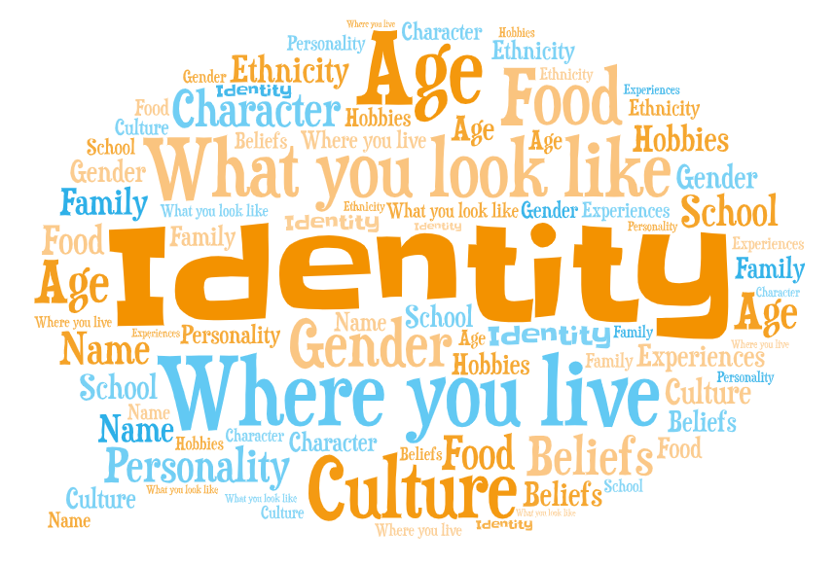
Our identity is made of so many different things, it could be:
• Personal information, e.g. your name, what you look like, age, school, where you live, your family.
• Personality and feelings, e.g. if you are loud, quiet, fun, shy, kind, caring, honest.
• Interests, hobbies and experiences, e.g. scootering, gaming, gardening, football, swimming, places you have been.
Notes:
https://emojipedia.org – Emoji head

Slide 4
Have you ever…

Slide 5
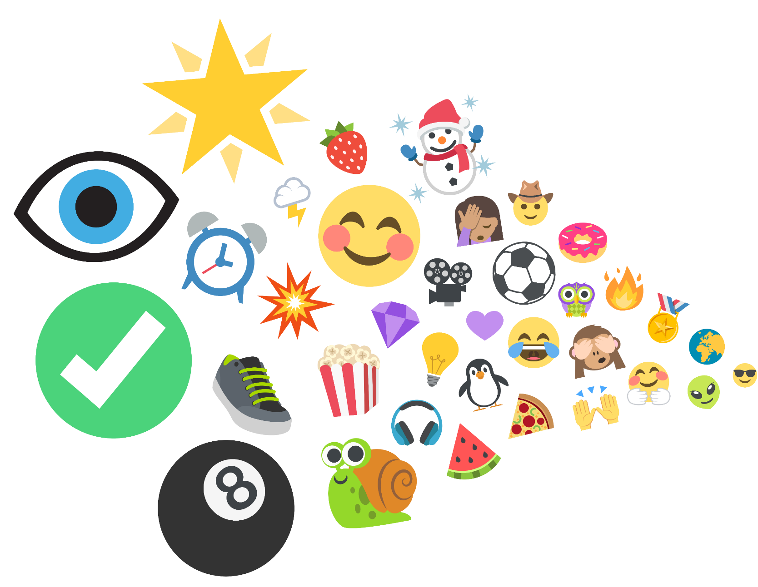
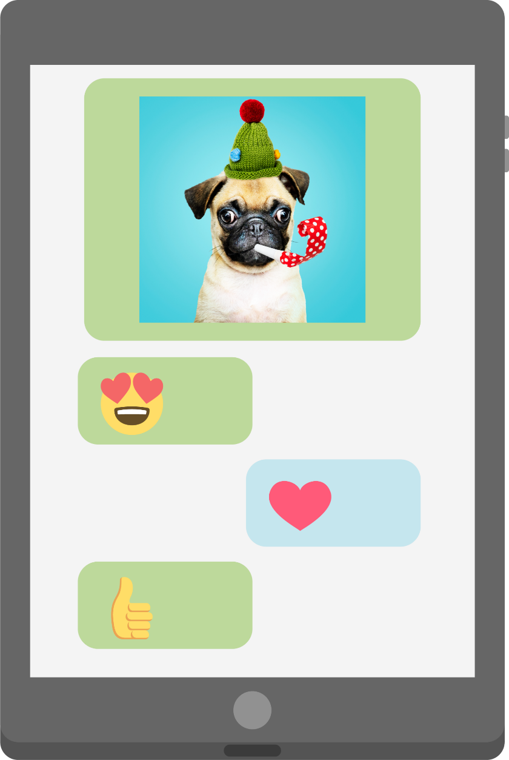
…seen or used an emoji?
Notes:
Shutterestock – tablet
Freepik – dog photo
Emojis from-
https://www.joypixels.com/emoji#all

Slide 6
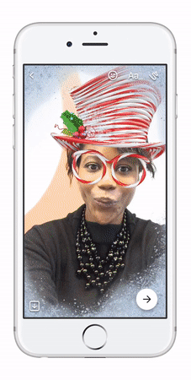
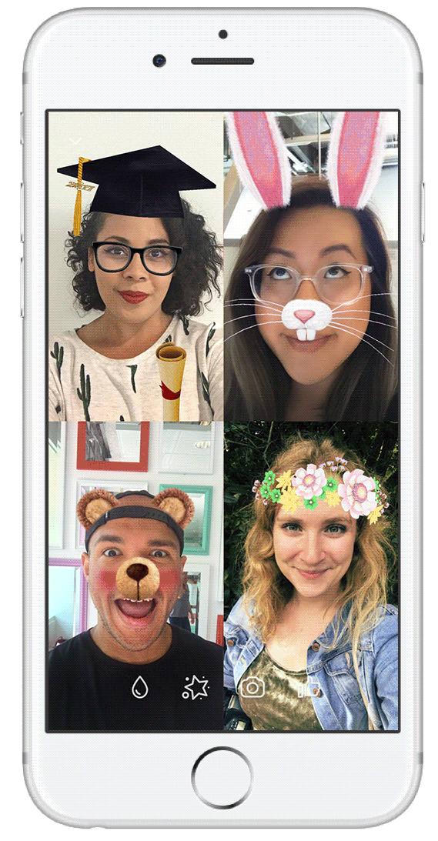
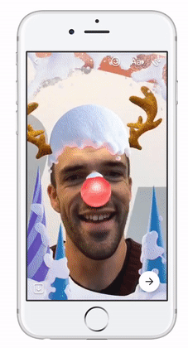
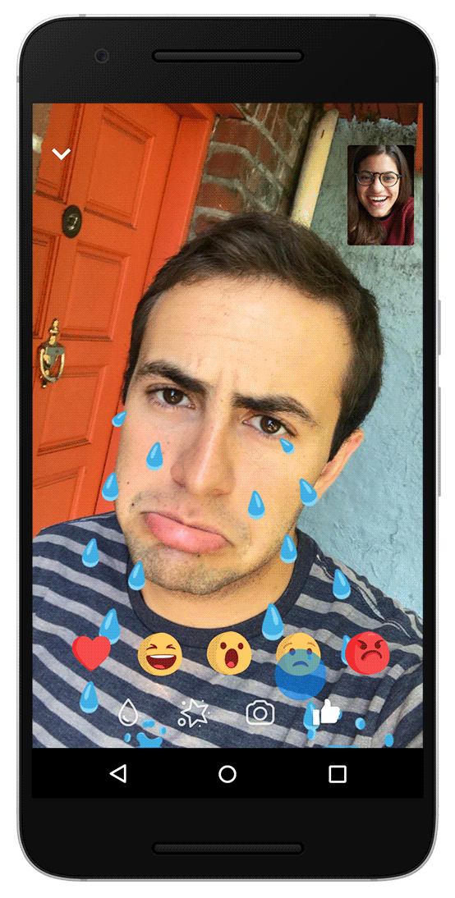
…used a filter online?
Notes:
© Facebook

Slide 7
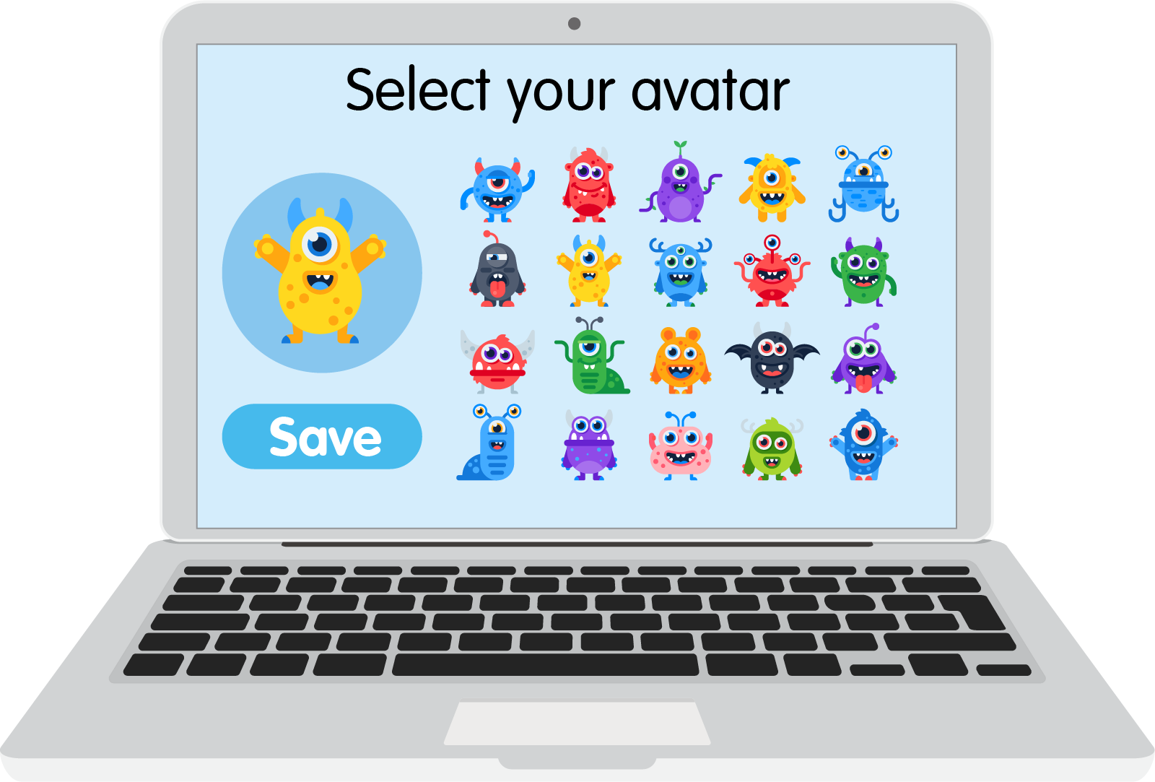
… created or chosen an avatar or character?

Slide 8
Username | Online
Gamer_girl467 | Yes
Jo.pizzaboss.73- | Yes
sleepy_meerkat | No
_Flying.fox.55 | Yes
mega.Millie | No
Invisible_penguin23 | No
xX-PLY2WIN-Xx | No
lucky-dimond.01 | No
…chosen a username?

Slide 9
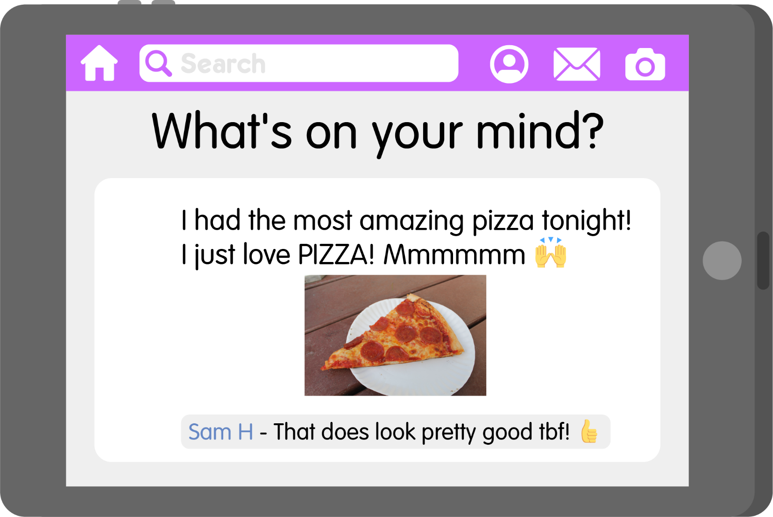
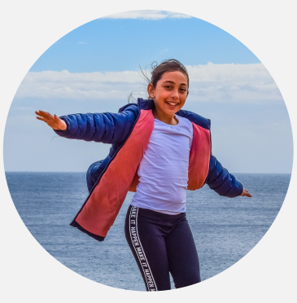
… shared something online about yourself or the things you like to do?

Slide 10
All of these examples are ways we are able to change or choose our identity online. When you create a character for example, you might choose to give it the same glasses you have, or the same hair colour, but it doesn’t tell other people everything about you and who you are. It’s not just you who has an online identity, lots of people across the world do too.

Slide 11
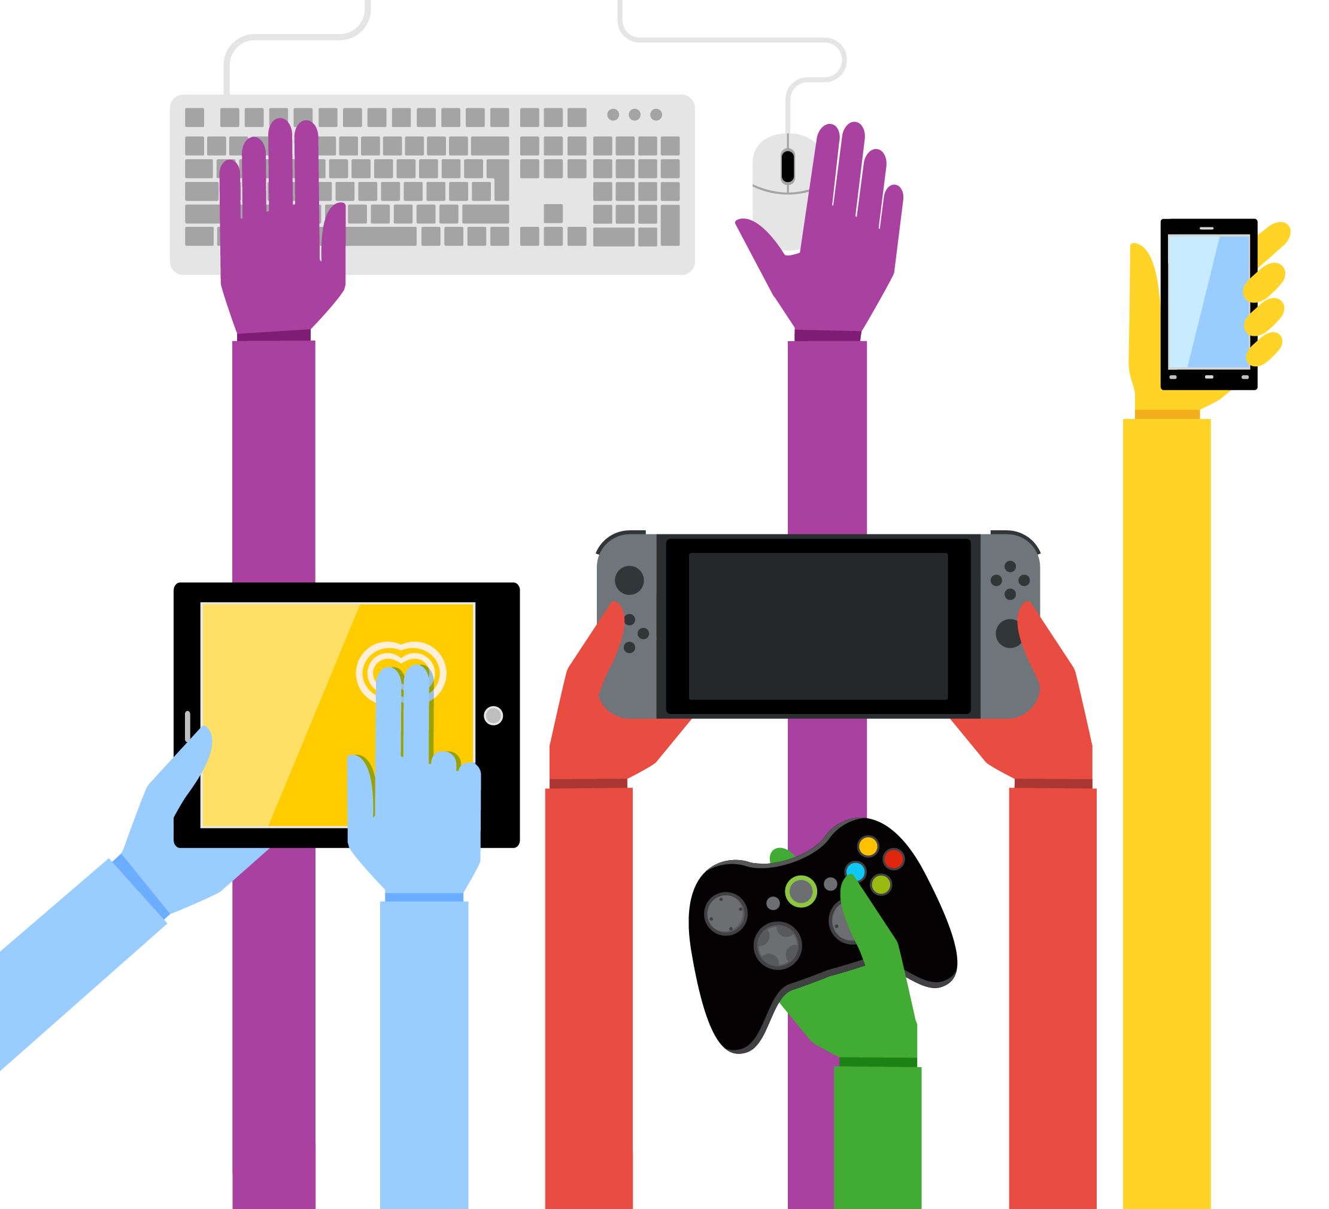
People all over the world use the internet.
So there are lots of different identities online.
58% of people go online!

Slide 12
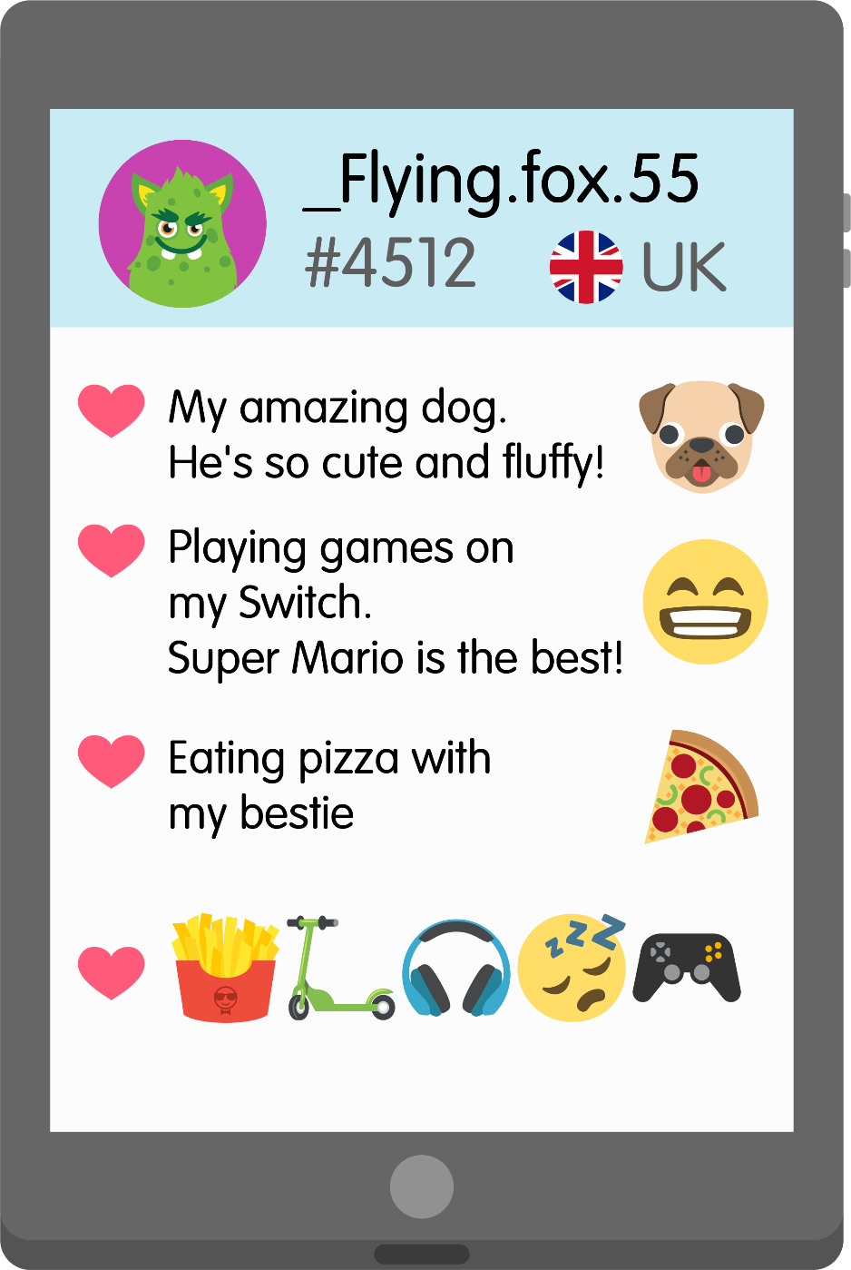
Online identity detectives
Time yourself with a 30 second timer what can you find out about this person by looking at this screen.

Slide 13
Online identity detectives
We can learn a lot about their online identity, like their hobbies and their favourite things, and some of these things make up their offline identity too.
However, they haven’t shared everything about their offline identity and they haven’t shared any personal information such as their full name, their school or their home address.
We don’t know how old they are or when their birthday is. They have used their online identity really safely.

Slide 14
There are lots of positive things about changing our identity online:
You can express yourself.
It can help keep you safe.
You can be creative.
It can be really fun!
Can anyone think of how this might also be a problem for our safety?

Slide 15
Can anyone think of how this might also be a problem for our safety?
We need to remember that if we see someone online, we see their online identity, but that might not tell us everything about them. Sometimes the things people post or say or do doesn’t reflect what they are really like offline. They might use usernames, photos, filters or avatars that are very different to their actual identity. This is why it is really important to remember that if we only know someone online, they are a stranger, and we should keep our identity and our personal information safe.

Slide 16
You can watch the videos on this page to learn more!
https://www.thinkuknow.co.uk/8_10/watch/

Slide 17
Always speak to an adult if…
Someone else online has worried or upset you.
You are ever unsure about something you’ve shared online about your identity.
Someone else online has asked you for your personal information or for photos or videos of you.

Slide 18
“I can do whatever I want online, and I can’t get into trouble because it’s my online identity talking not me.”

Slide 19
What have you learnt about online identities today?

