Slide 1
Home Learning Internet Safety!

Slide 2
Going Online
We are going online a lot at the moment due to do lots of learning at home. Here are some other reasons:
watching TV shows
playing games
watching online videos
talking to friends
finding out things
homelearning!
The Internet can be loads of fun!

Slide 3
But…
Who do you think owns the Internet?
Who do you think decides what can be put on to it?
Who makes sure the things on the Internet are truthful and real?
No one owns the Internet. No one decides what can be put on.
The Internet can be used by everyone and everyone can add things to it!
Trust means to be able to count on someone and know they are telling the truth. Do you think you can trust everything and everyone on the internet?

Slide 4
Would you…?
Talk to your partner about these two different situations. Tell them whether you would or wouldn’t do each thing and explain why.
If a stranger came up to you in the street, talked to you and asked you to go with them because they had something really good to show you, would you go?
If a stranger came up to you and told you they were giving away free televisions in a house up the road, would you believe them?

Slide 5
Would you…?
Here are some important things to remember when you are online:
Just like in the real world, the Internet has both nice and nasty people using it.
There might be people who want to help you and people who may want to trick you or be nasty to you. But you can’t see the people using the Internet and it is hard to tell who is nice and who isn’t!

Slide 6
Would you…?
Watch the video below with Timon and Pumba for more information!

Slide 7
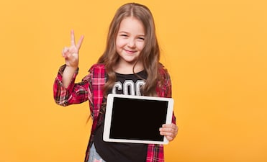
How to stay safe:
Try to only use websites you know can be trusted. If you aren’t sure – ask an adult!
Try to use websites that are for children as much as possible. When your teachers are setting home learning we will often give you websites to look at as we have tested them and checked that they are safe.
Remember - some people will pretend to be children to talk to you. Never give out your name or address! We don’t really know who we are talking to when we chat through the Internet.
Never arrange to meet an online friend without telling an adult!
Remember if you aren’t sure about anything, always ask a grown up.

Slide 8
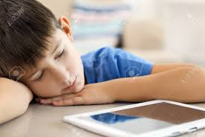
Cyberbullying
Bullying is when a person tries on purpose to hurt another person, either in what they say or what they do. It usually happens more than once.
Cyberbullying is the same but it happens online.
The cyberbullies may:
send nasty text messages or emails;
say unkind things about people on social
networking sites;
try to get others to say unkind and nasty things too;
send unkind photographs to lots of people.
Cyberbullying hurts people just the same as any other bullying.

Slide 9
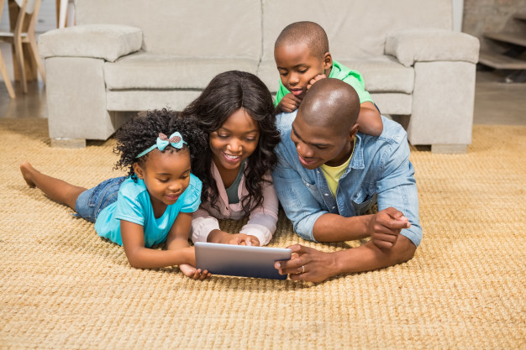
What If You’re Upset?
The most important thing to remember is if you see something that upsets you, tell an adult. It might be a grown up you live with or a teacher at school.
They can help you to report the thing you saw.
They can talk to you and make you feel OK and they can help you to find a website that is better.
They can help to stop the bullies hurting other people too.
No one has the right to hurt or upset anyone else – even online!

Slide 10
Activity:
Watch Jessie & Friends, Episode 2
• Find the Jessie & Friends cartoons at:
www.thinkuknow.co.uk/parents/jessie-and-friends-videos/
• Watch Episode 2: Sharing Pictures with your child.
• Then answer the questions on the next slide to chat about the cartoon

Slide 11
How did lots of people end up seeing the pictures?
What made Mo feel sad?
How did the friends get help when they needed it?
What did Miss Humphrey say she would do to help?
• Finish by watching the song again and having a sing-along!
Note: If your child wants to watch Episode 1 too, do watch it with them!
It’s aimed at younger children, but it’s still fun to watch.

Slide 12
Activity 2!
• Draw a picture of your favourite character singing the
funny tummy song.
• Ask them to include the lyrics from the song on their drawing.
•
Feel free to share what you have done with your class teacher!

Slide 13
Let's create an internet where we are.... Free to be ourselves Be proud of all the things that you enjoy, and keep on trying different things too. If there are new activities that you want to do online, ask an adult first to help you find them - to check they’re ok for you. Free to be kind Remember, the rules that you follow every day in real life also apply when you’re on the internet. It’s important to treat other people the way that you would like to be treated and always think about their feelings. Free to play It’s really important that your parents and carers know what you enjoy doing online, so that they can help you when you need it. Using the internet together as a family is really fun, and you’ll be the best teacher when it comes to showing everyone your favourite games! Free to be safe Some parts of your identity must stay private. This is your ‘personal information’ - which includes your name, date of birth, home address, school address, email address and passwords. Free to talk If anyone, or anything, online makes you feel worried, upset or uncomfortable, tell a trusted adult straight away. The sooner someone knows how you feel, the sooner you can be helped.

Slide 14
Message to Parents
• We have included lots of helpful documents that will give you ideas on how to keep your child safe not only during these strange times but also in the future when we return to some normality. It’s really important that you read them.
It’s also really important to have an open and understanding relationship with your child about using technology and to try and be approachable so that when an issue does arise your child feels comfortable talking to you about it.

Slide 15
The Childnet Film Competition!
You can now enter the 2020 Childnet Film Competition from home!
All you need to do is send us your 2 minute online safety film by Monday 22nd June. Just click on the category below that you wish to enter to find out more!
What is the Childnet Film competition?
The Childnet Film Competition is now in its 11th year and is open to all young people based in the UK. The challenge is to create a positive, short online safety film or a storyboard with a script in response to this year’s theme.
Visit the website for more information!:
https://www.childnet.com/resources/film-competition/2020

